Slide 1
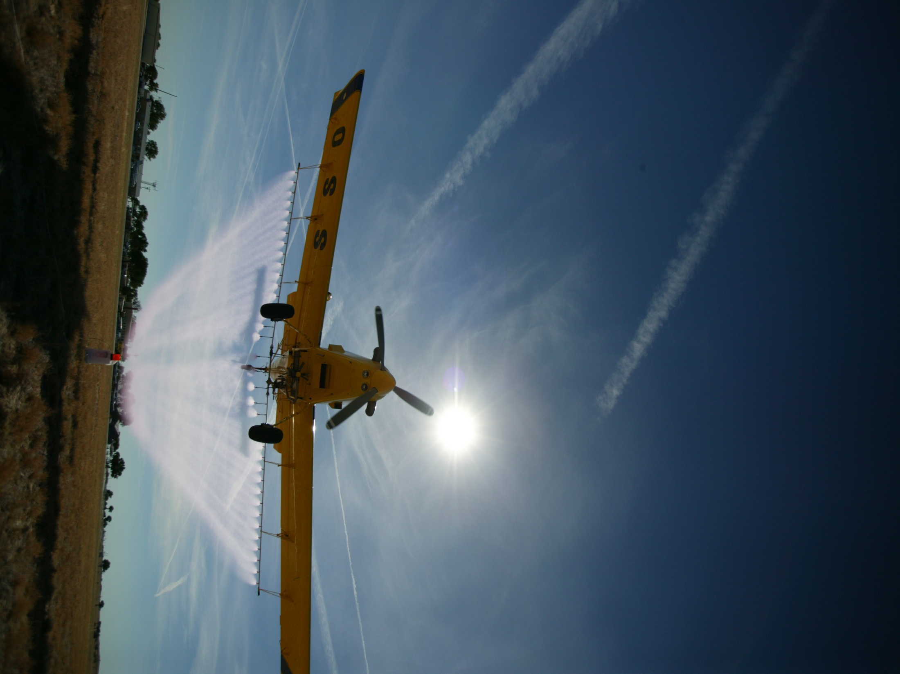

For more information contact:
rewolf@ksu.edu
www.bae.ksu.edu/faculty/wolf/

Slide 2


Application Technology Update
Robert E. Wolf
Extension Specialist Application Technology
Biological and Agricultural Engineering
Notes:
Use either title slide. Hide the one you do not want to use.

Slide 3
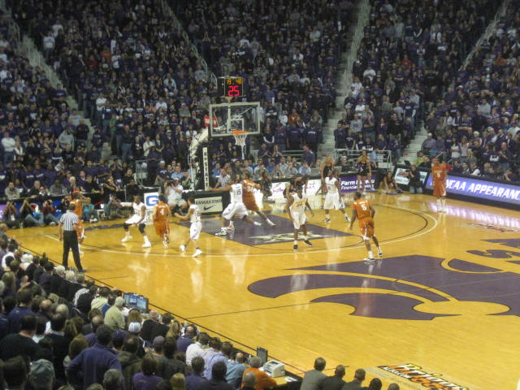
Every Man A Wildcat

Slide 4
What is your connection to spraying?
Farmer / Grower
Commercial Ground
Commercial Aerial
Consultant
Chemical Rep
State / Government
Extension / Research

Slide 5
What brand of sprayer do you use?
John Deere
Case/IH
Ag Chem
Spray Coupe
Miller
Red Ball
Other

Slide 6
What brand of sprayer do you use?
Bestway
Hardi
Wylie
Top Air
Schaben
Great Plains
Other

Slide 7
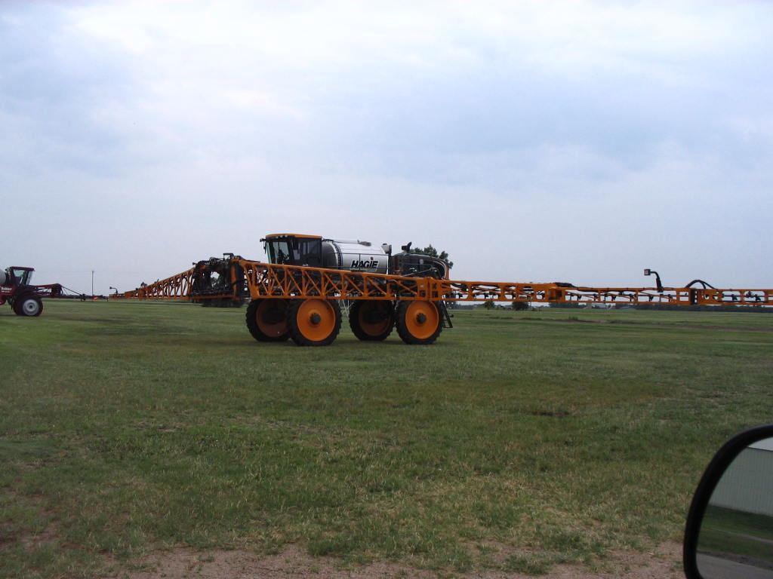
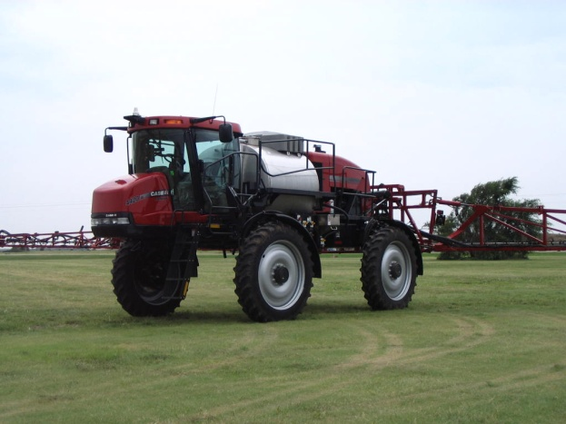
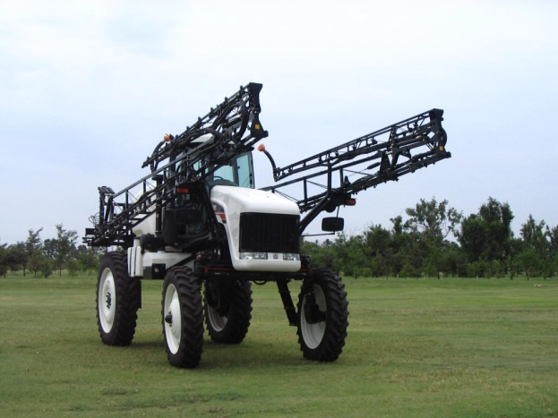
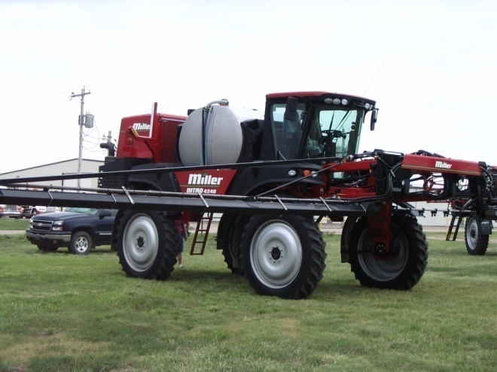
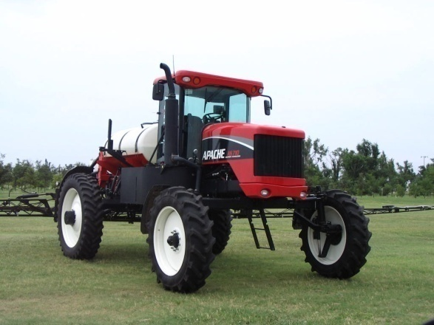
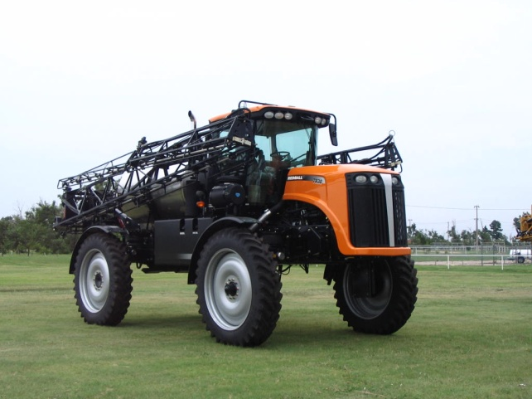
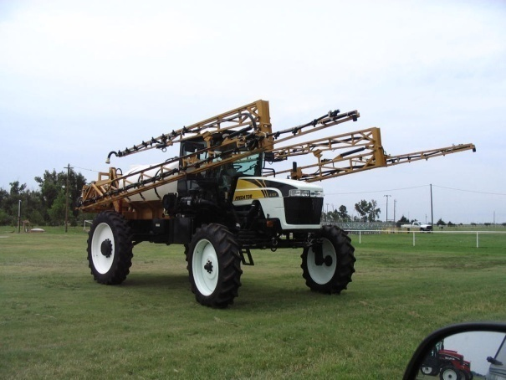
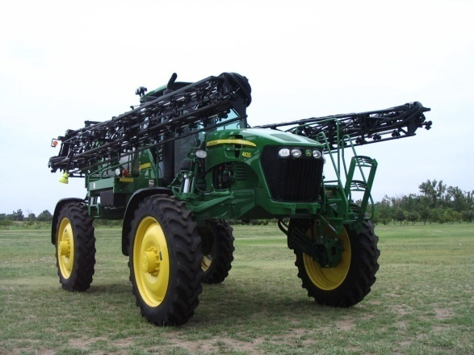
Options?

Slide 8


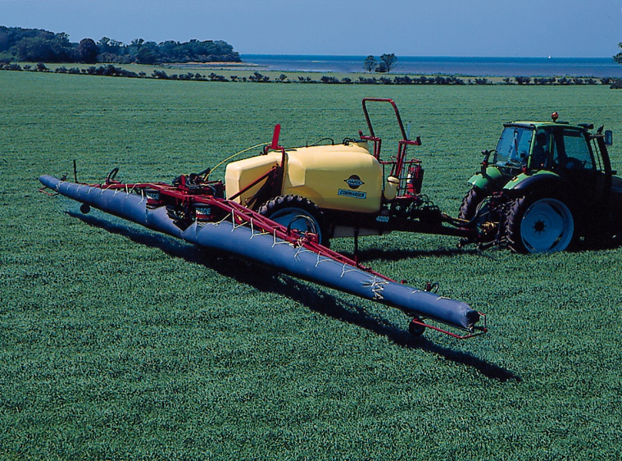
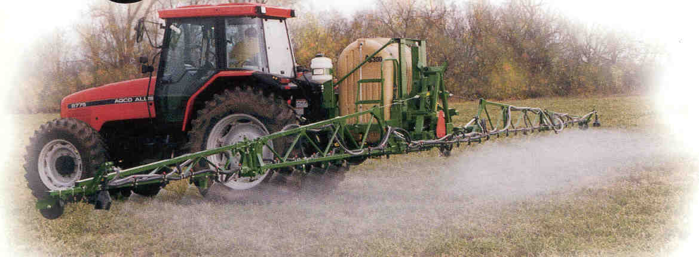
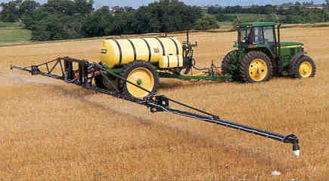
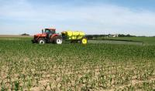
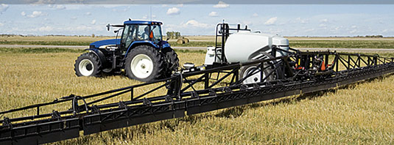
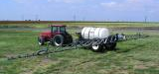
Options?

Slide 9
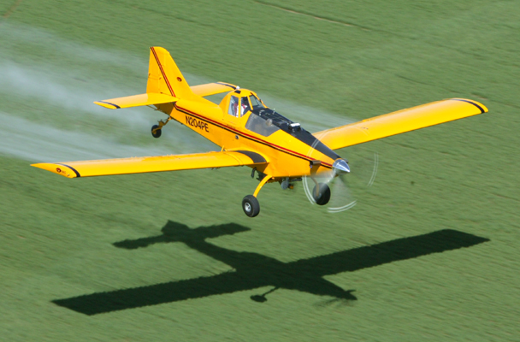
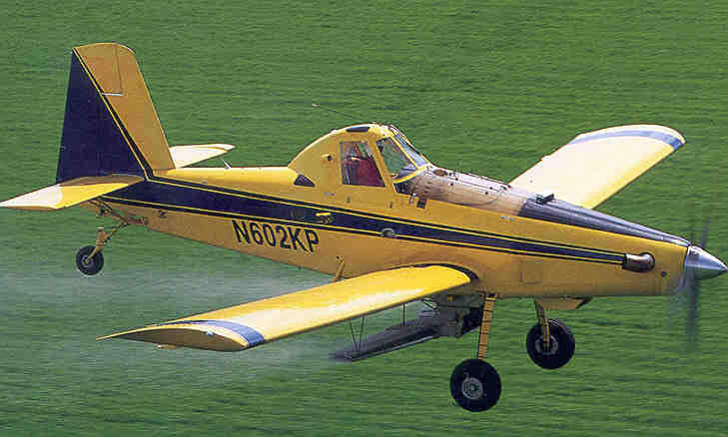
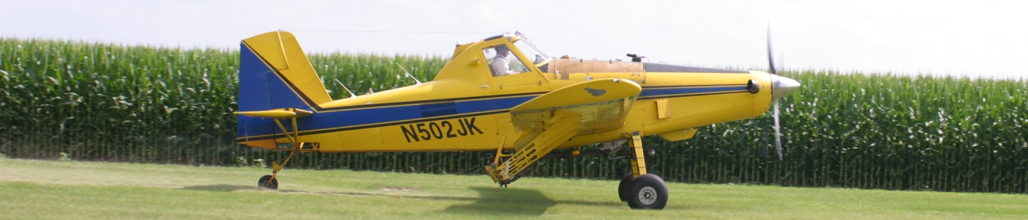
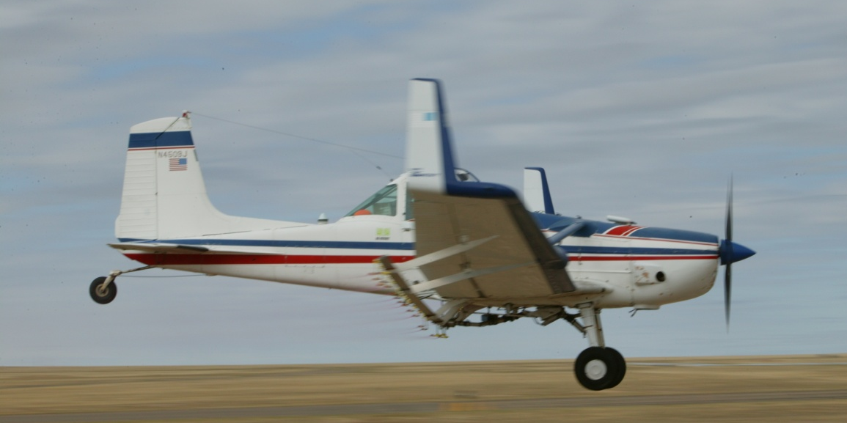


Slide 10
What is New???

Slide 11
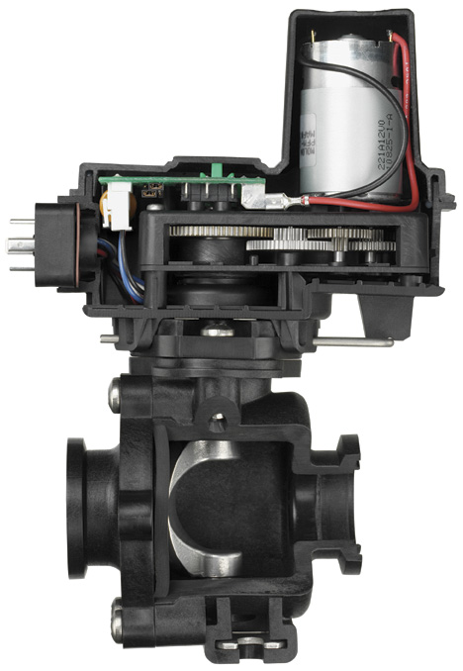
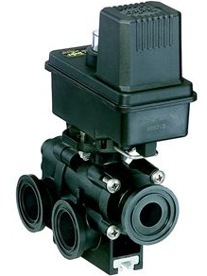
Flow Back Control:

Slide 12
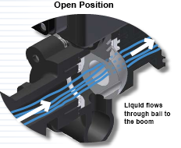
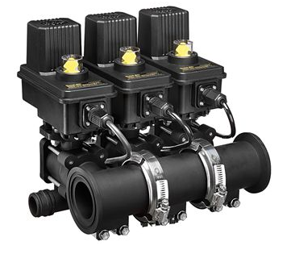
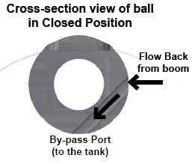
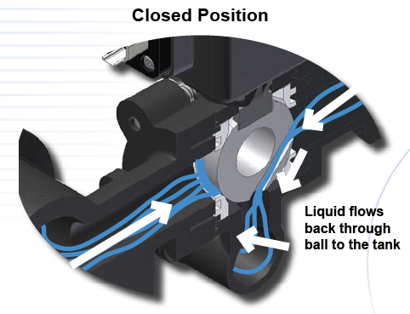
Flow Back Manifolds

Slide 13
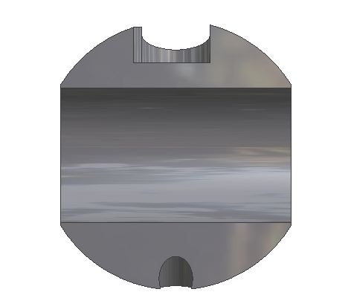
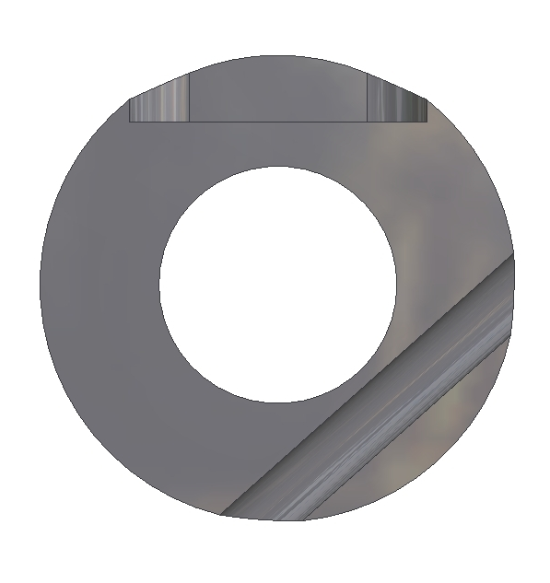
Flow Back Function
Spray Position
Off Position
TO
BOOM
INLET
INLET
FROM BOOM
BY-PASS PORT
BY-PASS PORT
0.6 second shutoff with a 32 gpm flow rate
Notes:
This illustrates the 450FB ball. 460FB has similar function.
Normal flow in spray position
In off position the second hole is exposed to boom pressure.
Pressure trapped after boom valves shut off is relieved.
DCVs shut off fast instead of waiting for pressure decay or “bleed down”

Slide 14
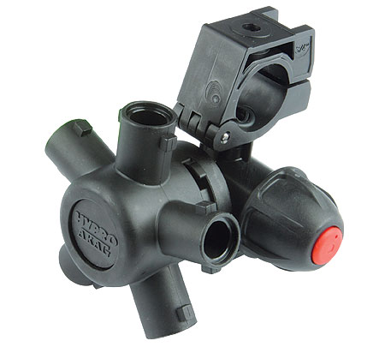
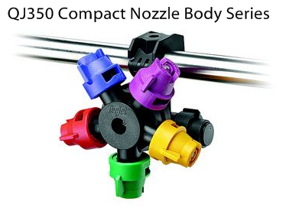
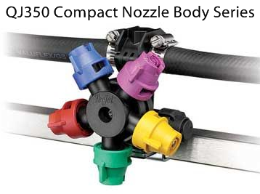
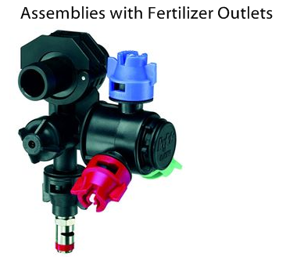
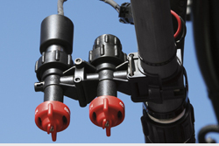
Wilger Combo-Rate®

Slide 15
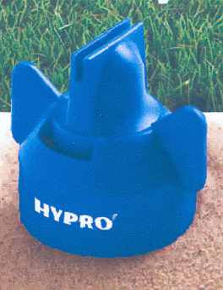
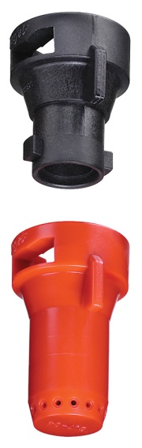
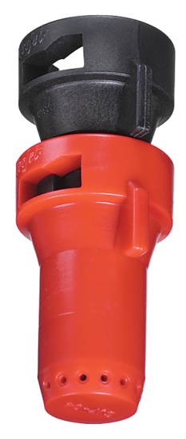
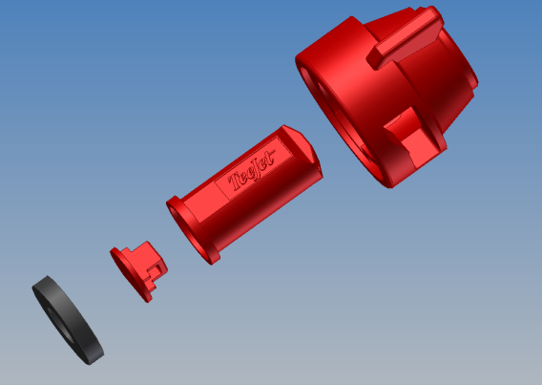
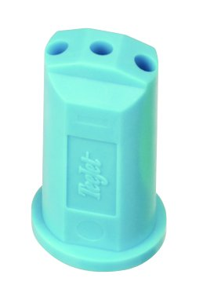
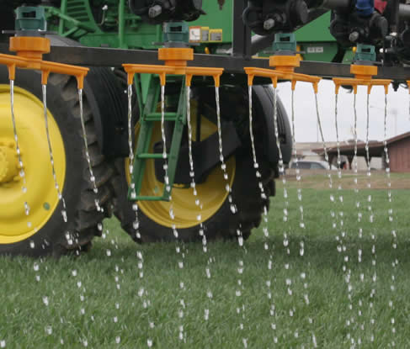
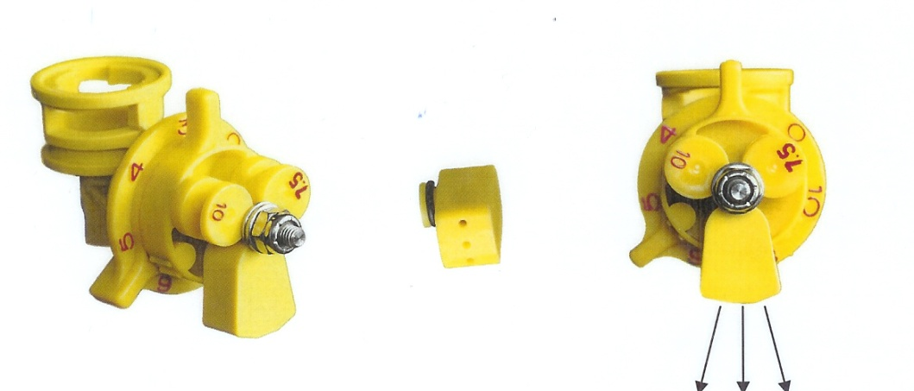

Nozzles for fertilizer on wheat:
Hi-Flow
StreamJet-7
StreamJet-3
CP Triple Stream Tip

Slide 16
What technology do you have on your sprayer?
Electronic Rate Controller
Lightbar Swath Marking
Autosteer
Auto Swath Control
Auto Boom Height Control
All of the above

Slide 17
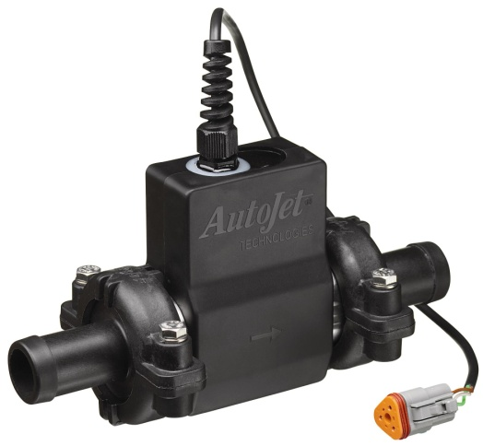
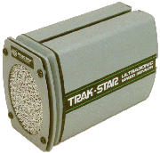
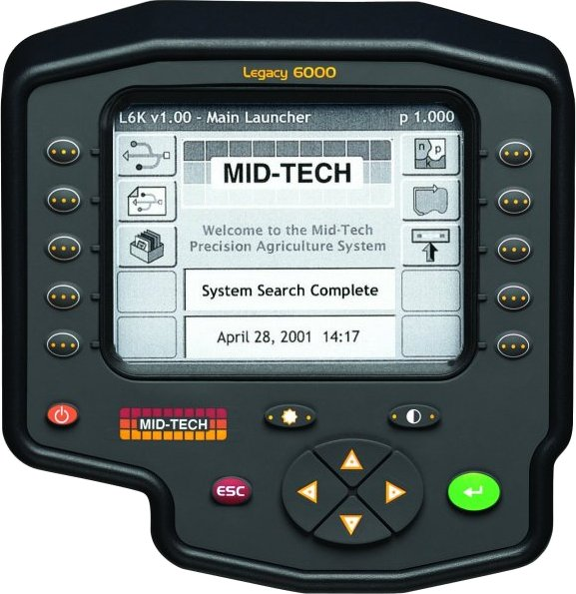
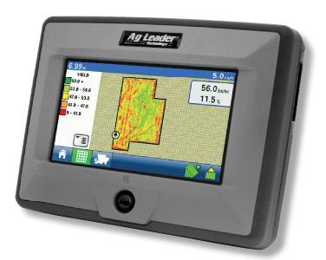
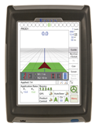
Rate Controllers:

Slide 18


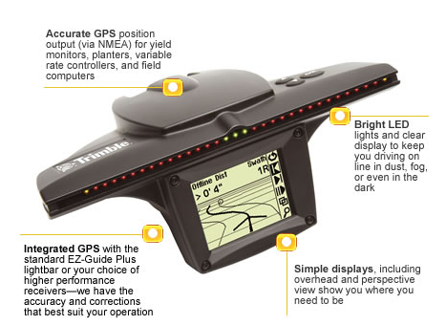
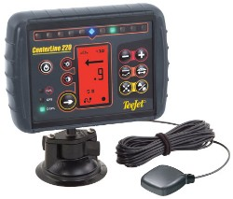
Parallel Swathing – light bars:
Notes:
Swath marking in becoming a widely used practice today. GPS is used to position the spray vehicles in the field. The straight-line A-B tracking line will guide the sprayer back and forth through the field in parallel swaths to match the programmed boom width. Light bars aide the driver in the guidance process. The photo in the lower left illustrates the system being used in the aerial application industry. The red lines are when the sprayer is working and the yellow lines show the turning paths. As this presentation was being developed advancements in using the parallel tracking devices to follow curves and work in circles are being perfected.

Slide 19

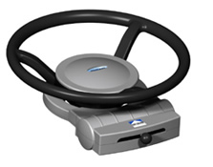
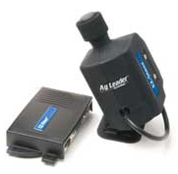
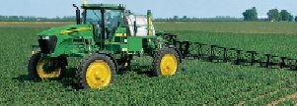







Auto Steering:

Slide 20




Automatic Boom Section Control

Slide 21

Swath Control Pro
John Deere - Animation

Slide 22




Slide 23








Automatic Boom Height Control
UC5
JD GS2 Panel

Slide 24





Load Command Spray Coupler
Auto Quick fill system
  3 minutes for 1200 gallons

Slide 25




Slide 26

August 10, 2010
Airport & Expo Grounds
Great Bend, KS

Slide 27

Accurate and efficient applications:
Increase Efficacy – Minimize Drift
Notes:
Many technological changes have occurred in the spray industry in recent years. Much attention has been given to application equipment to increase efficiency and minimize spray drift. This presentation is designed for you to share some of these application technologies in ground application with your applicator audiences. Equipment design changes have occurred in all forms of ground application. Much of the improvements has been directed at the reduction of spray drift.

Slide 28


Slide 29


Slide 30



Slide 31











Nozzle Technology……
Nozzles designed to reduce drift
Improved drop size control
Emphasis on ‘Spray Quality’
Notes:
Beginning with the ‘extended range’ flat fan nozzle (all major manufactures have one), continuing with the design of ‘preorifice inserts’ and ‘turbulation chambers’, and now with the ‘venturi’ style nozzle design, nozzle manufacturer's have worked to develop nozzles that are improving the quality of spray emitted.

Slide 32

Spray Characteristics are Important
Demonstrates Turbo Flat vs TurboDrop-5 MPH Wind

Slide 33
What is your typical application?
Herbicide
Fungicide
Insecticide
Fertilizer
Other

Slide 34
What nozzle do you use?
Flat-fan
Turbo flat-fan
Air Induction
Hollow cone
Turbo TwinJet
Don’t know!

Slide 35

Is this tip good or bad?

Slide 36

Nozzles Types?
air induced
Flat Spray Patterns
flat-fan
chamber
Notes:
Beginning with the ‘extended range’ flat fan nozzle (all major manufactures have one), continuing with the design of ‘preorifice inserts’ and ‘turbulation chambers’, and now with the ‘venturi’ style nozzle design, nozzle manufacturer's have worked to develop nozzles that are improving the quality of spray emitted.

Slide 37


Extended Range Flat-fan:
See Page 12-13, TeeJet Catalog 50A
Tapered edge pattern
80 and 110 degree fan
Requires overlap - 50 to 60%
15-60 psi range
80°
110°

Slide 38
Extended Range Flat-fan:

Slide 39

Nozzles Types?
Notes:
Beginning with the ‘extended range’ flat fan nozzle (all major manufactures have one), continuing with the design of ‘preorifice inserts’ and ‘turbulation chambers’, and now with the ‘venturi’ style nozzle design, nozzle manufacturer's have worked to develop nozzles that are improving the quality of spray emitted.

Slide 40


Turbo Flat-fan:
See Page 9, TeeJet Catalog 50A
Pre-orifice
Turbulence chamber as in the Turbo Flood
Tapered edge, wide angle flat pattern
Designed to work in flat-fan nozzle holder
Uniform spray distribution, 50-60% overlap
Wide pressure range, 15 – 90 psi
Large, drift resistant droplets
Plastic with superior wear characteristics
Exit orifice
Notes:
18

Slide 41

Turbo Flat-fan:
See Page 9, TeeJet Catalog 50A
Turbulence chamber as in the Turbo Flood
Tapered edge, wide angle flat pattern
Designed to work in flat-fan nozzle holder
Uniform spray distribution, 50-60% overlap
Wide pressure range, 15 – 90 psi
Large, drift resistant droplets
Plastic with superior wear characteristics
TT
XR
Notes:
18

Slide 42


New release in 2006:
See Page 10, TeeJet Catalog 50A
Dual outlet
Superior leaf coverage
Droplet range slightly larger that comparable TT flat-fan
Turbo TwinJet

Slide 43

Nozzles Types?
Notes:
Beginning with the ‘extended range’ flat fan nozzle (all major manufactures have one), continuing with the design of ‘preorifice inserts’ and ‘turbulation chambers’, and now with the ‘venturi’ style nozzle design, nozzle manufacturer's have worked to develop nozzles that are improving the quality of spray emitted.

Slide 44





Pre-orifice Air Induction Nozzles:
See Page 15-16, TeeJet Catalog 50A
Pre-orifice
Air induction
Mixing Chamber
Exit orifice

Slide 45

XR Flat-fan and Turbo Flat-fan compared to Venturi Style at 5.0 MPH wind and 40 psi
XR vs TurboDrop
Turbo Flat vs Turbo Drop
Notes:
This slide is an example of how visible the difference can be between the venturi nozzle on the right in both videos when compared to the XR in the left video and the turbulation chamber nozzle in the right video. All nozzles are operating at 40 psi in a simulated 5 MPH wind.

Slide 46

Air Induction Nozzle for Maximum Drift Control:
See Page 11, TeeJet Catalog 50A
More compact
Larger drops
Operates at lower pressures
Percentage of fines do not increase with pressure
Turbo Injection - TTI
TeeJet Handout
AITTJ60
Turbo TwinJet Induction

Slide 47


Slide 48

New release in 2007:
See Page 14, TeeJet Catalog 50A
XR outlet with venturi air aspirator design
More compact than AI style
2-piece with removable pre-orifice
AIR INDUCTION XR TeeJet

Slide 49



GuardianAir Induction:
More consistent droplet
All-in-one cap and screen
Wide angle with 15 degree incline toward the rear
Aim forward or rearword – alternate?
See Page 126-7, Hypro Spray Product Guide
GuardianAir

Slide 50
New Nozzles
AITTJ60
Turbo TwinJet Induction
Turbo TwinJet – TTJ60
AI XR TeeJet
GuardianAir - Hypro

Slide 51






New Nozzles
Air Mix & TDHSTF- Greenleaf
Leckler

Slide 52





Asymmetric

Slide 54




Materials and Methods
28 PSI
70 PSI
*
Twin-fan IDK-T
Turbo Flat-fan (TT)
AIXR Flat-fan
Air Mix (AM)
Guardian (GA)
Turbo Twin Flat-fan (TTJ60)
AIC Flat-fan
TDHSTF
Ultra Lo Drift (ULD)
*
*
40 PSI
*
*

Slide 57
Nozzle Efficacy/Drift Slope
1980
30 years
Reducing Spray Drift
Extended Range
Nozzle development timeline
XR, TR
Turbo Flood
Turbo TeeJet
Air Mix
AI XR
GuardianAir
AI
Ultra Low Drift
Turbo Drop
TTI
Chamber Design
Venturi Design - II
Venturi Design - I
Efficacy
2009

Slide 58

Nozzles-Recommended Use
flat spray
20-25 PSI
chamber
30-40 PSI
IN BETWEEN VENTURI
40 PSI
air induced/venturi
50-80 PSI
Notes:
Beginning with the ‘extended range’ flat fan nozzle (all major manufactures have one), continuing with the design of ‘preorifice inserts’ and ‘turbulation chambers’, and now with the ‘venturi’ style nozzle design, nozzle manufacturer's have worked to develop nozzles that are improving the quality of spray emitted.

Slide 59


Slide 60


Slide 61



Variable Rate/Mapped Applications
Predeveloped variable rate maps
Dependent on target variables
  weed pressures, species, size
Flow and droplet control issues

Slide 62

Variable Rate Liquid:
Direct Injection
  Complex
  Time lag
Fixed orifice nozzles
  Flow proportional to square root of pressure
  Difficult to achieve range in flow rates
Pulse Width Modulation
Variable orifice nozzles
  Pressure/Flow relationship is more complex

Slide 63



VariTarget:
Speed variations from 2-20 MPH
Application rates of 5-40 GPA
Spring tension
Variable area pre orifice
Variable area spray orifice
Optimize spray droplet size
Maintain efficacy and minimize drift
VeryFine
Fine
Medium
Coarse
Very Coarse
Notes:
This nozzle has been built for the task. Developed at the U of TN, sold to Delevan (Patent Squabble rumored), AgCo selling it. They are pushing on new sprayers. Most buyers have no idea about it. It has also been marketed in aerial applications and some problems are reported. The varialble orifices (flexible rubber parts) may not hold up to acres and acres of use. Some adjustments have been made to the gaskets but…. I have proposed a study with the KS Corn Board and am in the final screening for a go. There are no research trials showing efficacy and durability of this nozzle. Time will tell but is sorely needed. Priced at $65-85 per nozzle.

Slide 64

www.spraytarget.com

Slide 65

Variable Rate Nozzles
TurboDrop Variable Rate – TDVR
30 – 120 PSI
Equals a 4X rate change
Allows for –
  Greater application speed changes
  Different application rates in different fields or in the same field

Slide 66




Blended Pulse Technology
Independent Flow Control (1-8X)
Independent Drop Size Control
Boom section controls
NEW – individual nozzle control with along the boom flow control
NEW – tattler for plug detection…

Slide 67
Harrison Smart Nozzle:
Uses GPS for location in field.
Smart nozzle system utilizes computer driven valves to control flow.
Flow based on an operator prepared map.
Computer controls flow at individual nozzles by -
  Interrupting flow on areas not intended for spray
  Terminating spray on areas previously sprayed to prevent overlap
Currently being developed for pesticide and fertilizer applications.
Sprayers and planting equipment
http://www.h-agtec.com/

Slide 68
Calibration!!!!
The next phase!
A new concept for applicators!
Ensuring that the spray droplet spectrum is what it is supposed to be to maximize efficacy while minimizing drift!

Slide 69

2009
ASABE S-572.1 Droplet Size Standard

Slide 70
Spray quality categories.
ASABE Standard S-572.1
Category (symbol) | Color Code
Extra Fine (XF) | Purple
Very Fine (VF) | Red
Fine (F) | orange
Medium (M) | yellow
Coarse (C) | Blue
Very Coarse (VC) | Green
Extra Course (XC) | White
Ultra Coarse (UC) | Black
2009

Slide 71

ASABE Standard
>150
Fungicides/Insecticides
151-250
251-350
351-450
Herbicides
451-550
>551
Source: Crop Life – July 2002
Notes:
Summary chart with descriptions and approximate droplet sizes recommended. Important to mention the relative size so they can keep it in perspective.

Slide 72


Slide 73

Page 4

Slide 74



Slide 75


See Page 182, TeeJet Catalog 50A

Slide 76





Slide 77


Slide 78


Selecting the proper nozzle….
Page 9, 12, 14, 15
Calculate GPM (formula)
Look under GPM column
Match to pressure-psi
Choose the size needed
Operate at given pressure and speed used in formula to achieve GPA
.30
Notes:
Select the pressure to suit the nozzle type. Bigger the orifice the lower the pressure. Pressure gage is used to emphasize that the pressure should be monitored at the nozzle for the most accurate flow rate measurement.

Slide 79



Fact Sheet: MF2869
www.bae.ksu.edu/faculty/wolf/

Slide 80


www.hypropumps.com

Slide 81

Greenleaf Droplet chart:
www.turbodrop.com

Slide 82





Slide 83




Slide 84



Slide 85


Slide 86


Slide 87


Slide 88

http://www.ksda.gov//

Slide 89

Drift Reduction Additives:
Many available!
Not EPA regulated
Long chain polymers
Soluble powders
Reduction in off-target movement documented
Not all will work!!!!
Pump shear problems
Effect on the pattern?
Deposition Aids

Slide 90


Chemical Producers & Distributors Association

Slide 91
Total Drift Ranked:
water average
g
fg
ef
ef
bcd
cde
cde
de
abc
ab
a
a
a

Slide 92




Volume Median Diameter (VMD)
% less than 210 Microns
37
51
36
35
45
23
30
14
15
26
19
22
14
13
22
10
17
29
29
15
Percent fines
40 psi 40 psi 40 psi 70 psi
Bob Klein, U of Nebraska

Slide 93


Slide 94
Disclaimer:
Brand names appearing in this presentation are for identification and illustration purposes only.
No endorsement is intended, nor is criticism implied of similar products not mentioned.

Slide 95



rewolf@ksu.edu
For more information contact:
Thanks!
www.bae.ksu.edu/faculty/wolf/

Slide 96

Questions?

