Slide 1
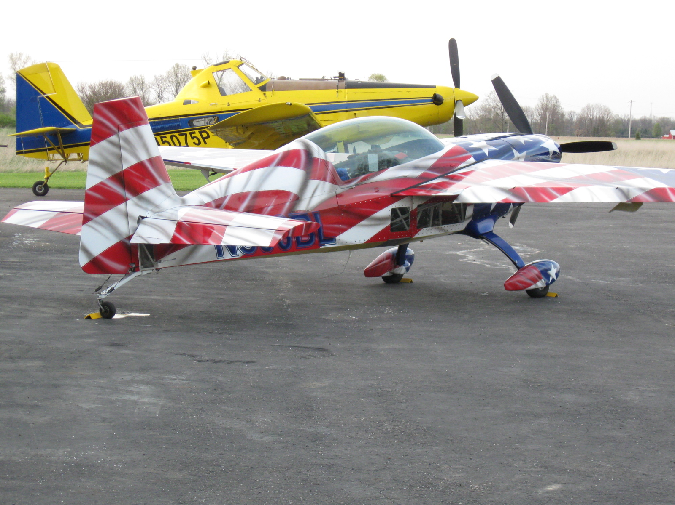
rewolf@ksu.edu
For more information contact:
www.bae.ksu.edu/faculty/wolf/

Slide 2
Application Technology Update
Robert E. Wolf
Extension Specialist Application Technology
Biological and Agricultural Engineering
Notes:
Use either title slide. Hide the one you do not want to use.

Slide 3
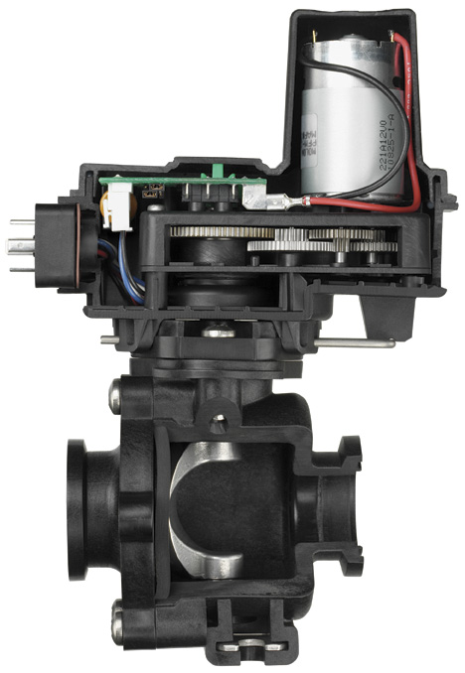
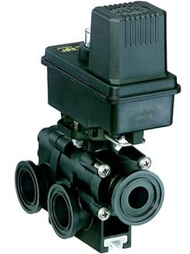
Flow Back Control:

Slide 4
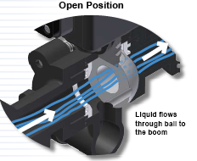
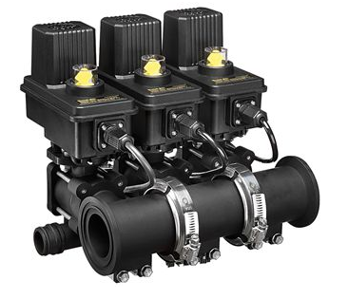
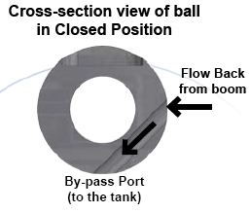
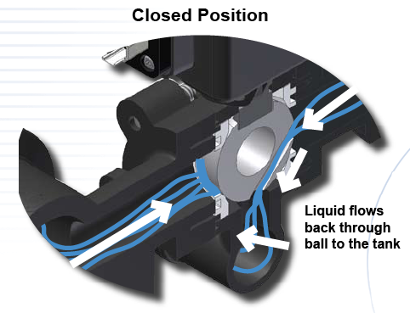
Flow Back Manifolds

Slide 5
Flow Back Function
Spray Position
Off Position
TO
BOOM
INLET
INLET
FROM BOOM
BY-PASS PORT
BY-PASS PORT
0.6 second shutoff with a 32 gpm flow rate
Notes:
This illustrates the 450FB ball. 460FB has similar function.
Normal flow in spray position
In off position the second hole is exposed to boom pressure.
Pressure trapped after boom valves shut off is relieved.
DCVs shut off fast instead of waiting for pressure decay or “bleed down”

Slide 6
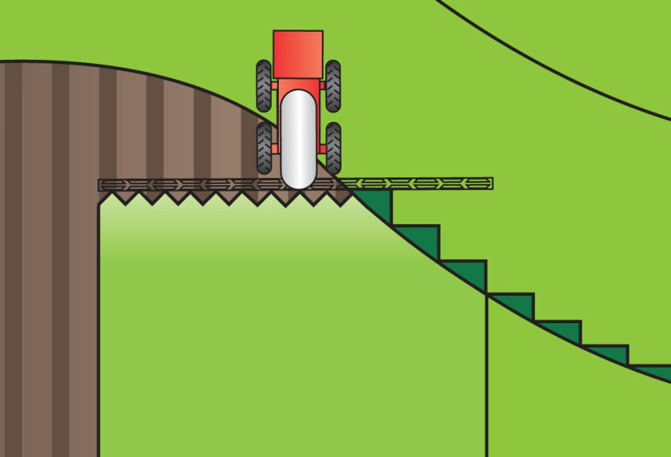
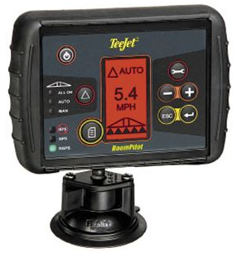
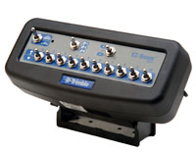
Automatic Boom Section Control

Slide 7
Swath Control Pro
John Deere - Animation

Slide 8
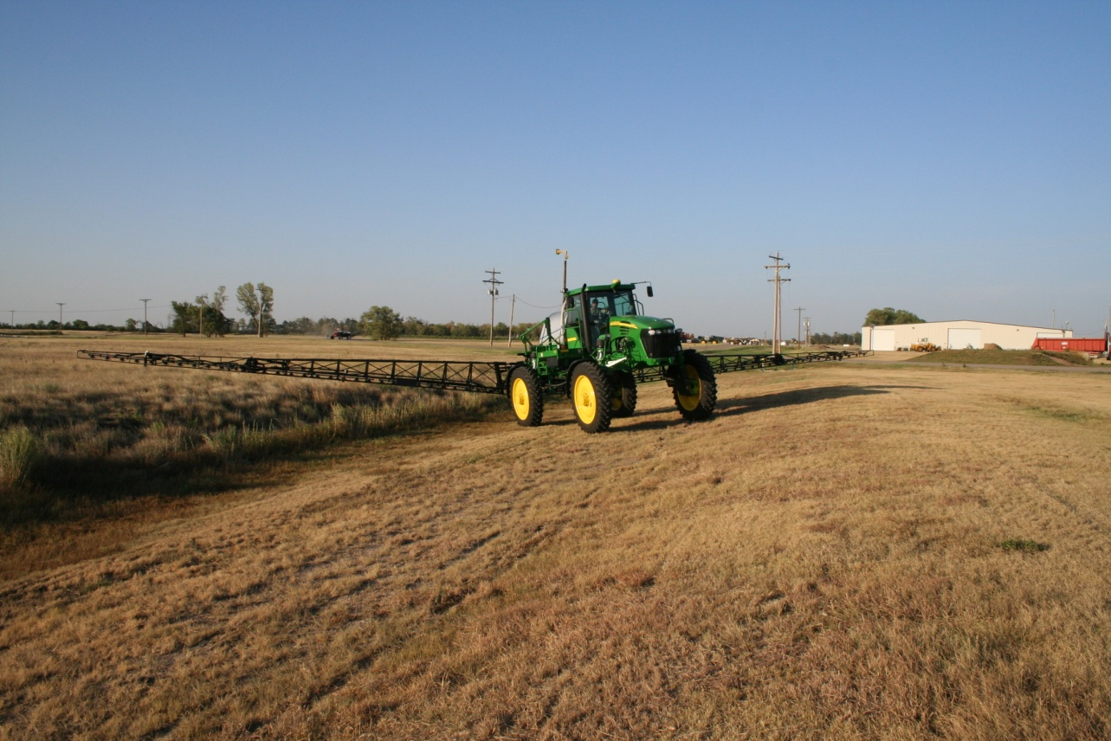
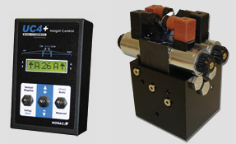
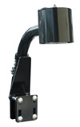
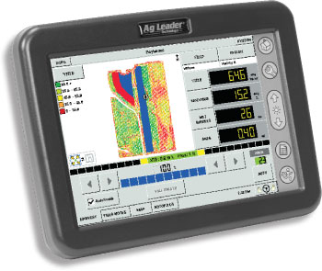
Automatic Boom Height Control
UC5
JD GS2 Panel

Slide 9
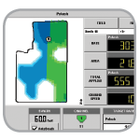
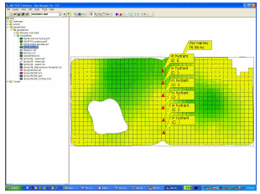
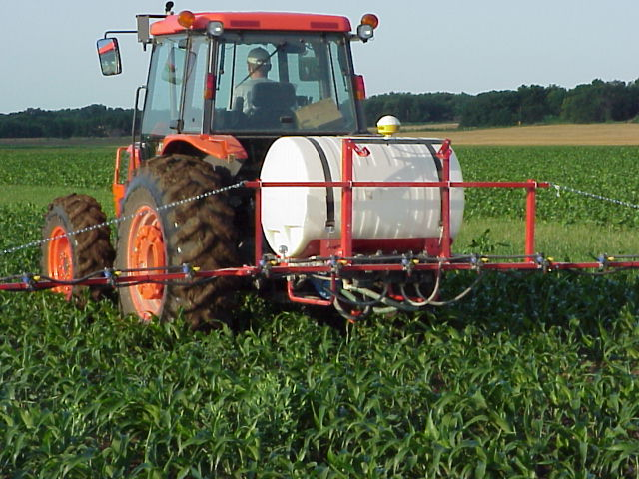
Variable Rate/Mapped Applications
Predeveloped variable rate maps
Dependent on target variables
weed pressures, species, size
Flow and droplet control issues

Slide 10
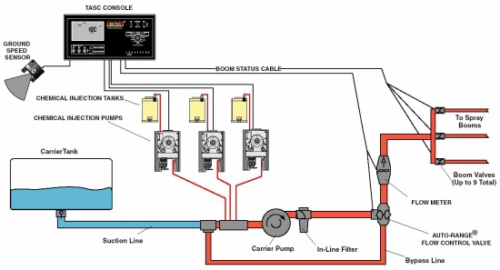
Variable Rate Liquid:
Direct Injection
Complex
Time lag
Fixed orifice nozzles
Flow proportional to square root of pressure
Difficult to achieve range in flow rates
Pulse Width Modulation
Variable orifice nozzles
Pressure/Flow relationship is more complex

Slide 11
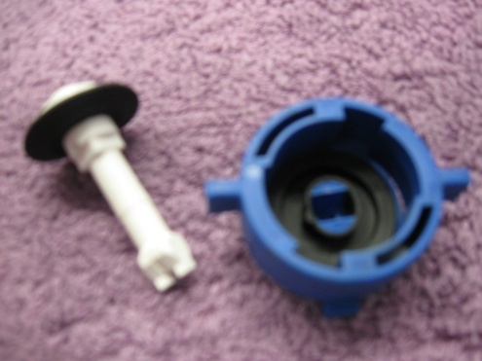
VariTarget:
Speed variations from 2-20 MPH
Application rates of 5-40 GPA
Spring tension
Variable area pre orifice
Variable area spray orifice
Optimize spray droplet size
Maintain efficacy and minimize drift
Very Fine
Fine
Medium
Coarse
Very Coarse
Notes:
This nozzle has been built for the task. Developed at the U of TN, sold to Delevan (Patent Squabble rumored), AgCo selling it. They are pushing on new sprayers. Most buyers have no idea about it. It has also been marketed in aerial applications and some problems are reported. The varialble orifices (flexible rubber parts) may not hold up to acres and acres of use. Some adjustments have been made to the gaskets but…. I have proposed a study with the KS Corn Board and am in the final screening for a go. There are no research trials showing efficacy and durability of this nozzle. Time will tell but is sorely needed. Priced at $65-85 per nozzle.

Slide 12
Variable Rate Nozzles
TurboDrop Variable Rate – TDVR
30 – 120 PSI
Equals a 4X rate change
Allows for –
Greater application speed changes
Different application rates in different fields or in the same field

Slide 13
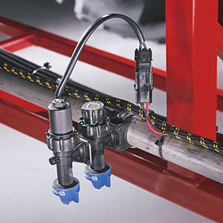
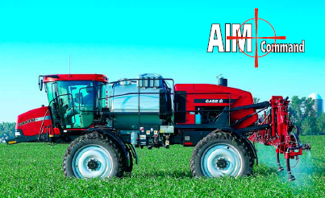
Blended Pulse Technology
Independent Flow Control (1-8X)
Independent Drop Size Control
Separate boom section controls
NEW/Coming Soon! – Individual nozzle control
Individual On/off along the boom
Flow control along the boom at individual nozzles for speed changes

Slide 14
Pulse compared to conventional:
Conventional
PWM

Slide 15
Harrison Smart Nozzle: H-AgTec
Uses GPS for location in field.
Smart Nozzle spray system utilizes computer driven valves to control flow.
Flow based on an operator prepared map.
Computer controls flow at individual nozzles by -
Interrupting flow on areas not intended for spray
Terminating spray on areas previously sprayed to prevent overlap
Currently being developed for pesticide and fertilizer applications for sprayers and planting equipment.
2010 - Announced release of AutoSwath Control/Dickey-john - Planters
http://www.h-agtec.com/

Slide 16
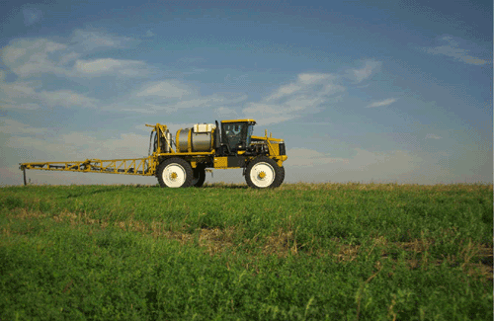
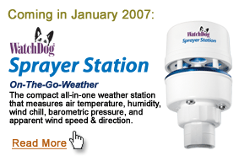
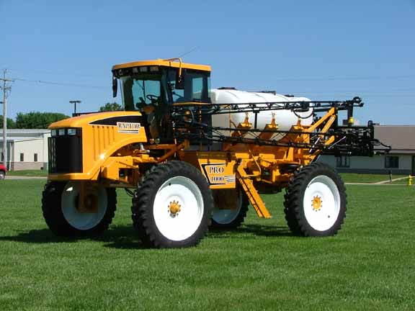
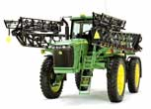
On board weather instrumentation:

Slide 17
Calibration!!!! The next phase!
A new concept for applicators!
Ensuring that the spray droplet spectrum is what it is supposed to be to maximize efficacy while minimizing drift!

Slide 18
ASABE S-572 Droplet Size Standard

Slide 19
Spray quality categories.
ASABE Standard S-572.1
Category (symbol) | Color Code
Extra Fine (XF) | Purple
Very Fine (VF) | Red
Fine (F) | orange
Medium (M) | yellow
Coarse (C) | Blue
Very Coarse (VC) | Green
Extra Course (XC) | White
Ultra Coarse (UC) | Black
2009

Slide 20
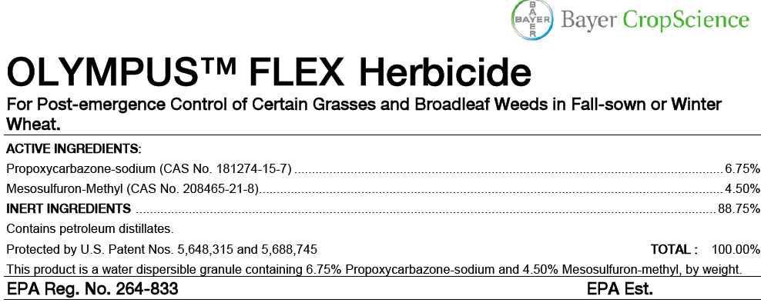

Slide 21
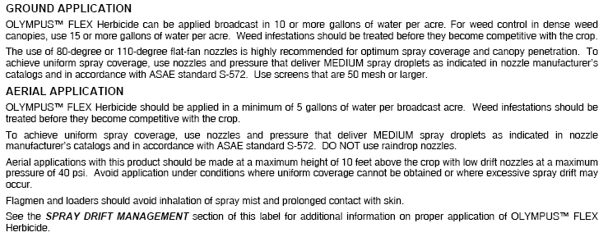
Page 4

Slide 22
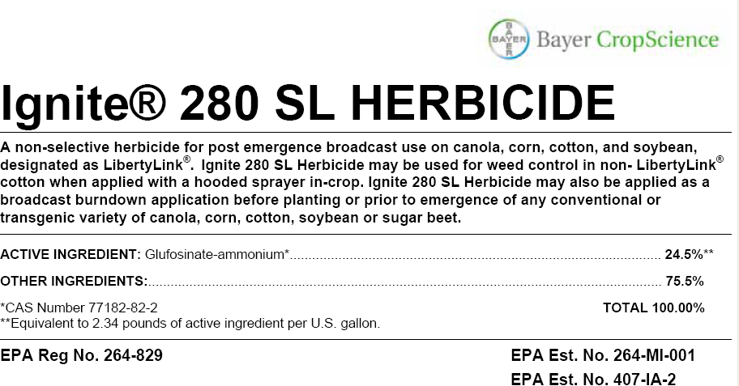

Slide 23
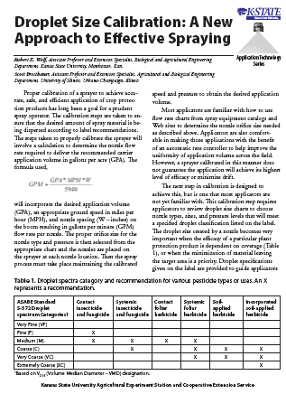
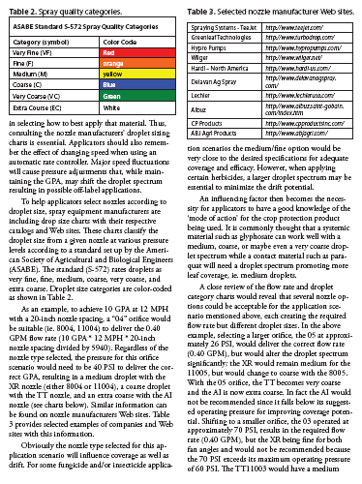
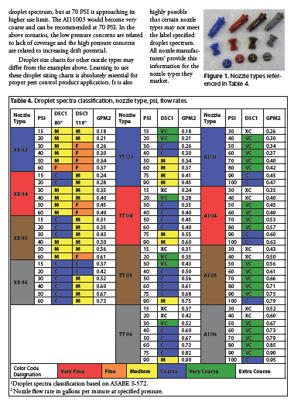
Fact Sheet: MF2869
www.bae.ksu.edu/faculty/wolf/

Slide 24
Solution Factor:
Changes the flow rate ?????
Changes the droplet spectra !!!!

Slide 25
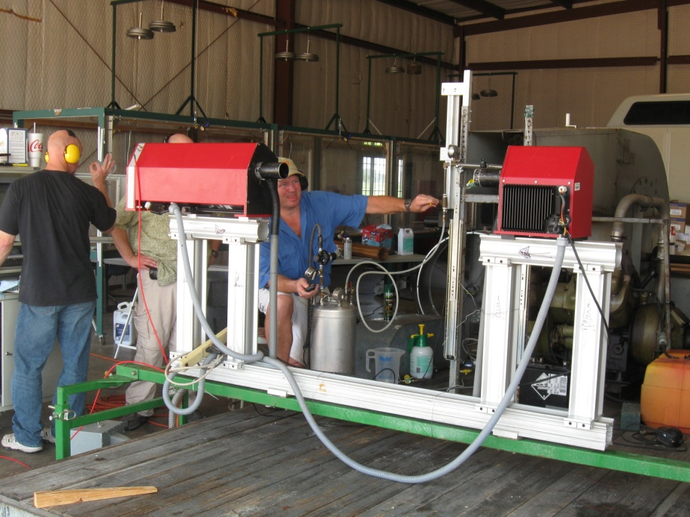
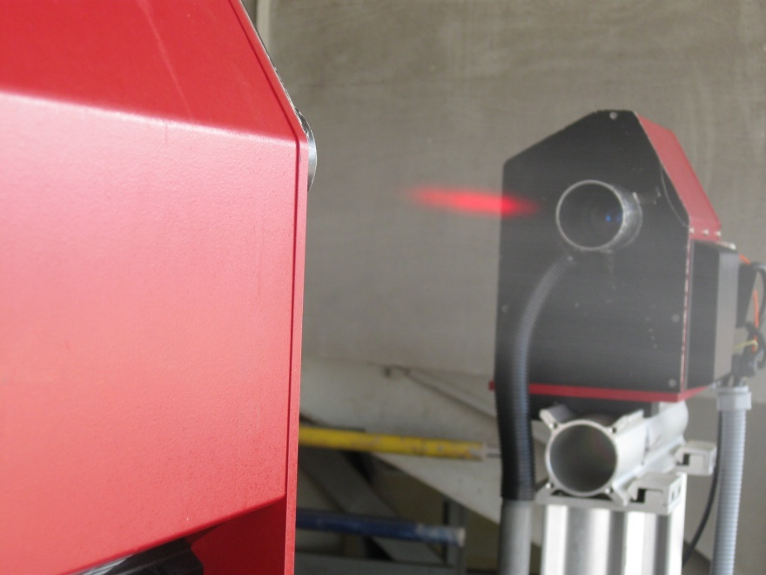
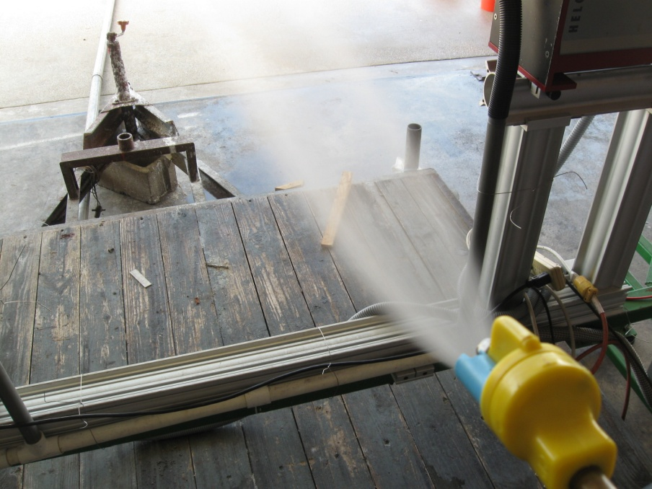
Need to evaluate droplets of solutions:

Slide 26
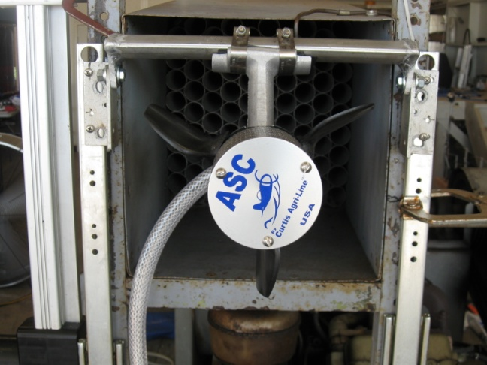
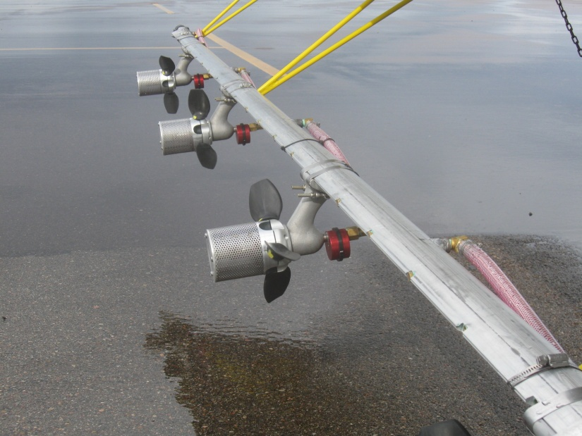

Slide 27
Disclaimer:
Brand names appearing in this presentation are for identification and illustration purposes only.
No endorsement is intended, nor is criticism implied of similar products not mentioned.

