Slide 1


Application Technology Update
Focus on Nozzles
Robert E. Wolf
Extension Specialist Application Technology
Biological and Agricultural Engineering
Notes:
Use either title slide. Hide the one you do not want to use.

Slide 2
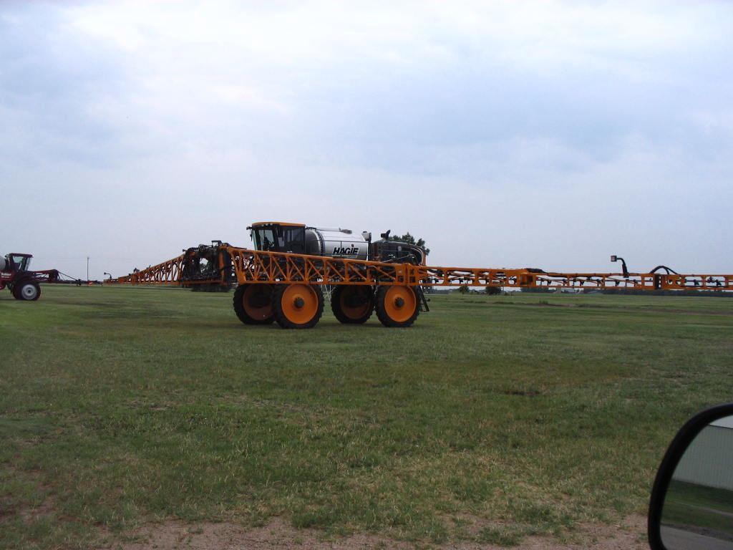
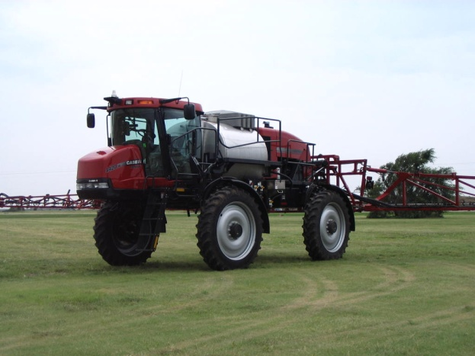
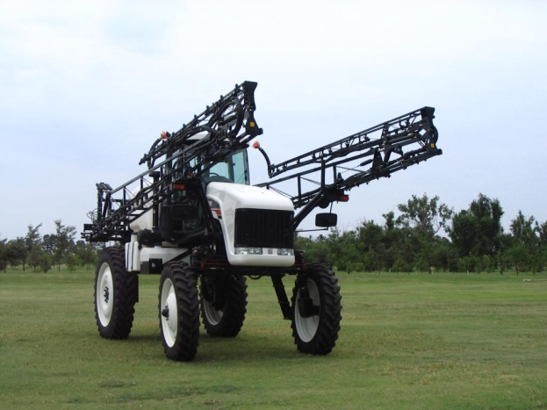
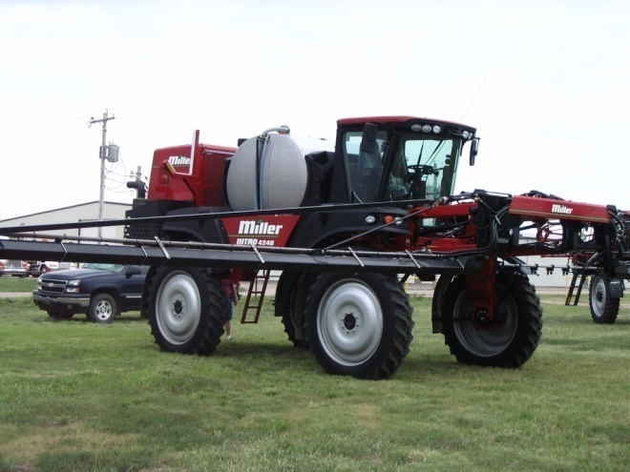
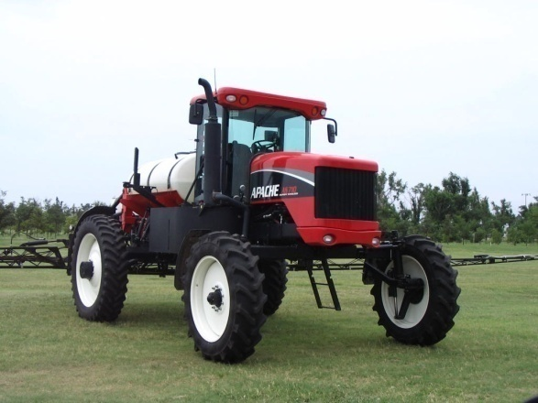
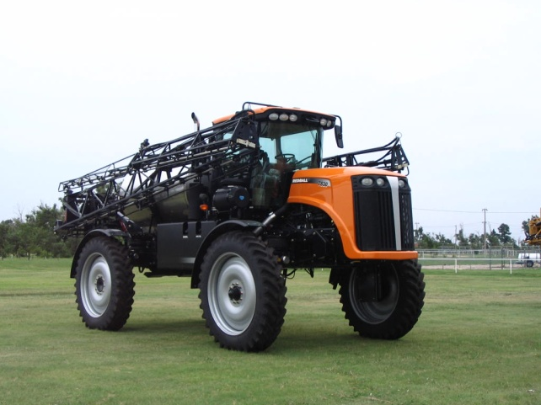
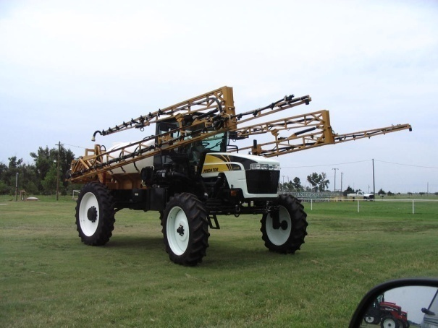
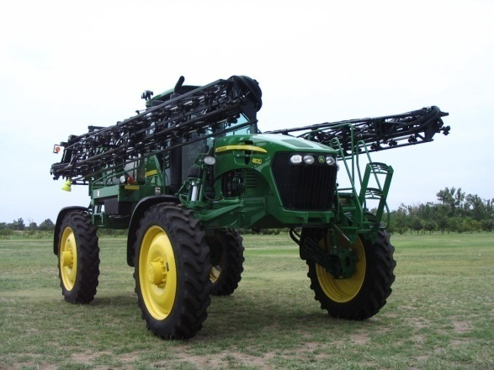
Options?

Slide 3


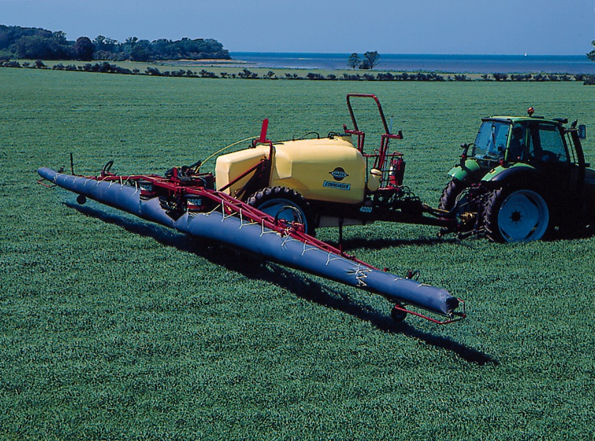
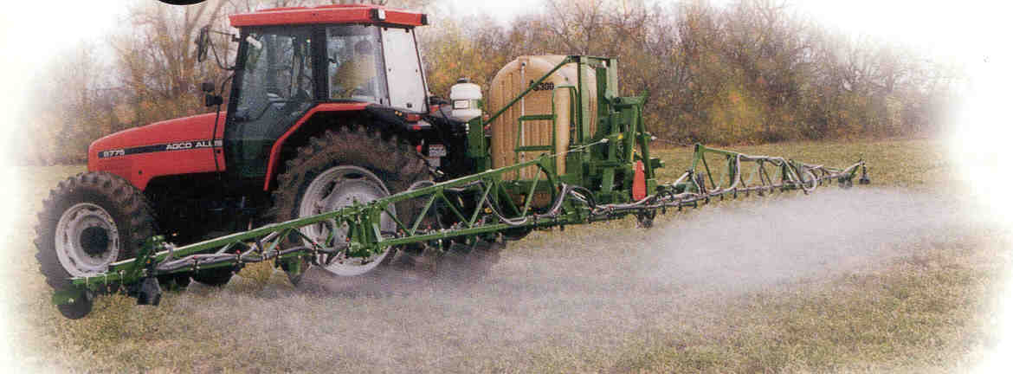
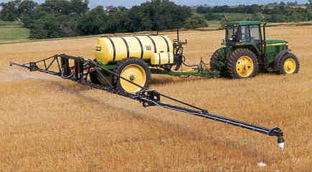
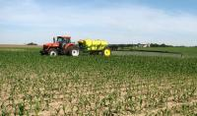
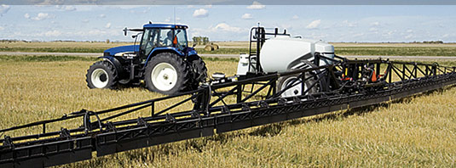
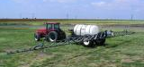
Options?

Slide 4
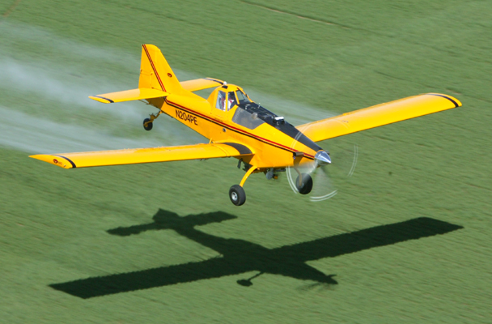
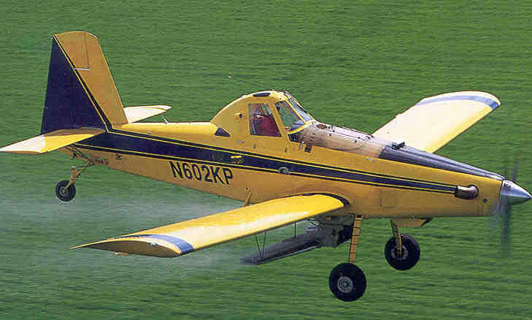
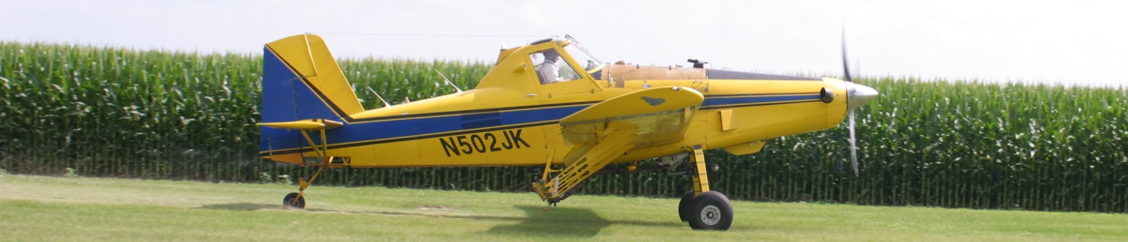
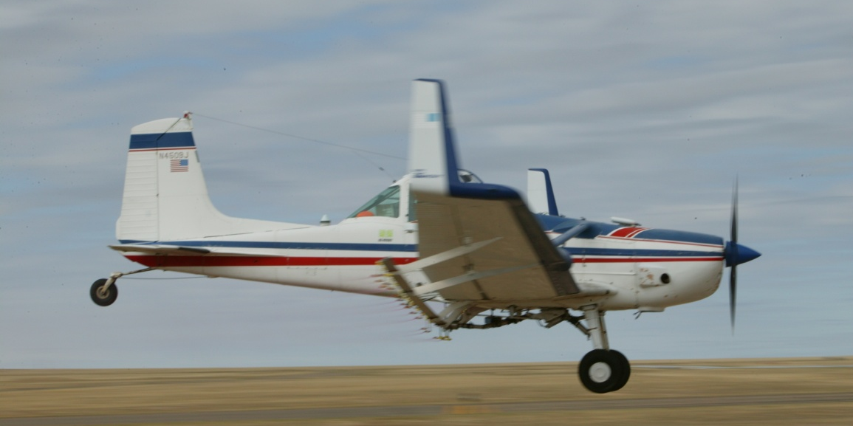


Slide 5
What is New???

Slide 6
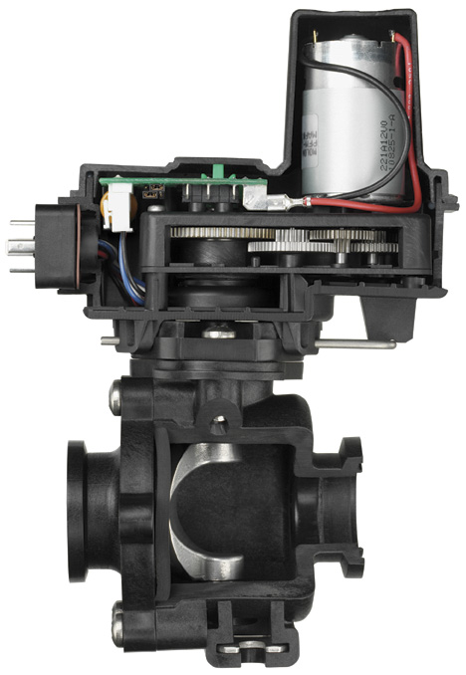
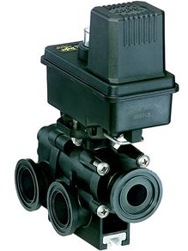
Flow Back Control:

Slide 7
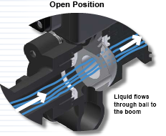
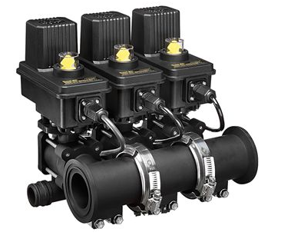
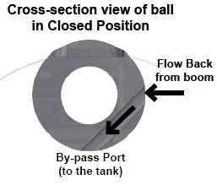
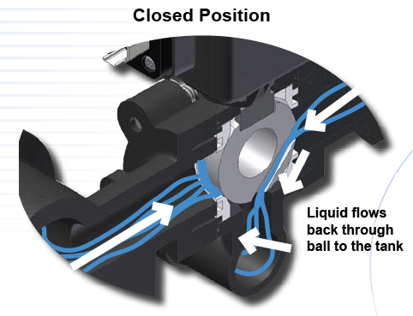
Flow Back Manifolds

Slide 8
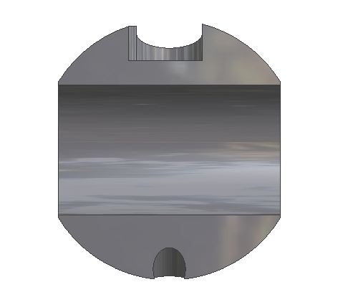
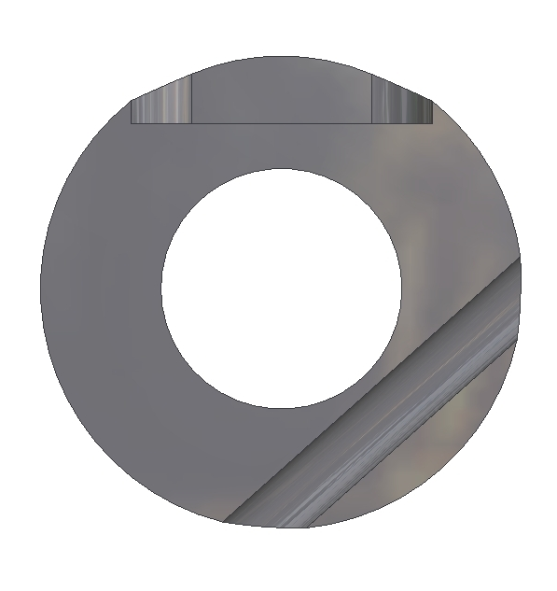
Flow Back Function
Spray Position
Off Position
TO
BOOM
INLET
INLET
FROM BOOM
BY-PASS PORT
BY-PASS PORT
0.6 second shutoff with a 32 gpm flow rate
Notes:
This illustrates the 450FB ball. 460FB has similar function.
Normal flow in spray position
In off position the second hole is exposed to boom pressure.
Pressure trapped after boom valves shut off is relieved.
DCVs shut off fast instead of waiting for pressure decay or “bleed down”

Slide 9

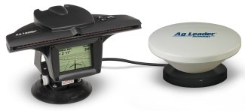
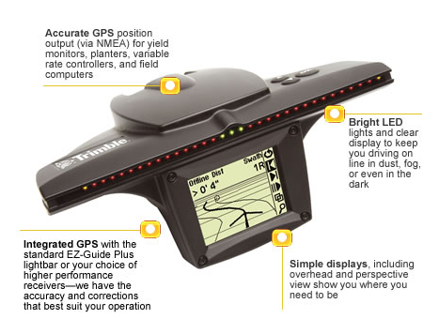
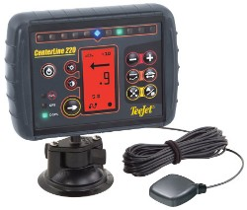
Parallel Swathing – light bars:
Notes:
Swath marking in becoming a widely used practice today. GPS is used to position the spray vehicles in the field. The straight-line A-B tracking line will guide the sprayer back and forth through the field in parallel swaths to match the programmed boom width. Light bars aide the driver in the guidance process. The photo in the lower left illustrates the system being used in the aerial application industry. The red lines are when the sprayer is working and the yellow lines show the turning paths. As this presentation was being developed advancements in using the parallel tracking devices to follow curves and work in circles are being perfected.

Slide 10
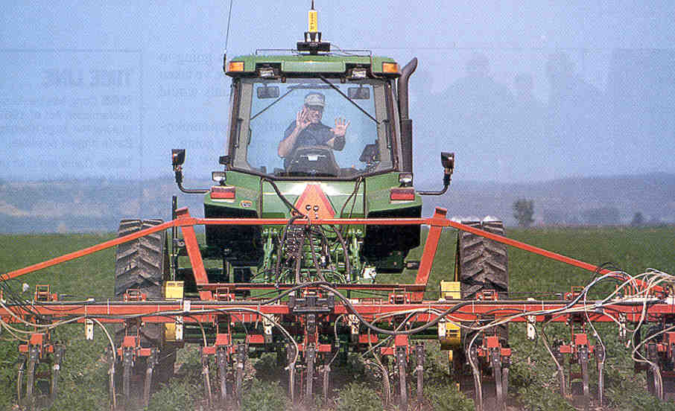
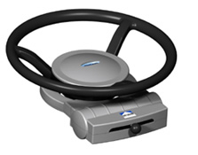
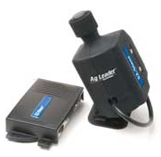
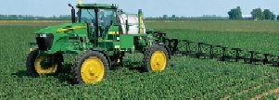
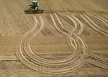
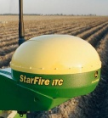
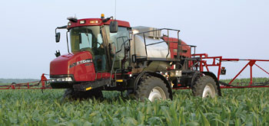

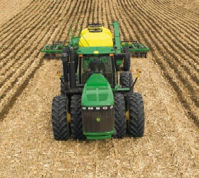

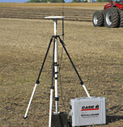
Auto Steering:

Slide 11
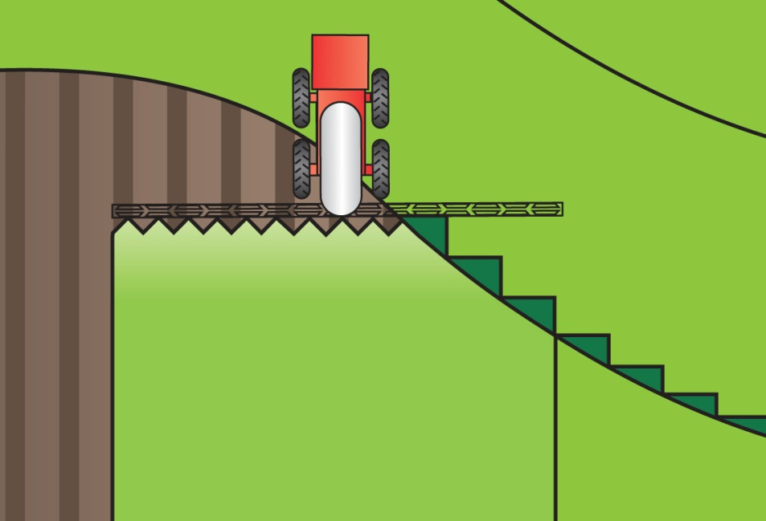
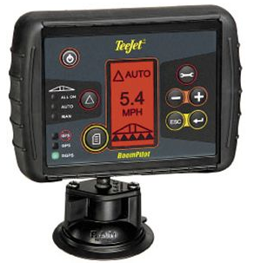
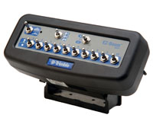

Automatic Boom Section Control

Slide 12
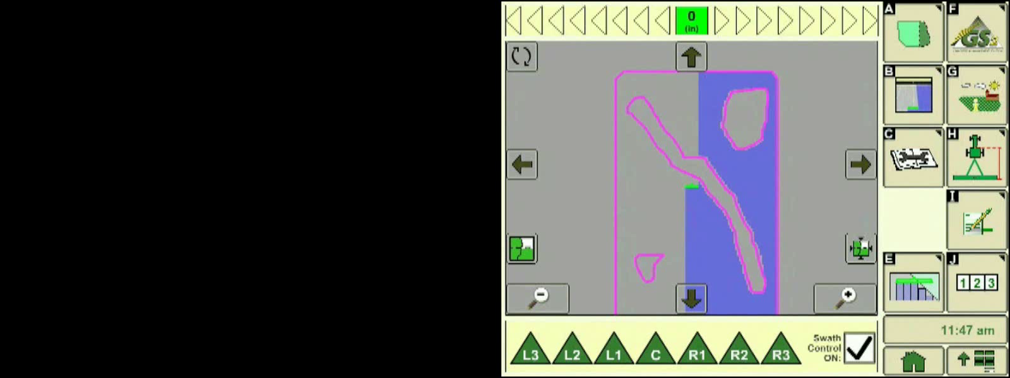
Swath Control Pro
John Deere - Animation

Slide 13
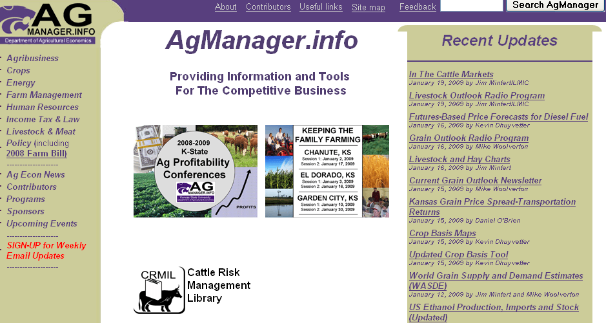

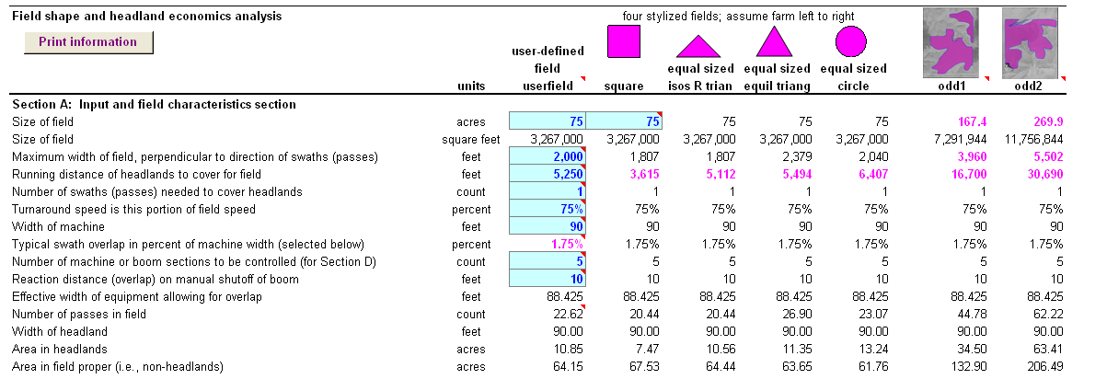

Slide 14
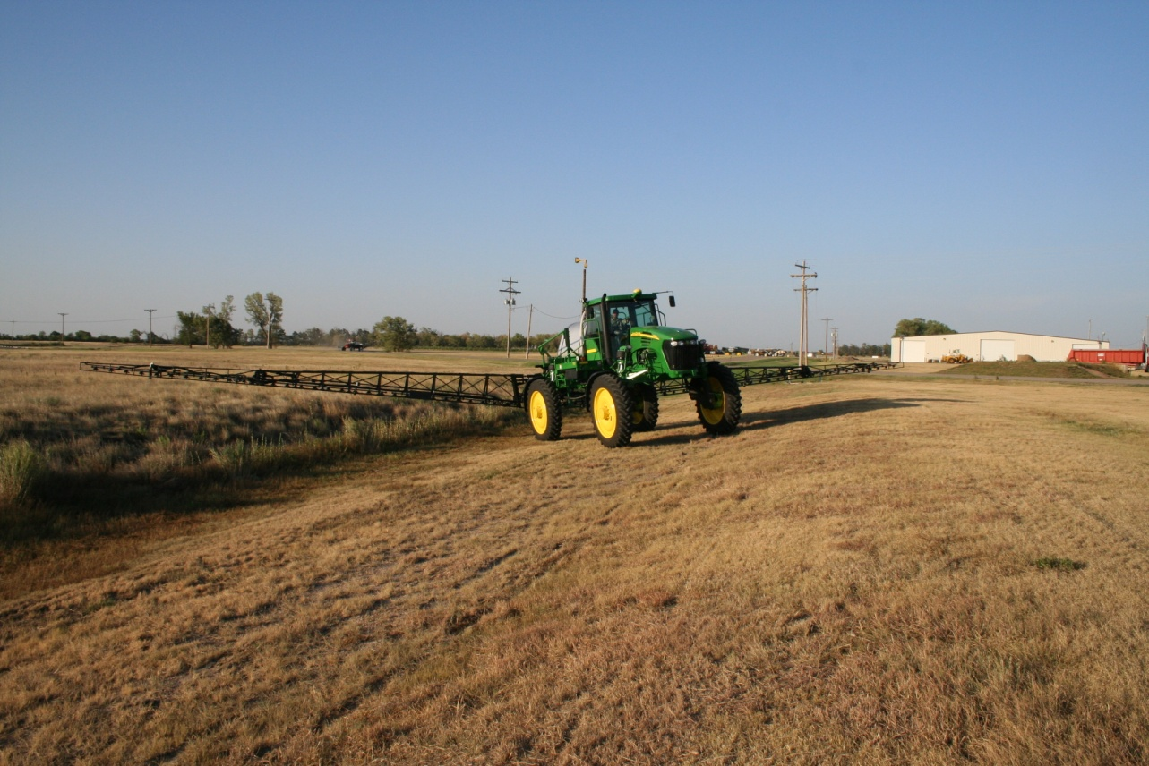
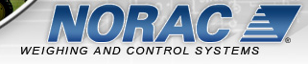
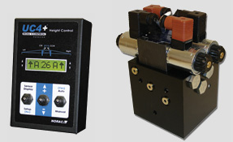
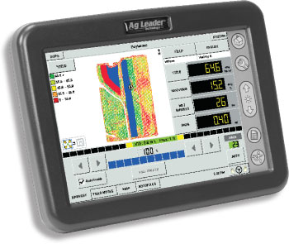
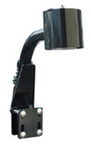

Automatic Boom Height Control
UC5

Slide 15
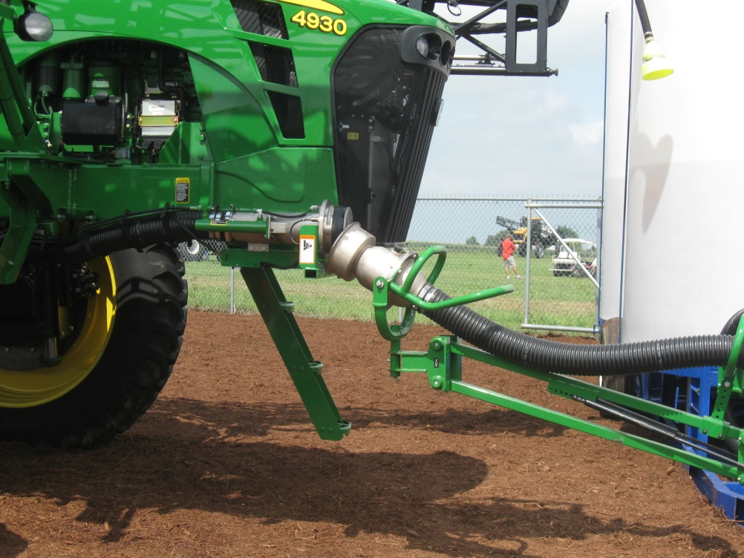




Load Command Spray Coupler
Auto Quick fill system
  3 minutes for 1200 gallons

Slide 16

Accurate and efficient applications:
Increase Efficacy – Minimize Drift
Notes:
Many technological changes have occurred in the spray industry in recent years. Much attention has been given to application equipment to increase efficiency and minimize spray drift. This presentation is designed for you to share some of these application technologies in ground application with your applicator audiences. Equipment design changes have occurred in all forms of ground application. Much of the improvements has been directed at the reduction of spray drift.

Slide 17


Slide 18












Nozzle Technology……
Nozzles designed to reduce drift
Improved drop size control
Emphasis on ‘Spray Quality’
Notes:
Beginning with the ‘extended range’ flat fan nozzle (all major manufactures have one), continuing with the design of ‘preorifice inserts’ and ‘turbulation chambers’, and now with the ‘venturi’ style nozzle design, nozzle manufacturer's have worked to develop nozzles that are improving the quality of spray emitted.

Slide 19

Spray Characteristics are Important
Demonstrates Turbo Flat vs TurboDrop-5 MPH Wind

Slide 20
Nozzle Efficacy/Drift Slope
1980
30 years
Reducing Spray Drift
Extended Range
Nozzle development timeline
XR, TR
Turbo Flood
Turbo TeeJet
Air Mix
AI XR
GuardianAir
AI
Ultra Low Drift
Turbo Drop
TTI
Chamber Design
Venturi Design - II
Venturi Design - I
Efficacy
2009

Slide 21









New Nozzles
AITTJ60
Turbo TwinJet Induction
Turbo TwinJet – TTJ60
AI XR TeeJet
GuardianAir - Hypro

Slide 22






New Nozzles
Air Mix & TDHSTF- Greenleaf
Leckler

Slide 23






Slide 24







Nozzles for fertilizer on wheat:
Hi-Flow
StreamJet-7
StreamJet-3
CP Triple Stream Tip

Slide 25



VariTarget:
Speed variations from 2-20 MPH
Application rates of 5-40 GPA
Spring tension
Variable area pre orifice
Variable area spray orifice
Optimize spray droplet size
Maintain efficacy and minimize drift
VeryFine
Fine
Medium
Coarse
Very Coarse
Notes:
This nozzle has been built for the task. Developed at the U of TN, sold to Delevan (Patent Squabble rumored), AgCo selling it. They are pushing on new sprayers. Most buyers have no idea about it. It has also been marketed in aerial applications and some problems are reported. The varialble orifices (flexible rubber parts) may not hold up to acres and acres of use. Some adjustments have been made to the gaskets but…. I have proposed a study with the KS Corn Board and am in the final screening for a go. There are no research trials showing efficacy and durability of this nozzle. Time will tell but is sorely needed. Priced at $65-85 per nozzle.

Slide 26

www.spraytarget.com

Slide 27

Variable Rate Nozzles
TurboDrop Variable Rate – TDVR
30 – 120 PSI
Equals a 4X rate change
Allows for –
  Greater application speed changes
  Different application rates in different fields or in the same field

Slide 28




Blended Pulse Technology
Independent Flow Control (1-8X)
Independent Drop Size Control
Boom section controls
NEW – individual nozzle control with along the boom flow control
NEW – tattler for plug detection…

Slide 29


Slide 30




Materials and Methods
28 PSI
70 PSI
*
Twin-fan IDK-T
Turbo Flat-fan (TT)
AIXR Flat-fan
Air Mix (AM)
Guardian (GA)
Turbo Twin Flat-fan (TTJ60)
AIC Flat-fan
TDHSTF
Ultra Lo Drift (ULD)
*
*
40 PSI
*
*

Slide 33


Calibration!!!!
GPA
Ensuring that the spray output is what it is supposed to be!

Slide 34

Calibration/Nozzle Selection:
What is the first step?
Use label to select the
  application volume
  product rate
Choose an appropriate travel speed - MPH
Effective width of application
  nozzle spacing
Calculate GPM – Flow rate per nozzle
Select the correct size of nozzle!
Notes:
This emphasizes my philosophy on calibration and leads into selecting the correct nozzle size. Begins with the label (the law), then based on travel speed. Nozzle spacing is used but typically does not change – usually 20-inches. Formula on next slides with example of a calculation.

Slide 36



Improving Coverage?
500 microns = 1
250 microns = 8
125 microns = 64

Slide 37

Courtesy of Ken Giles, U of California Davis

Slide 38
Calibration!!!!
The next phase!
A new concept for applicators!
Ensuring that the spray droplet spectrum is what it is supposed to be to maximize efficacy while minimizing drift!

Slide 39
ASABE S-572 Droplet Size Standard

Slide 40
Spray quality categories.
ASABE Standard S-572.1
Category (symbol) | Color Code
Extra Fine (XF) | Purple
Very Fine (VF) | Red
Fine (F) | orange
Medium (M) | yellow
Coarse (C) | Blue
Very Coarse (VC) | Green
Extra Course (XC) | White
Ultra Coarse (UC) | Black
2009

Slide 41

ASABE Standard
>150
Fungicides/Insecticides
151-250
251-350
351-450
Herbicides
451-550
>551
Source: Crop Life – July 2002
Notes:
Summary chart with descriptions and approximate droplet sizes recommended. Important to mention the relative size so they can keep it in perspective.

Slide 42


Slide 43

Page 4

Slide 44



Slide 45


See Page 182, TeeJet Catalog 50A

Slide 46

Droplet Selection/Calibration:
p. 15

Slide 47


Slide 48


www.hypropumps.com

Slide 49

Greenleaf Droplet chart:
www.turbodrop.com

Slide 50




Slide 51




Slide 52



Slide 53


Slide 54

Drift Reduction Additives:
Many available!
Not EPA regulated
Long chain polymers
Soluble powders
Reduction in off-target movement documented
Not all will work!!!!
Pump shear problems
Effect on the pattern?
Deposition Aids

Slide 55


Chemical Producers & Distributors Association

Slide 56
Total Drift Ranked:
water average
g
fg
ef
ef
bcd
cde
cde
de
abc
ab
a
a
a

Slide 57




Volume Median Diameter (VMD)
% less than 210 Microns
37
51
36
35
45
23
30
14
15
26
19
22
14
13
22
10
17
29
29
15
Percent fines
40 psi 40 psi 40 psi 70 psi
Bob Klein, U of Nebraska

Slide 58
Disclaimer:
Brand names appearing in this presentation are for identification and illustration purposes only.
No endorsement is intended, nor is criticism implied of similar products not mentioned.

Slide 59



rewolf@ksu.edu
For more information contact:
Thanks!
www.bae.ksu.edu/faculty/wolf/

