Slide 1


Nozzle Design Update and
Application Technology Update
Robert E. Wolf
Extension Specialist Application Technology
Biological and Agricultural Engineering
Notes:
Use either title slide. Hide the one you do not want to use.

Slide 2
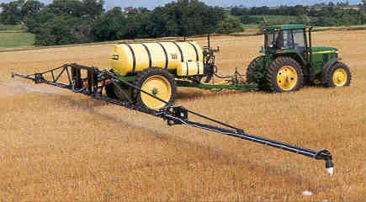
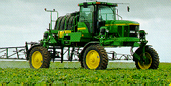
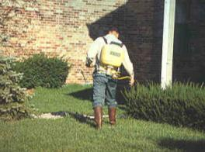
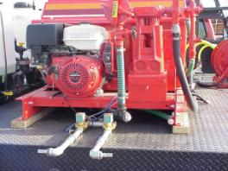
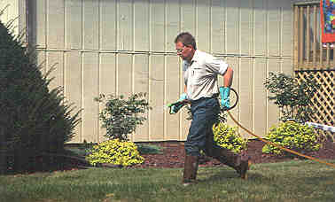
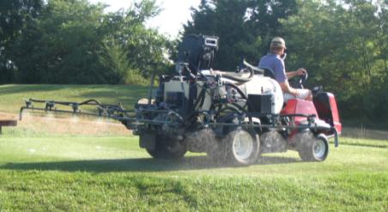
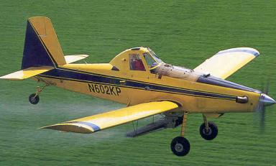
Notes:
Cost range from $10K – $30K for farmer, golf course, and road side sprayers. Obviously will very greatly dependant on how set up.
Commercial sprayers will range from $50 to $250K. Really some variation with these systems from Spra-Coupe and Appache types all the way to the Rogator, Case-IH, and John Deere systems. New 800 gallon turbine powered Air Tractor (150 MPH spray speed) could run close to $1.5 million today. The above picture is a 600 gallon version. AT is building a new 1025 gallon version.

Slide 3
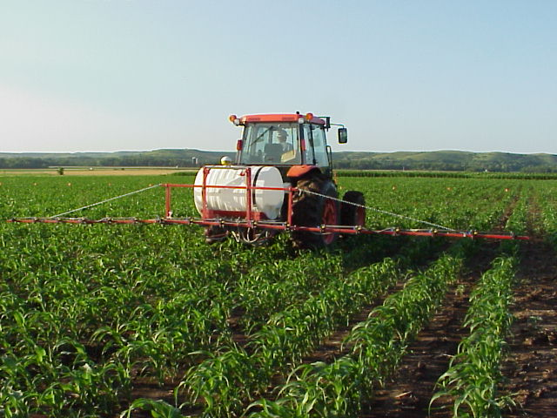
Accurate And Efficient Applications
Increase Efficacy
Minimize Drift
Maximize Productivity
Notes:
Many technological changes have occurred in the spray industry in recent years. Much attention has been given to application equipment to increase efficiency and minimize spray drift. This presentation is designed for you to share some of these application technologies in ground application with your applicator audiences. Equipment design changes have occurred in all forms of ground application. Much of the improvements has been directed at the reduction of spray drift.

Slide 4
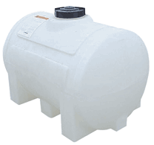
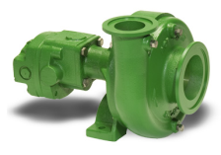
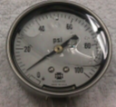
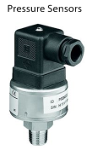
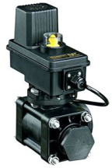
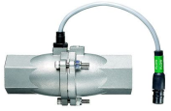

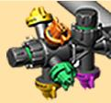
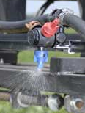
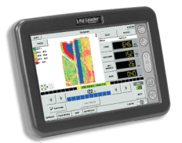
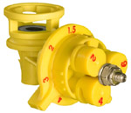
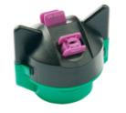
Sprayer Components:
Tanks – poly, stainless
Pump, Strainers, Agitation
Pressure gauge
Hoses, Flow control assemblies
Electronics: monitors-computers- controllers (GPS/GIS)
Distribution system
Nozzles – Not expensive but KEY!
Notes:
Regardless of how much it cost most spray systems will have similar components. Some may be fancier but all doing the basic functions. Go to next slide at bullet #2. This slide reappears to continue discussion.

Slide 5
What is New???

Slide 6
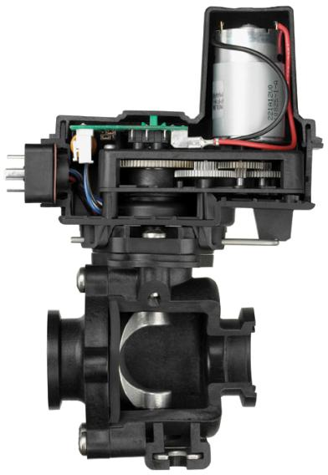
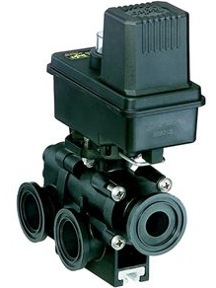
Flow Back Control:

Slide 7
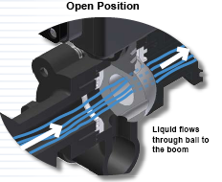
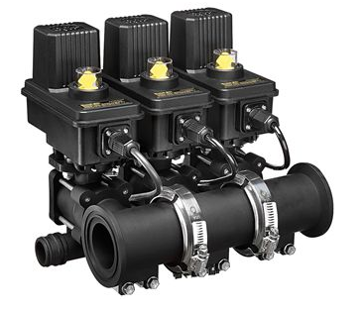
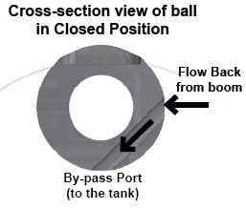
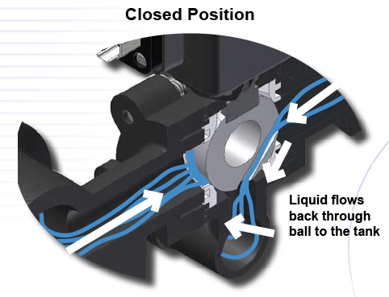
Flow Back Manifolds

Slide 8
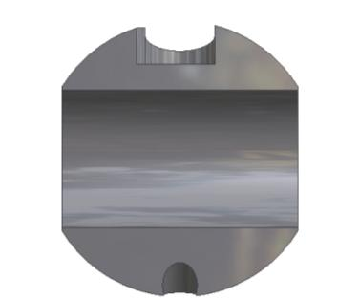
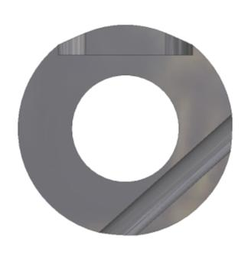
Flow Back Function
Spray Position
Off Position
TO
BOOM
INLET
INLET
FROM BOOM
BY-PASS PORT
BY-PASS PORT
0.6 second shutoff with a 32 gpm flow rate
Notes:
This illustrates the 450FB ball. 460FB has similar function.
Normal flow in spray position
In off position the second hole is exposed to boom pressure.
Pressure trapped after boom valves shut off is relieved.
DCVs shut off fast instead of waiting for pressure decay or “bleed down”

Slide 9
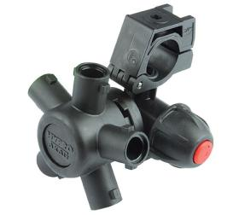
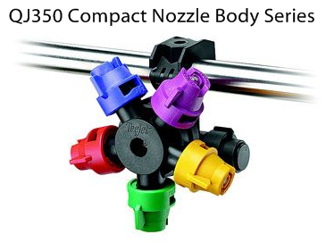
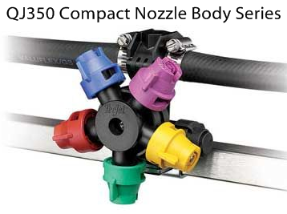
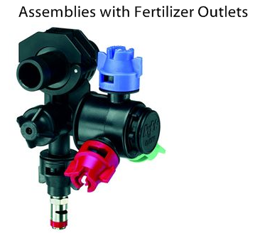
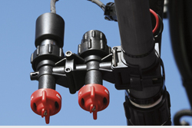
Wilger Combo-Rate®

Slide 10
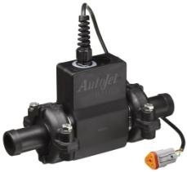
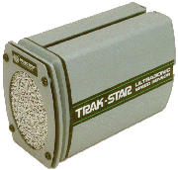
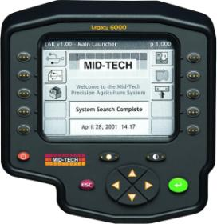

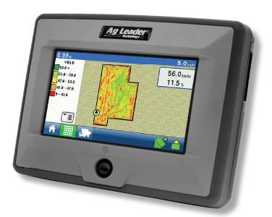
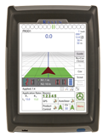
Rate Controllers:

Slide 11

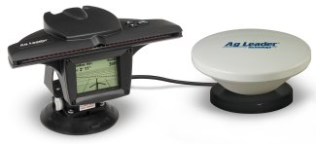
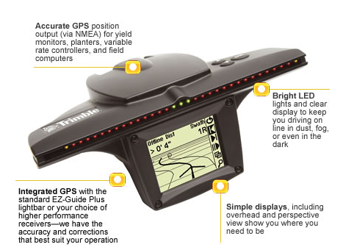
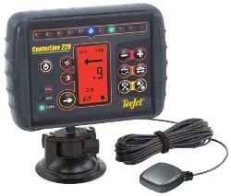
Parallel Swathing – light bars:
Notes:
Swath marking in becoming a widely used practice today. GPS is used to position the spray vehicles in the field. The straight-line A-B tracking line will guide the sprayer back and forth through the field in parallel swaths to match the programmed boom width. Light bars aide the driver in the guidance process. The photo in the lower left illustrates the system being used in the aerial application industry. The red lines are when the sprayer is working and the yellow lines show the turning paths. As this presentation was being developed advancements in using the parallel tracking devices to follow curves and work in circles are being perfected.

Slide 12
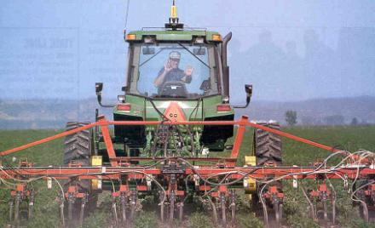
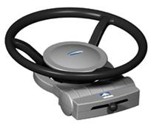
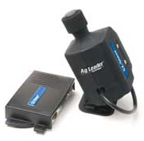
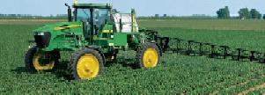
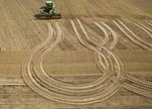
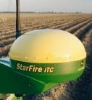
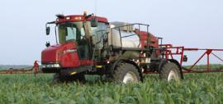

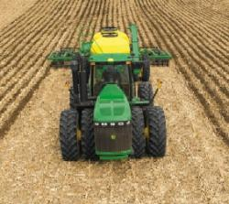

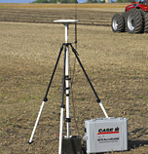
Auto Steering:

Slide 13
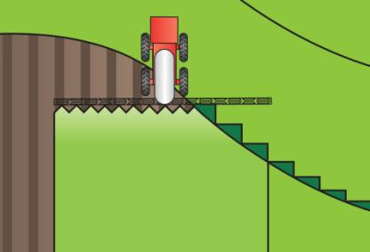



Automatic Boom Section Control

Slide 14

Swath Control Pro
John Deere - Animation

Slide 15







Automatic Boom Height Control
UC5
JD GS2 Panel

Slide 16



Variable Rate/Mapped Applications
Predeveloped variable rate maps
Dependent on target variables
  weed pressures, species, size
Flow and droplet control issues

Slide 17




VariTarget:
Speed variations from 2-20 MPH
Application rates of 5-40 GPA
Spring tension
Variable area pre orifice
Variable area spray orifice
Optimize spray droplet size
Maintain efficacy and minimize drift
Very Fine
Fine
Medium
Coarse
Very Coarse
Notes:
This nozzle has been built for the task. Developed at the U of TN, sold to Delevan (Patent Squabble rumored), AgCo selling it. They are pushing on new sprayers. Most buyers have no idea about it. It has also been marketed in aerial applications and some problems are reported. The varialble orifices (flexible rubber parts) may not hold up to acres and acres of use. Some adjustments have been made to the gaskets but…. I have proposed a study with the KS Corn Board and am in the final screening for a go. There are no research trials showing efficacy and durability of this nozzle. Time will tell but is sorely needed. Priced at $65-85 per nozzle.

Slide 18


Variable Rate Nozzles
TurboDrop Variable Rate – TDVR
30 – 120 PSI
Equals a 4X rate change
Allows for –
  Greater application speed changes
  Different application rates in different fields or in the same field

Slide 19




Blended Pulse Technology
Independent Flow Control (1-8X)
Independent Drop Size Control
Separate boom section controls
NEW/Coming Soon! – Individual nozzle control
  Individual On/off along the boom
  Flow control along the boom at individual nozzles for speed changes

Slide 20

How it Works:
Uses high speed solenoid valves to regulate flow
Varies application rate with duty cycle: independently of pressure

Slide 21


Pulse compared to conventional:
Conventional
PWM

Slide 22

What is Pulse Width?
Type of control system
Modulates a DC square wave signal

Slide 23

Courtesy of Ken Giles, U of California Davis

Slide 24
Harrison Smart Nozzle: H-AgTec
Uses GPS for location in field.
Smart Nozzle spray system utilizes computer driven valves to control flow.
Flow based on an operator prepared map.
Computer controls flow at individual nozzles by -
  Interrupting flow on areas not intended for spray
  Terminating spray on areas previously sprayed to prevent overlap
Currently being developed for pesticide and fertilizer applications for sprayers and planting equipment.
2010 - Announced release of AutoSwath Control/Dickey-john - Planters
http://www.h-agtec.com/

Slide 25





On board weather instrumentation:

Slide 26

Accurate and efficient applications:
Increase Efficacy – Minimize Drift
Notes:
Many technological changes have occurred in the spray industry in recent years. Much attention has been given to application equipment to increase efficiency and minimize spray drift. This presentation is designed for you to share some of these application technologies in ground application with your applicator audiences. Equipment design changes have occurred in all forms of ground application. Much of the improvements has been directed at the reduction of spray drift.

Slide 27
Nozzles are important because:
Control the amount – GPA.
Determine uniformity of application.
Affects the coverage.
Influences the drift potential.
Notes:
These are my points to emphasize the nozzles importance. The next several slides will explain or highlight each point in more detail.

Slide 28
Calibration!!!!
GPA
Ensuring that the spray output is what it is supposed to be!
Calibrating Boom Sprayers – MF2894

Slide 29





SpotOn Electronic Calibration Tool
Successful Farming Sponsored and will publish findings.
Scott Bretthauer - U of I
Jim Wilson - SDSU
Randy Taylor - OSU
Bobby Grisso & Pat Hipkins - VTU
Mark Hanna – ISU
Bob Wolf – KSU

Slide 30

Calibration/Nozzle Selection:
What is the first step?
Use label to select the
  application volume
  product rate
Choose an appropriate travel speed - MPH
Effective width of application
  nozzle spacing
Calculate GPM – Flow rate per nozzle
Select the correct size of nozzle!
Notes:
This emphasizes my philosophy on calibration and leads into selecting the correct nozzle size. Begins with the label (the law), then based on travel speed. Nozzle spacing is used but typically does not change – usually 20-inches. Formula on next slides with example of a calculation.

Slide 31
Flow Rate Equation:
Equation
See Page 173, TeeJet Catalog 50A
Calculates for amount of flow from one nozzle
Represents the size of nozzle to put on the sprayer
Notes:
This is the key formula.

Slide 32
GPM Example Solution:
.30gpm
Answer
Notes:
Example of 12 gpa at 12 MPH. Will need an orifice to deliver 0.48 gpm. Pressure to be determined on following slide.

Slide 33


Selecting the proper nozzle….
Page 9, 12, 14, 15
Calculate GPM (formula)
Look under GPM column
Match to pressure-psi
Choose the size needed
Operate at given pressure and speed used in formula to achieve GPA
.30
Notes:
Select the pressure to suit the nozzle type. Bigger the orifice the lower the pressure. Pressure gage is used to emphasize that the pressure should be monitored at the nozzle for the most accurate flow rate measurement.

Slide 34


Slide 35


Slide 36



Slide 37














Nozzle Technology
Nozzles designed to reduce drift
Improved drop size control
Emphasis on ‘spray quality’
Notes:
Beginning with the ‘extended range’ flat fan nozzle (all major manufactures have one), continuing with the design of ‘preorifice inserts’ and ‘turbulation chambers’, and now with the ‘venturi’ style nozzle design, nozzle manufacturer's have worked to develop nozzles that are improving the quality of spray emitted.

Slide 38

Spray Characteristics are Important
Demonstrates Turbo Flat vs TurboDrop-5 MPH Wind

Slide 39
Nozzle Efficacy/Drift Slope
1980
30 years
Reducing Spray Drift
Extended Range
Nozzle development timeline
XR, TR
Turbo Flood
Turbo TeeJet
Wilger Designs
Air Mix
AI XR
GuardianAir
AI
Ultra Low Drift
Turbo Drop
TTI
Chamber Design
Venturi Design - II
Venturi Design - I
Efficacy
2010

Slide 40





Nozzles Types?
air induced
Flat Spray Patterns
flat-fan
chamber
Notes:
Beginning with the ‘extended range’ flat fan nozzle (all major manufactures have one), continuing with the design of ‘preorifice inserts’ and ‘turbulation chambers’, and now with the ‘venturi’ style nozzle design, nozzle manufacturer's have worked to develop nozzles that are improving the quality of spray emitted.

Slide 41

Nozzles Types?
Notes:
Beginning with the ‘extended range’ flat fan nozzle (all major manufactures have one), continuing with the design of ‘preorifice inserts’ and ‘turbulation chambers’, and now with the ‘venturi’ style nozzle design, nozzle manufacturer's have worked to develop nozzles that are improving the quality of spray emitted.

Slide 42
Demo – Pattern check

Slide 43
Demo – extended range flat-fan

Slide 44
Extended Range Flat-Fan
Tapered edge pattern
80 and 110 degree fan
Requires overlap - 50 to 60%
15-60 psi range
Unless - working with higher application volumes
10 GPA and above - Fungicides

Slide 45
Nozzles Types?
Notes:
Beginning with the ‘extended range’ flat fan nozzle (all major manufactures have one), continuing with the design of ‘preorifice inserts’ and ‘turbulation chambers’, and now with the ‘venturi’ style nozzle design, nozzle manufacturer's have worked to develop nozzles that are improving the quality of spray emitted.

Slide 46


Turbo Flat-fan:
chamber
Pre-orifice
Turbulence chamber as in the Turbo Flood
Tapered edge, wide angle flat pattern
Designed to work in flat-fan nozzle holder
Uniform spray distribution, 50-60% overlap
Wide pressure range, 15 – 90 psi
Large, drift resistant droplets
Plastic with superior wear characteristics
Exit orifice
Notes:
18

Slide 47



New Release In 2006
See Page 10, TeeJet Catalog 50A
Dual outlet
Superior leaf coverage
Droplet range slightly larger that comparable TT flat-fan
Turbo TwinJet

Slide 48
Demo – turbo flat-fan

Slide 49

Nozzles Types?
Notes:
Beginning with the ‘extended range’ flat fan nozzle (all major manufactures have one), continuing with the design of ‘preorifice inserts’ and ‘turbulation chambers’, and now with the ‘venturi’ style nozzle design, nozzle manufacturer's have worked to develop nozzles that are improving the quality of spray emitted.

Slide 50







Pre-Orifice VENTURI Nozzles
See Page 15, TeeJet Catalog 50A
Pre-orifice
Air induction
Mixing Chamber
Exit orifice

Slide 51
Demo –venturi flat-fan

Slide 52



Air Induction Nozzle for Maximum Drift Control:
See Page 11, TeeJet Catalog 50A
More compact
Larger drops
Operates at lower pressures
Percentage of fines do not increase with pressure
Turbo Injection - TTI
TeeJet Handout
AITTJ60
Turbo TwinJet Induction

Slide 53
Demo –turbo venturi flat-fan

Slide 54
Improving Potential
For Efficacy

Slide 55



Slide 56


New release in 2007:
See Page 14, TeeJet Catalog 50A
XR outlet with venturi air aspirator design
More compact than AI style
2-piece with removable pre-orifice
AI XR TeeJet

Slide 57




GuardianAir Induction:
More consistent droplet
All-in-one cap and screen
Wide angle with 15 degree incline toward the rear
Aim forward or rearword – alternate?
See Page 16, Hypro Spray Tip Guide
GuardianAir

Slide 58
Demo –AM, AIXR Guardian

Slide 59






Slide 60
Demo – TDHSTF

Slide 61



Nozzles-Recommended Use
flat spray
20-25 PSI
chamber
30-40 PSI
IN BETWEEN VENTURI
40 PSI
air induced/venturi
50-80 PSI
Notes:
Beginning with the ‘extended range’ flat fan nozzle (all major manufactures have one), continuing with the design of ‘preorifice inserts’ and ‘turbulation chambers’, and now with the ‘venturi’ style nozzle design, nozzle manufacturer's have worked to develop nozzles that are improving the quality of spray emitted.

Slide 62
Calibration!!!!
The next phase!
A new concept for applicators!
Ensuring that the spray droplet spectrum is what it is supposed to be to maximize efficacy while minimizing drift!
Droplet Size Calibration: A New Approach to Effective Spraying – MF2869

Slide 63

2009
ASABE S-572.1 Droplet Size Standard

Slide 64
Spray Quality Categories
ASABE Standard S-572.1
Category (symbol) | Color Code
Extra Fine (XF) | Purple
Very Fine (VF) | Red
Fine (F) | Orange
Medium (M) | Yellow
Coarse (C) | Blue
Very Coarse (VC) | Green
Extra Coarse (XC) | White
Ultra Coarse (UC) | Black
2009
NEW
S572
NEW

Slide 65

ASABE Standard
>150
Fungicides/Insecticides
151-250
251-350
351-450
Herbicides
451-550
>551
Source: Crop Life – July 2002
Notes:
Summary chart with descriptions and approximate droplet sizes recommended. Important to mention the relative size so they can keep it in perspective.

Slide 66


Slide 67

Page 4

Slide 68



Slide 69
- 15 GPA
- Generate MEDIUM spray droplets (ASABE S-572)
- Do not use nozzles and pressures that result in COARSE sprays

Slide 70


See Page 182, TeeJet Catalog 50A

Slide 71

Droplet Selection/Calibration:
p. 15

Slide 72





Slide 73
Selecting The Proper Nozzle
Page 9, 12, 14, 15
Calculate GPM (formula)
Look under GPM column
Choose the size needed
Match pressure(psi) and Droplet Classification
Operate at given pressure and speed used in formula to achieve GPA and the desired droplet size
MEDIUM
0.30 gpm
Notes:
Select the pressure to suit the nozzle type. Bigger the orifice the lower the pressure. Pressure gage is used to emphasize that the pressure should be monitored at the nozzle for the most accurate flow rate measurement.

Slide 74



Fact Sheet: MF2869
www.bae.ksu.edu/faculty/wolf

Slide 75


www.hypropumps.com

Slide 76


Slide 77

www.turbodrop.com

Slide 78





Slide 79




Slide 80





Slide 81





Slide 82



Slide 83


Slide 84
Comparing Droplet Spectra – Example
Nozzle | PSI | DSC | Nozzle | PSI | DSC |  | Nozzle | PSI | DSC
TT 11002 | 90 | F | AI 11002 | 90 | C |  | GA11002 | 90 | M
TT 110025 | 59 | M | AI 110025 | 59 | VC |  | GA110025 | 59 | C
TT 11003 | 40 | C | AI 11003 | 40 | VC |  | GA11003 | 40 | C
TT 11004 | 23 | VC | AM11002 | 90 | F |  | CP65T-SL (3-6) | 35 | XC
TTI 11002 | 90 | XC | AM100025 | 59 | M |  | CP65T-SL (3-4) | 40 | XC
TTI 110025 | 59 | XC | AM11003 | 40 | C |  | Wilger SR80-025 | 41 | M
XR 80025 | 40 | M | TDXL11002 | 90 | F |  | Wilger DR110-02 | 64 | M
XR 110025 | 59 | F | TDXL110025 | 59 | M | C | Wilger SR110-03 | 28 | M
XR 8003 | 40 | M | TDXL11003 | 40 | VC |  | Wilger MR100-025 | 41 | M
XR 11003 | 40 | F | ULD12002 | 90 | M
XR 8004 | 23 | C | ULD120025 | 59 | C
XR 11004 | 23 | M | ULD12003 | 40 | C
AIXR 11002 | 90 | M
AIXR 110025 | 59 | C
0.30 gpm
MEDIUM
Ignite

Slide 85
Selected Nozzle Manufacturer Websites
Hypro Pumps | www.hypropumps.com
Greenleaf Technologies | www.turbodrop.com
Spraying Systems – TeeJet | www.teejet.com
Wilger | www.wilger.net
CP Products | www.cpproducts.com
Hardi – North America | www.hardi-us.com
Delavan Ag Spray | www.delavanagspray.com
Lechler | www.lechlerusa.com
ABJ Agri Products | www.abjagri.com

Slide 86

Strategies to Reduce Drift:
Select nozzle to increase drop size
Increase flow rates - higher application volumes
Use lower pressures
Use lower spray (boom) heights
Avoid high application speeds/rapid speed changes
Avoid adverse weather conditions
  High winds, light & variable winds, calm air
Consider using buffer zones
Consider using new technologies:
  drift reduction nozzles
  drift reduction additives
  shields, electrostatics, air-assist
Notes:
This list of ways to reduce drift is designed to encourage applicators to include as many of the strategies as possible into their daily application routine. One item alone may not prove successful. Many have thought the addition of drift control additives alone would be the cure all. Technological advancements are occurring that are showing promise in reducing drift. Encourage operators to be open minded regarding adoption even though many are coming with hefty price tags. The price of a drift claim as a comparison should always be kept in mind.
We can not eliminate drift, but by using good management and adopting spray practices with drift reduction in mind, improvements will occur.

Slide 87

Drift Reduction Additives:
Many available!
Long chain polymers
Soluble powders
Reduction in off-target movement documented
Not all will work!!!!
Pump shear problems
Effect on the pattern?
Deposition Aids

Slide 88


Chemical Producers & Distributors Association

Slide 89
Total Drift Ranked:
water average
g
fg
ef
ef
bcd
cde
cde
de
abc
ab
a
a
a

Slide 90
Solution Factor:
Changes the flow rate ?????
Changes the droplet spectra !!!!

Slide 91




Need to evaluate droplets of solutions:

Slide 92






Slide 93




Volume Median Diameter (VMD)
% less than 210 Microns
37
51
36
35
45
23
30
14
15
26
19
22
14
13
22
10
17
29
29
15
Percent fines
40 psi 40 psi 40 psi 70 psi
Bob Klein, U of Nebraska

Slide 94


Slide 95
Disclaimer:
Brand names appearing in this presentation are for identification and illustration purposes only.
No endorsement is intended, nor is criticism implied of similar products not mentioned.

Slide 96



rewolf@ksu.edu
For more information contact:
Thanks!
www.bae.ksu.edu/faculty/wolf/

