Slide 1
Adjuvants and How They Influence Application Practices
Robert E. Wolf
Extension Specialist Application Technology
Biological and Agricultural Engineering
Notes:
Use either title slide. Hide the one you do not want to use.

Slide 2
The Pesticide Application Process
Creating the Spray Solution
Atomization
Drop Transport to Target
Impaction / Deposition
Post-Impact Drop Behavior
Retention – Spreading – Penetration – Translocation
Contact Action
Systemic Action
Biological Effect

Slide 3
What is an adjuvant?
Many different attempts to define
An adjuvant is broadly defined as any substance added to the spray tank, separate from the pesticide formulation, that will improve the performance of the pesticide.
Spray adjuvants…modify the applied crop protection product to increase its efficacy.

Slide 4
What is an adjuvant?
ASTM - E1519: A material added to a spray tank mix to aid or modify the action of an agrichemical, or the physical characteristics of the mixture.
Adjuvants and surfactants are added to spray solutions to improve the performance of crop protection compounds (herbicides).

Slide 5
Adjuvant Categories Based on Herbicide Label Recommendations
Nonionic Surfactants (NIS)
Crop Oil Concentrates (COC)
High Surfactant Oil Concentrates (HSOC)
Modified Seed Oil (MSO, ESO)
Ammonium Fertilizers (UAN, AMS)
Deposition Aids (Drift control, retention)
Activator Adjuvants

Slide 6
Additional Adjuvant Types
Improve the spray application process
Water conditioners
Compatibility aids
pH adjusters
Antifoam/defoaming aids
Drift reduction/deposition aids
Dyes/colorants/foam markers
Utility Adjuvants

Slide 7
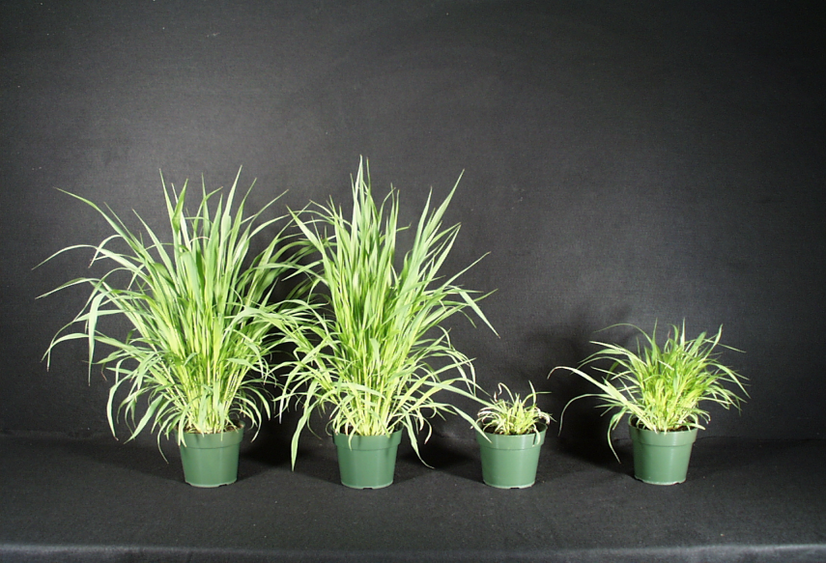
Not All Adjuvants are the Same
Untreated
Nicosulfuron Alone
+ 0.2% NIS
+ 0.1% NIS

Slide 9
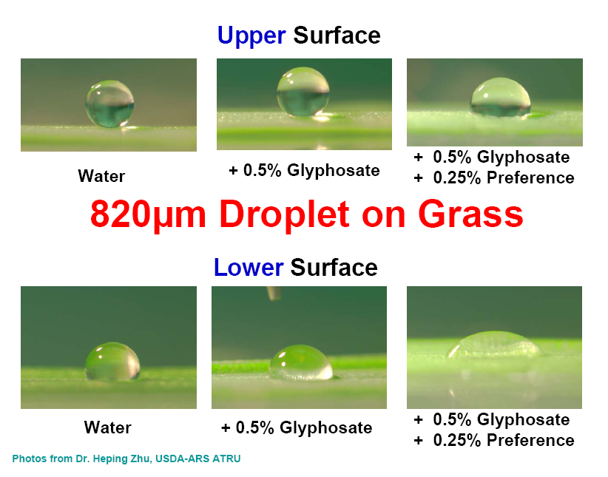

Slide 10
Adjuvant descriptors:
Wetting
Spreading
Sticking
Softening Water
Improving Absorption
Drift Reducing
Defoaming
Multipurpose?
Utility Adjuvants

Slide 11
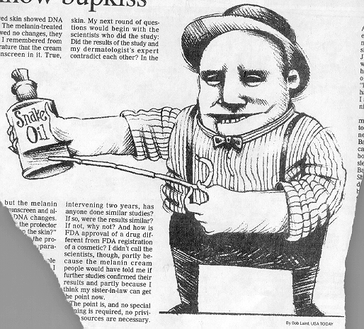
Drift Reduction/Deposition Aids:
Many available!
Not EPA regulated
Long chain polymers
Soluble powders
50 - 80% reduction in off-target movement
Not all will work!!!!
Pump shear problems
Effect on the pattern?
Deposition Aids

Slide 13
Drift Study

Slide 14
Product Name | Product Company | Mixing rateª
Tap water 1 | Local supply | X-77 only
Superb HC + Interlock | Winfield Solutions | 133 oz + 33 oz / 50 gal
Formula 1 | United Suppliers | 1.5 qt / 50 gal
#PX056-Z | Precision Labs, Inc | 5 qt / 50 gal
Tap water 2 | Local supply | X-77 only
Ag 06037 | Winfield Solutions | 64 oz / 50 gal
Ag 08050 | Winfield Solutions | 80 oz / 50 gal
Interlock 1.25 | Winfield Solutions | 80 oz / 50 gal
Control | GarrCo Products, Inc | 2 oz /50 gal
Tap water 3 | Local supply | X-77 only
INT 908 | Rosen’s | 5 gal / 45 gal
Tap water + Prime Oil^{b} | Local supply + Winfield Solutions | 266 oz / 50 gal
Interlock 0.8 | Winfield Solutions | 50 oz / 50 gal
ª All tank mixes included X-77 at .25% v/v (16 ounces per 50 gallon load).
^{b}Oil to simulate a suggested tank mix with fungicide (Prime Oil @ 1 pint/acre).

Slide 15
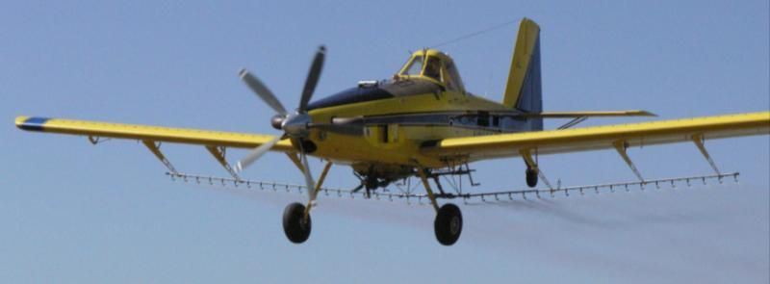
Materials and Methods (2008):
AT 502A(Rucker Flying Service)
Drop booms
CP-11TT #15 straight stream nozzles w/8° deflection
44 PSI
156 mph ground speed by GPS
Droplet spectrum: Medium, %volume <200 = 7.65%
Aircraft calibrated for 3 GPA

Slide 16
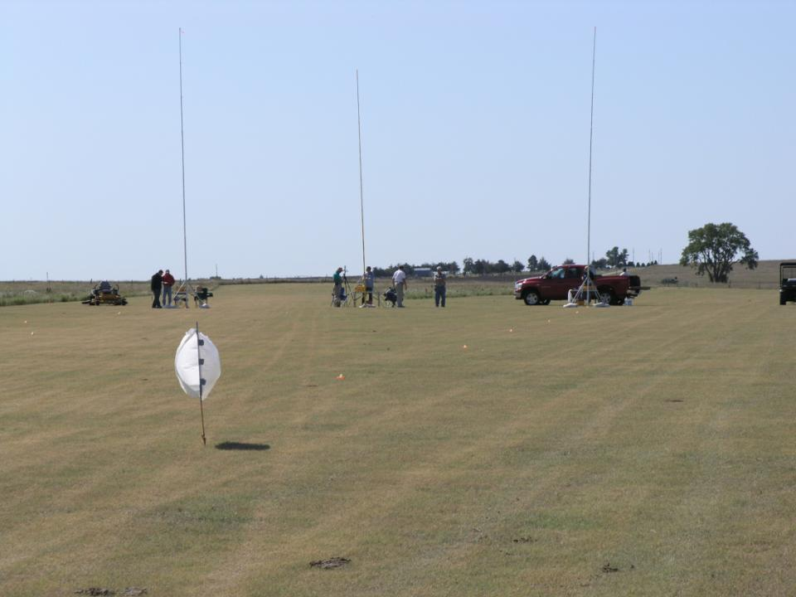
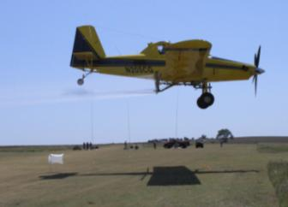
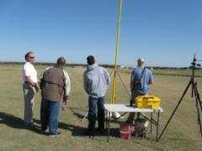

Slide 17
Treatment VMD’s:

Slide 18
Total Drift Ranked:
water average
g
fg
ef
ef
bcd
cde
cde
de
% Area Coverage
abc
ab
a
a
a

Slide 19
Corn Fungicide Studies

Slide 20
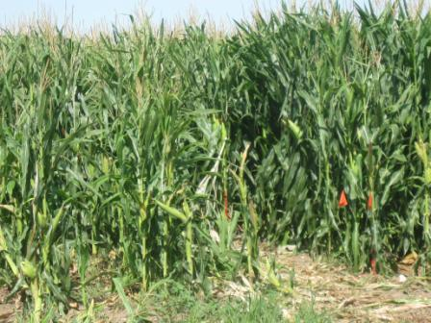

Slide 21
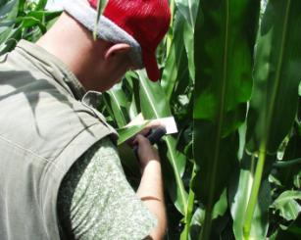
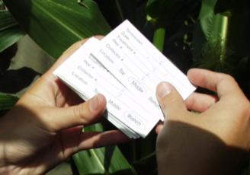
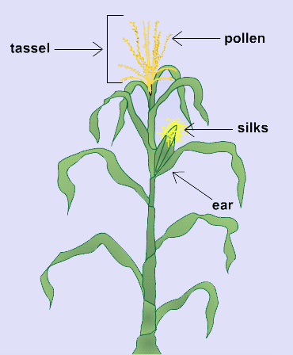
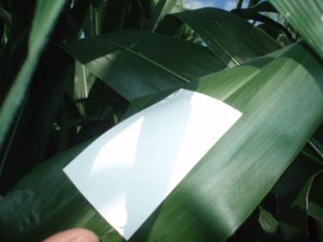
Plot 65 ft.
Row 1
Row 10
Center row
Card & Plant heights

Slide 22
2007
ab
a
c
bc
bc
bc
bc
c
NS
Droplet Size Affects
b
a
ab
ab
ab
ab
ab
ab
ab
NS
Crop Oil Concentrate (COC)
Non-ionic Surfactant (NIS)
Methylated Seed Oil (MSO) & NIS & Controlled Release Fertilizer (25-0-0 B)
NIS & Interlock
Quilt & NIS
MSO + Organosilicone Surfactant Blend & Controlled Release Fertilizer (25-0-0 B)
High Surfactant Oil Concentrate & Interlock
NIS + AG 06037
NIS + AG 06038
AR 9. COC + Control

Slide 23
Coverage
2008
All treatments – Headline @ 6 ounces/acre
Premium COC @ 16 oz
Between @ 8 oz
Downdraft @ 4 oz
USEX0108 @ 4 oz
USEX0108 @ 8 oz
6. USEX0208 @ 4 oz
USEX0208 @ 8 oz
USEX0308 @ 4 oz
USEX0308 @ 8 oz
SRN-28 + Between @ 8 oz

Slide 24
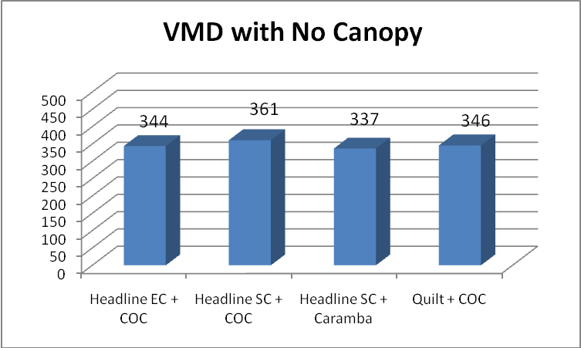
2009

Slide 25
Solution Factor:
Changes the flow rate ?????
Changes the droplet spectra !!!!

Slide 26
Droplet Studies

Slide 27
Volume Median Diameter (VMD)
% less than 210 Microns
37
51
36
35
45
23
30
14
15
26
19
22
14
13
22
10
17
29
29
15
Percent fines
40 psi 40 psi 40 psi 70 psi
Bob Klein, U of Nebraska

Slide 28
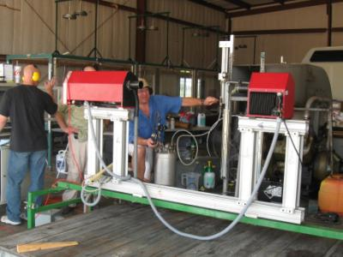
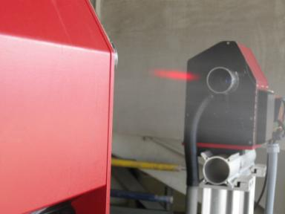
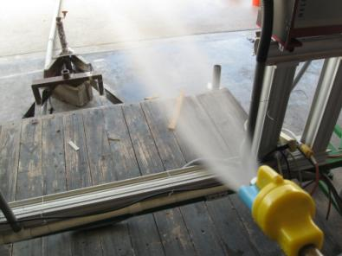
Need to evaluate droplets of solutions:

Slide 29
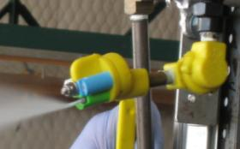
CP11TT4015 Flat-Fan
140 MPH
40 PSI
23 degree orientation

Slide 30
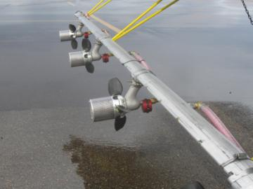
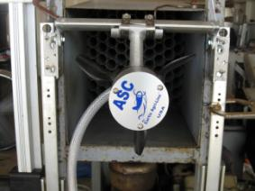
ASC D-12 Rotary Atomizer
140 MPH
26 PSI
2 GPA
Blade pitch #2

Slide 31
ASC D-12 Rotary Atomizer
Treatments
Water
Water + Quilt
Water + Quilt + Foliar Fertilizer
Water + Quilt + NIS
Water + Quilt + COC
Water + Quilt + Deposition Aid
140 MPH
26 PSI
2 GPA
Blade pitch #2

Slide 32
CP11TT4015 Flat-Fan
Treatments
Water
Water + Quilt
Water + Quilt + Foliar Fertilizer
Water + Quilt + NIS
Water + Quilt + COC
Water + Quilt + Deposition Aid
140 MPH
40 PSI
23 degree orientation

Slide 33
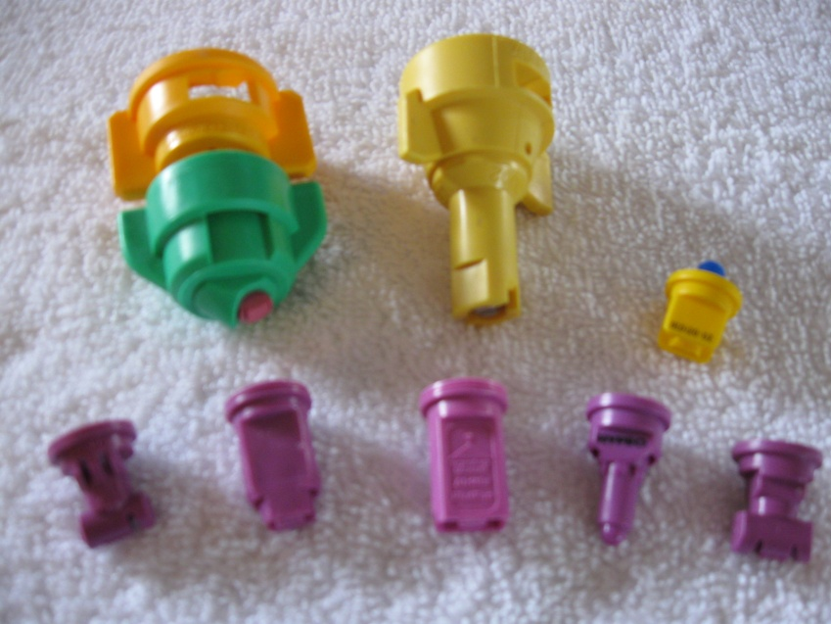
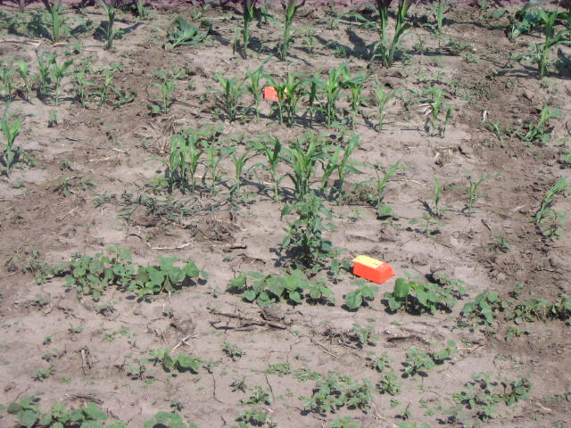
Ground Nozzle Field Trials

Slide 34
Solution Effect – College Station in the Wind Tunnel

Slide 35
Solution Effect - North Platte - Lab Using Product
Nozzle Type | PSI | Water | Glyphosate | Paraquat
TT110025 | 40 | 302 | 314 | 272
AIXR110025 | 40 | 438 | 410 | 429
AM110025 | 40 | 427 | 415 | 427
GA110025 | 40 | 414 | 367 | 397
TTJ60110025 | 40 | 340 | 370 | 290
AIC11002 | 70 | 488 | 428 | 423
ULD12002 | 70 | 347 | 339 | 342
TDHSTF11002 | 70 | 403 | 363 | 385

Slide 36
Summary
Adjuvants allow for more consistent pesticide activity and should be viewed as a safety net for performance.
Adjuvants optimize pesticide efficacy
In general, adjuvants don’t create value….they retain the value of the pesticide.

Slide 37
Summary cont’d
The idea of superior adjuvants allowing for reduced pesticide application rates to save money should be discouraged.
This may have only been true with glyphosate.
The next 10 years will rely on herbicides without large amounts of rate flexibility so the goal of the adjuvant will be to simply just achieve acceptable control levels.

Slide 38
Calibration!!!! The next phase!
A new concept for applicators!
Ensuring that the spray droplet spectrum is what it is supposed to be to maximize efficacy while minimizing drift!

Slide 39
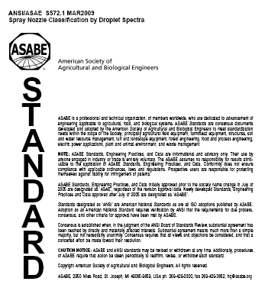
ASABE S-572 Droplet Size Standard

Slide 40
Spray quality categories.
ASABE Standard S-572.1
Category (symbol) | Color Code
Extra Fine (XF) | Purple
Very Fine (VF) | Red
Fine (F) | orange
Medium (M) | yellow
Coarse (C) | Blue
Very Coarse (VC) | Green
Extra Course (XC) | White
Ultra Coarse (UC) | Black
2009

Slide 41
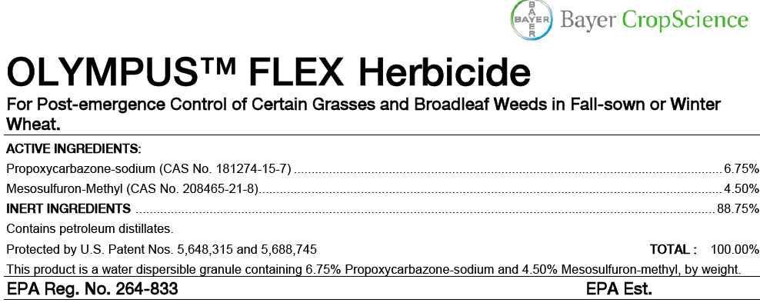

Slide 42
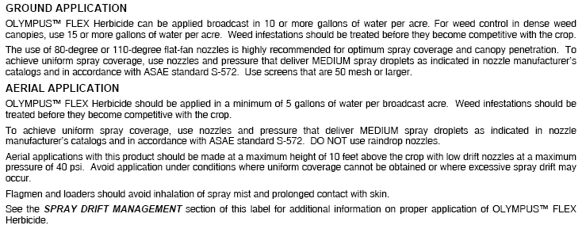
Page 4

Slide 43
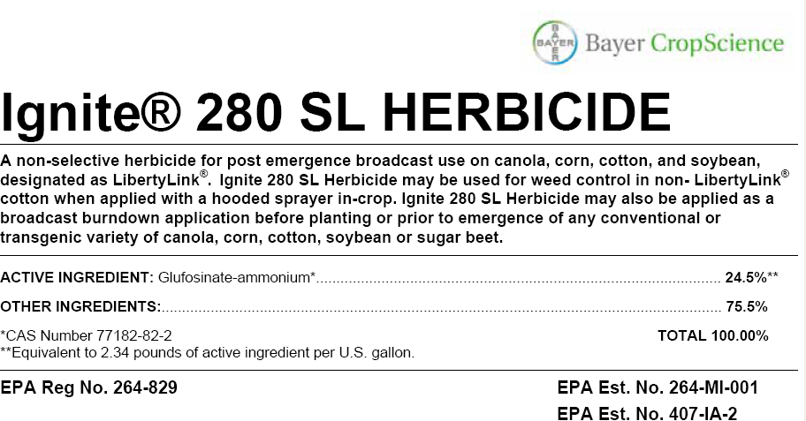

Slide 44
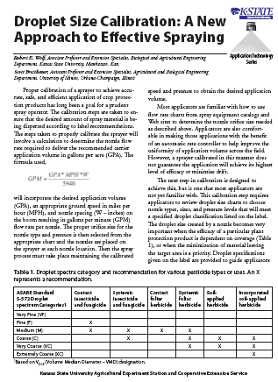
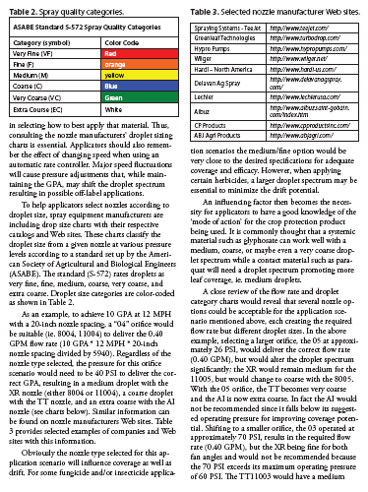
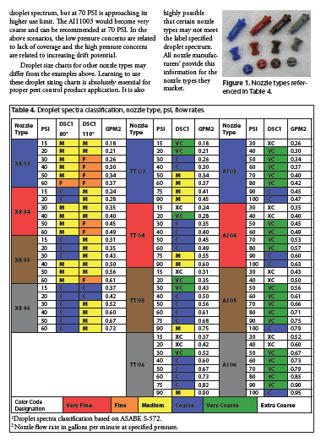
Fact Sheet: MF2869
www.bae.ksu.edu/faculty/wolf/

Slide 45
Disclaimer:
Brand names appearing in this presentation are for identification and illustration purposes only.
No endorsement is intended, nor is criticism implied of similar products not mentioned.

Slide 46
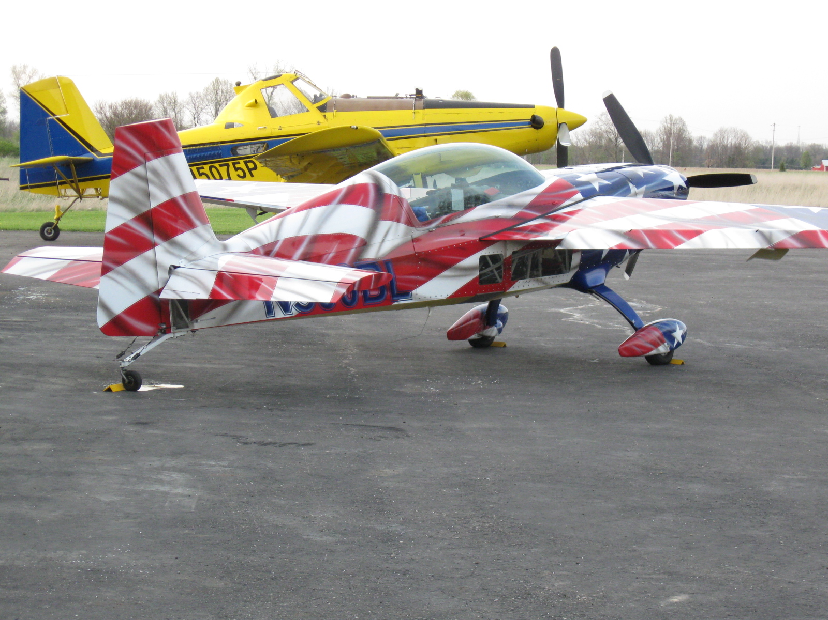
rewolf@ksu.edu
For more information contact:
Thanks!
www.bae.ksu.edu/faculty/wolf/

