Slide 1


Train-the-Trainer
Crop Production PFT
Robert E. Wolf
Extension Specialist Application Technology
Biological and Agricultural Engineering
Notes:
Use either title slide. Hide the one you do not want to use.

Slide 2
Train-the-Trainer Outline:
Calibration
Nozzle type discussion
Using the demonstration table
Calibration

Slide 3
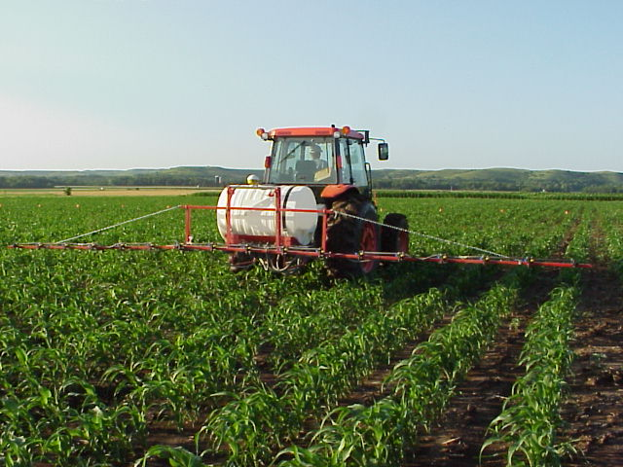
Accurate And Efficient Applications
Increase Efficacy
Minimize Drift
Maximize Productivity
Notes:
Many technological changes have occurred in the spray industry in recent years. Much attention has been given to application equipment to increase efficiency and minimize spray drift. This presentation is designed for you to share some of these application technologies in ground application with your applicator audiences. Equipment design changes have occurred in all forms of ground application. Much of the improvements has been directed at the reduction of spray drift.

Slide 4
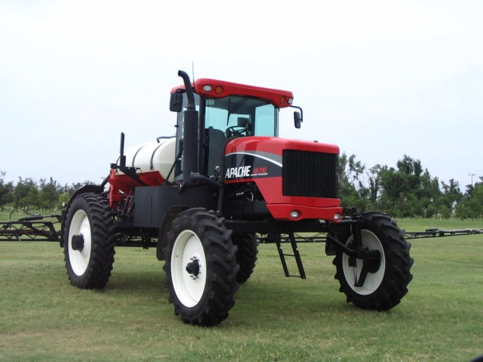
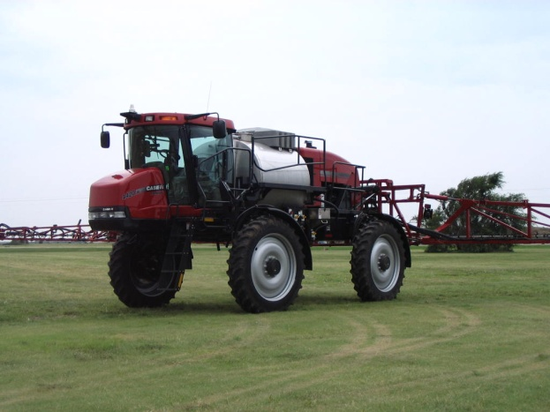
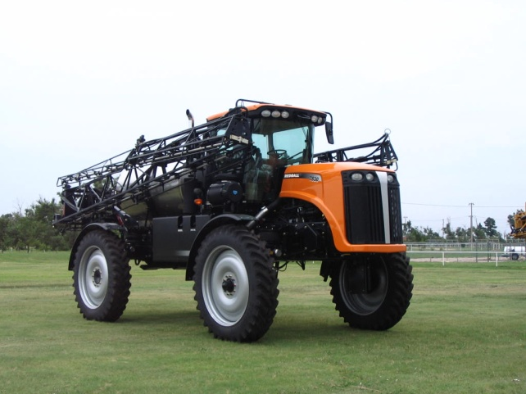
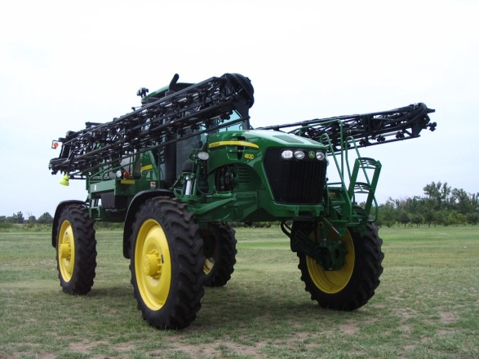
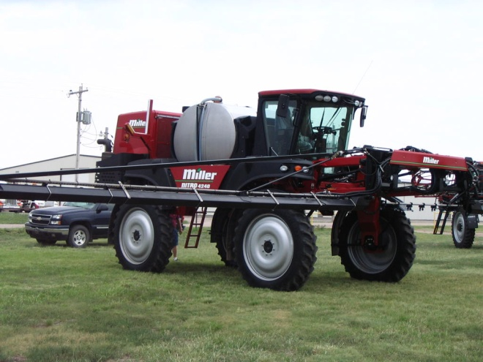
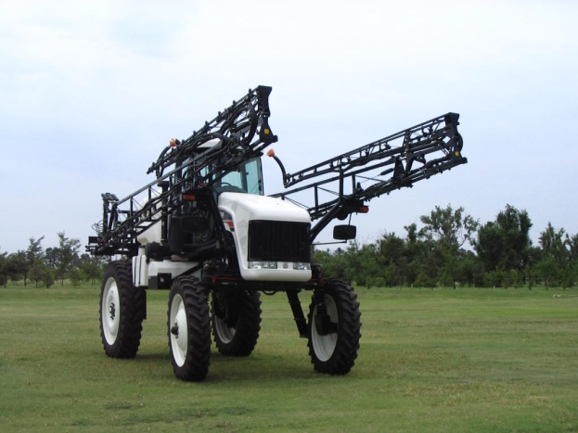
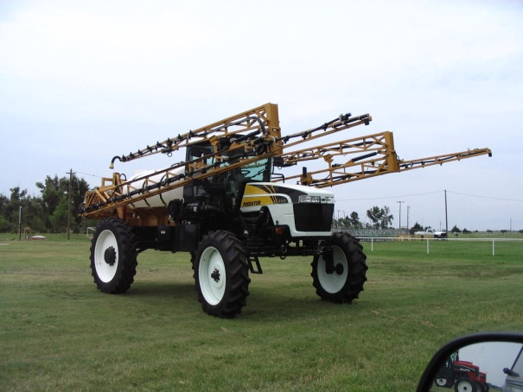
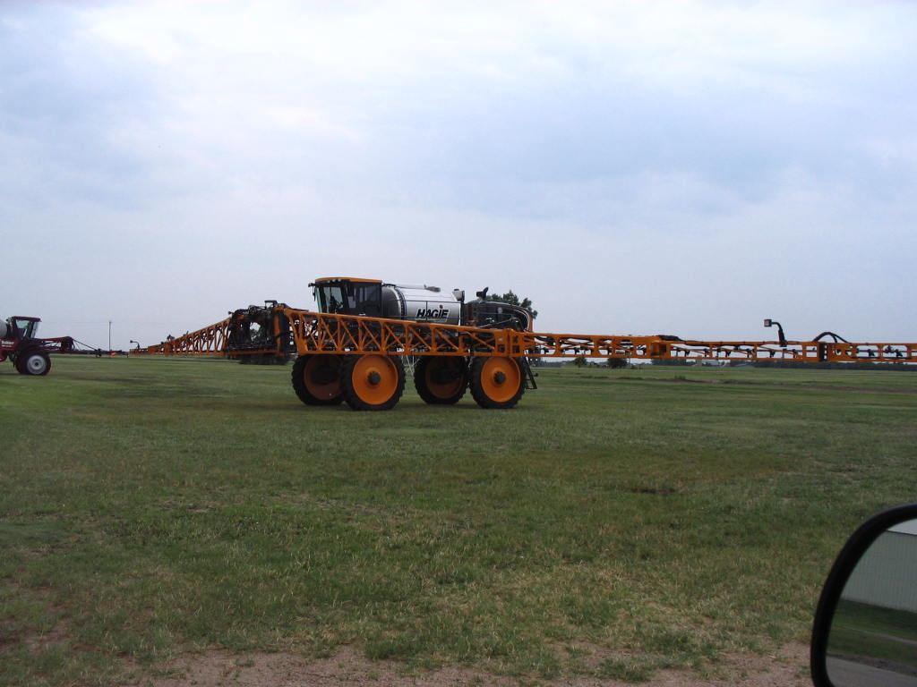
Options?

Slide 5


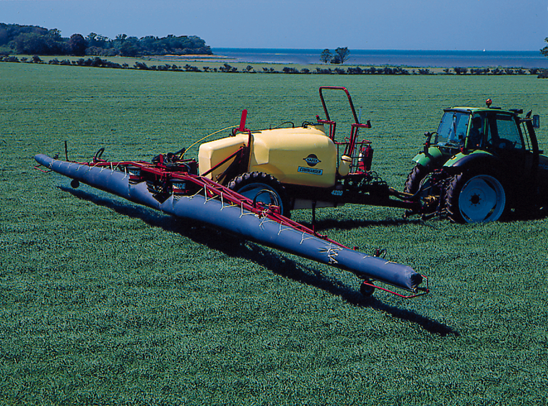
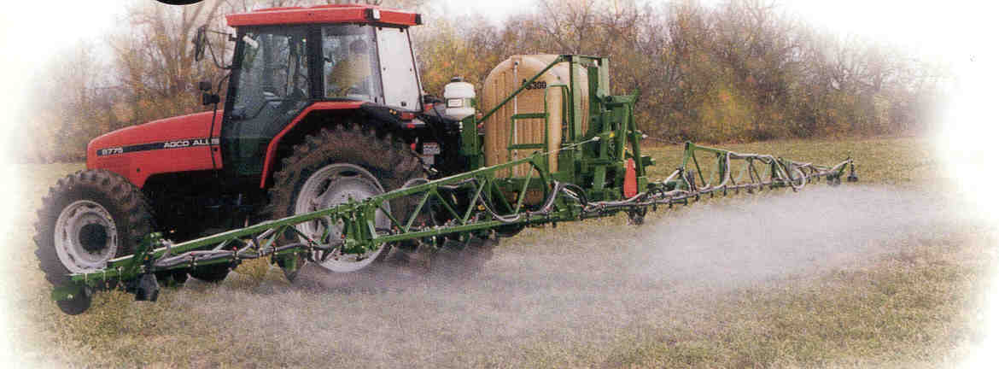
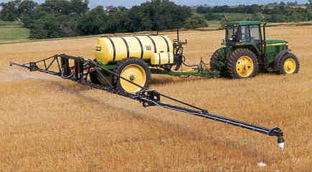
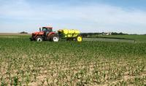
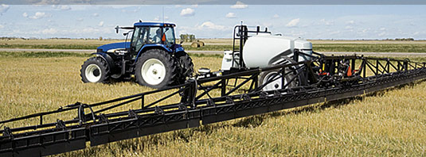
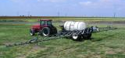
Options?

Slide 6
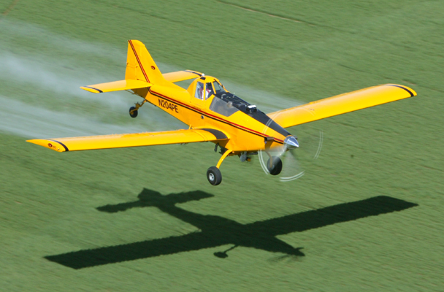
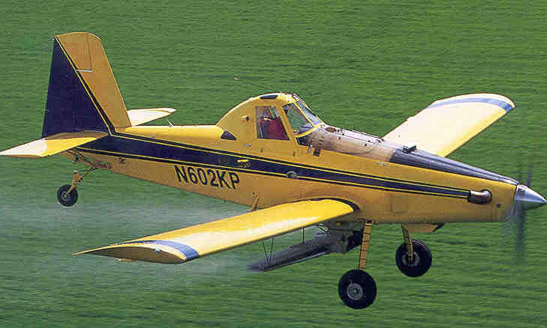


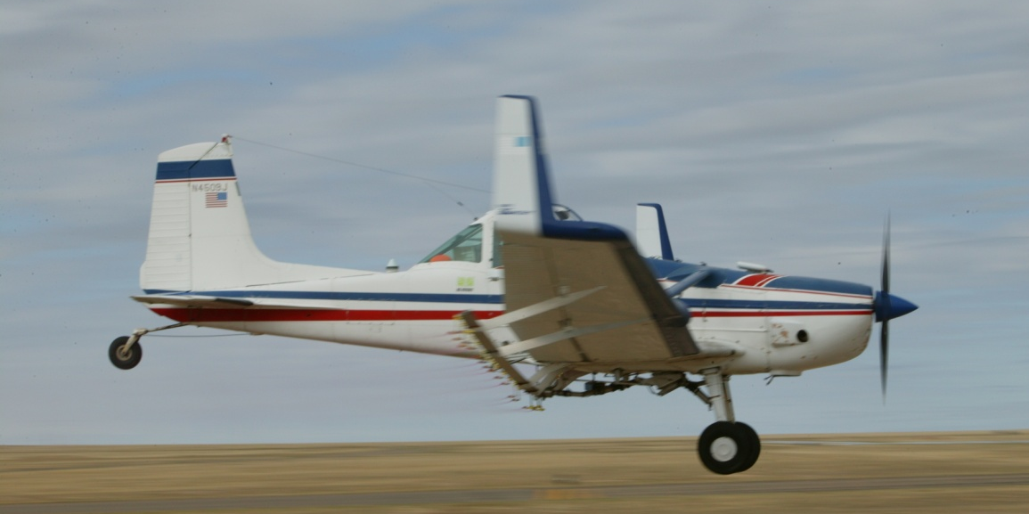

Slide 7
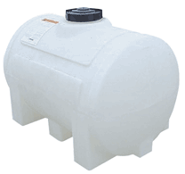
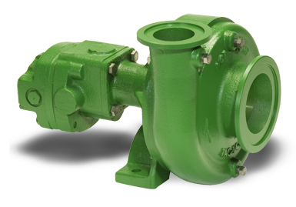
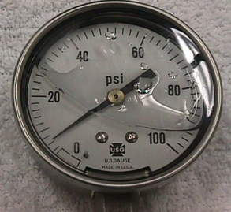
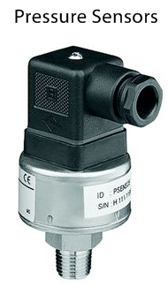
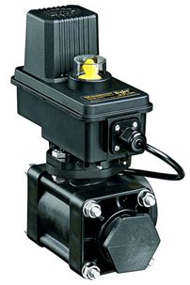
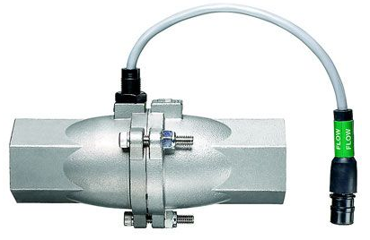

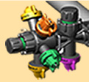
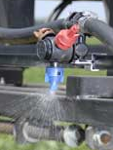
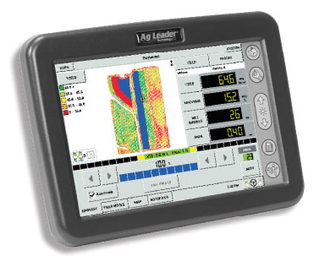
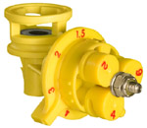
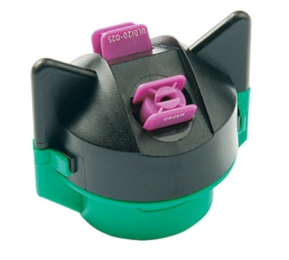
Sprayer Components:
Tanks – poly, stainless
Pump, Strainers, Agitation
Pressure gauge
Hoses, Flow control assemblies
Electronics: monitors-computers- controllers (GPS/GIS)
Distribution system
Nozzles – Not expensive but KEY!
Notes:
Regardless of how much it cost most spray systems will have similar components. Some may be fancier but all doing the basic functions. Go to next slide at bullet #2. This slide reappears to continue discussion.

Slide 8
Nozzles are important because:
Control the amount – GPA.
Determine uniformity of application.
Affects the coverage.
Influences the drift potential.
Notes:
These are my points to emphasize the nozzles importance. The next several slides will explain or highlight each point in more detail.

Slide 9
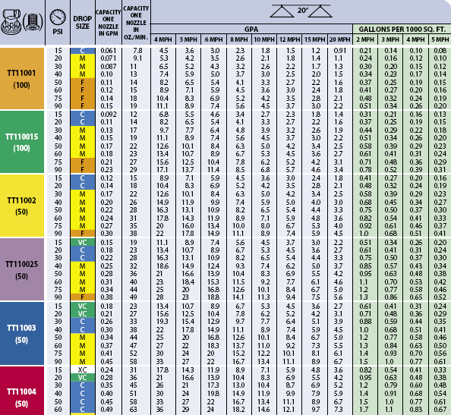
Nozzle Controls amount applied:
Nozzle Flow Rate is affected by:
Orifice size
Pressure
Solution characteristics
Page 174
Page 9

Slide 10
Calibration!!!!
GPA
Ensuring that the spray output is what it is supposed to be!
2010 Chemical Weed Control, pp. 4-10
Calibrating Boom Sprayers – MF2894

Slide 11
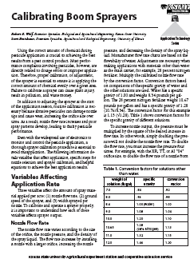
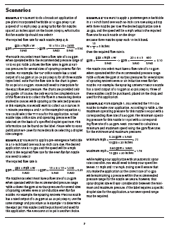
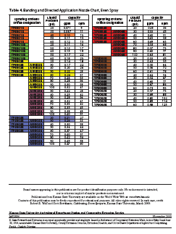
Fact Sheet: MF2894
www.bae.ksu.edu/faculty/wolf

Slide 12
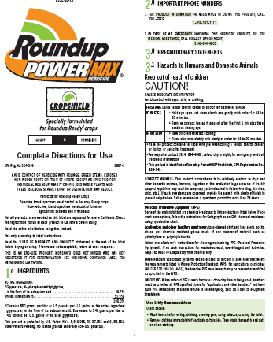
Calibration/Nozzle Selection:
What is the first step?
Use label to select the
  application volume
  product rate
Choose an appropriate travel speed - MPH
Effective width of application
  nozzle spacing
Calculate GPM – Flow rate per nozzle
Select the correct size of nozzle!
Notes:
This emphasizes my philosophy on calibration and leads into selecting the correct nozzle size. Begins with the label (the law), then based on travel speed. Nozzle spacing is used but typically does not change – usually 20-inches. Formula on next slides with example of a calculation.

Slide 13
Flow Rate Equation:
Equation
See Page 173, TeeJet Catalog 50A
Calculates for amount of flow from one nozzle
Represents the size of nozzle to put on the sprayer
Notes:
This is the key formula.

Slide 14
GPM Example Solution:
.30gpm
Answer
Notes:
Example of 12 gpa at 12 MPH. Will need an orifice to deliver 0.48 gpm. Pressure to be determined on following slide.

Slide 15
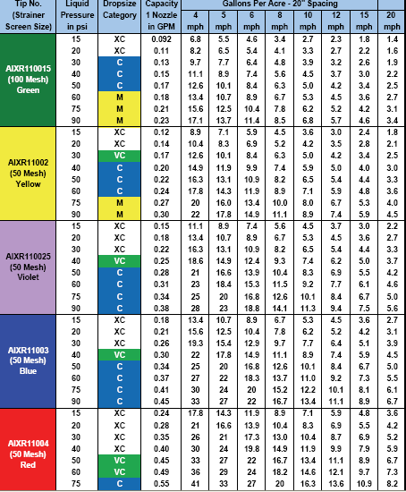

Selecting the proper nozzle….
Page 9, 12, 14, 15
Calculate GPM (formula)
Look under GPM column
Match to pressure-psi
Choose the size needed
Operate at given pressure and speed used in formula to achieve GPA
.30
Notes:
Select the pressure to suit the nozzle type. Bigger the orifice the lower the pressure. Pressure gage is used to emphasize that the pressure should be monitored at the nozzle for the most accurate flow rate measurement.

Slide 16
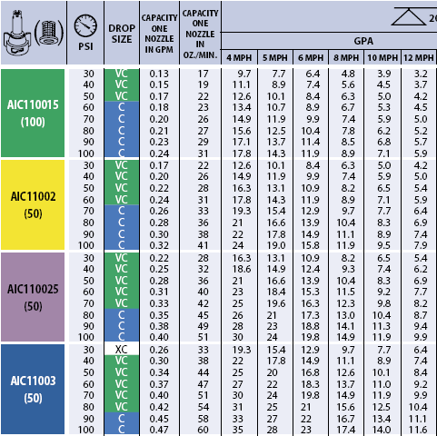
Selecting the proper nozzle….
Page15
Calculate GPM (formula)
Look under GPM column
Match to pressure-psi
Choose the size needed
Operate at given pressure and speed used in formula to achieve GPA
.30
Notes:
Select the pressure to suit the nozzle type. Bigger the orifice the lower the pressure. Pressure gage is used to emphasize that the pressure should be monitored at the nozzle for the most accurate flow rate measurement.

Slide 17
Scenarios

Slide 18
GPM Example Solution:
Answer

Slide 19
Convert to OPM:
OPM = GPM x 128 =
OPM = ____ x 128 =
ounces

Slide 20
MPH Example:
Your sprayer is set up with flat fan nozzles spaced at 20-inches with a measured flow rate of .40 GPM. Your desired application volume is 12 GPA. What would be the MPH required when using these nozzles to achieve this GPA?
What PSI should be used?

Slide 21
MPH Example Solution:
MPH=?
GPM=?
GPA=?
W=?
MPH?
GPM=.40
GPA=12
W=20

Slide 22
MPH Example Solution:
9.9
Answer

Slide 23
MEASURE SPEED
(1 MPH = 88 Feet traveled in 60 seconds)
Measure the ground speed in an area similar to the conditions of the area to be sprayed!
Notes:
15

Slide 24
Determining MPH Example:
A sprayer takes 22 seconds for the first pass and 24 seconds for the return pass to travel a measured course of 200 feet, what is the speed in MPH?
22
24
23
200
5.9
23
See Page 173, TeeJet Catalog 50A

Slide 25
Spray Solution Characteristics:
Surface Tension
B. Density
C. Viscosity
Effects droplet size, not flow
Weight/unit volume
density - flow rate decreases
Resistance to flow
Notes:
11

Slide 26
Conversion for a 28% solution:
28% = _______ lbs/gal
Specific Gravity =
Weight of 28%/gal divided by
weight of water/gal
=
Notes:
17

Slide 27
Conversion for a 28% solution:
10.65
28% = _______ lbs/gal
Specific Gravity =
Weight of 28%/gal divided by
weight of water/gal
10.65
=
1.28
8.34
See Page 174, TeeJet Catalog 50A
Notes:
18

Slide 28
Conversion factor =
square root of specific gravity of 28%
1.13
x =
1.13
Calibrated flow rate
Notes:
20

Slide 29
Conversion factor – earlier example:
square root of specific gravity of 28%
1.13
.34
.30 x =
1.13
Calibrated flow rate
Adjusted flow rate
Notes:
20

Slide 30
Calibration Steps – a review:
1. Select application rate
from the label
2. Select an appropriate ground speed
3. Determine effective sprayed width
4. Determine the flow rate required
5. Select nozzle that will give the required flow rate
6. Convert flow rate from GPM to OPM
7. Collect the output from one or all nozzles
8. Determine the amount of pesticide needed - label
9. Operate the sprayer at speed from step 2
10. Check flow frequently- compare all nozzles

Slide 31
Nomenclature:
Extended Range
Trade Name
(S,H,P,K,SS)
Stainless Steel Insert Orifice
VisiFlo Color Coding
Fan angle and flow rate-orifice size
Rated Pressure =
40 psi for most nozzle types
10 psi for turbo flood nozzles
Notes:
7

Slide 32
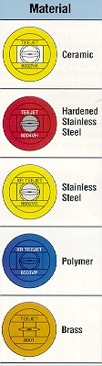
MATERIALS AND WEAR
Percent increase in nozzle flow rate
Flat-fan spray nozzles after 40 hour test
Notes:
8

Slide 33
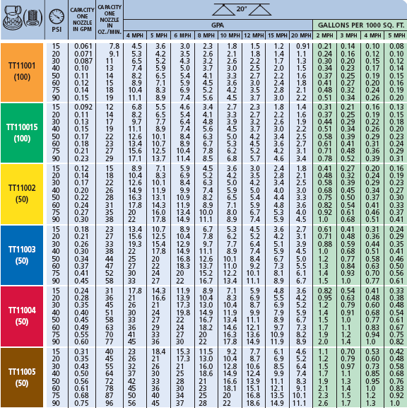
Nozzle Selection Chart:
Page 9 – Turbo Flat-fan
Page 12 – XR Fat-fan
Page 15 – AI Flat-fan

Slide 34
Nozzle Replacement:
Replacing worn spray nozzles protects against the danger of a chemical misapplication.
A combination of calibration and visual observation can be used to determine whether nozzles need to be replaced.
  Increased flow rate
  Poor patterns

Slide 35
Nozzle Replacement:
Nozzle material
Sprayed solution
Pressure used
Cost of application error vs nozzle replacement cost

Slide 36
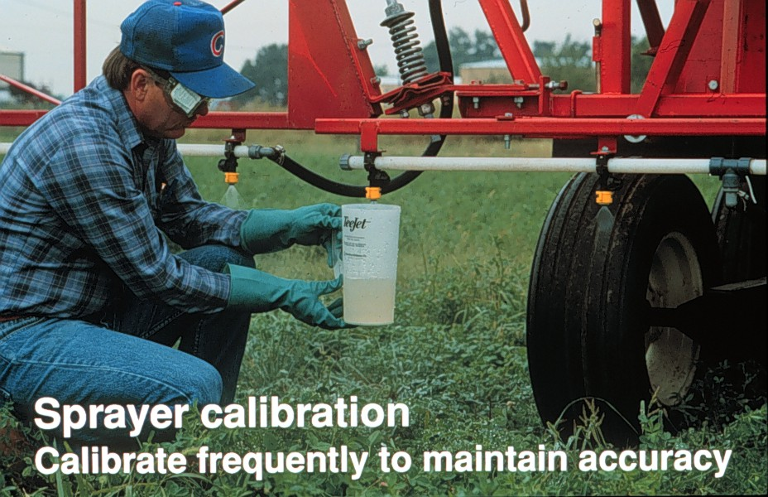
Notes:
Final check for accuracy. The container over a time collection is the most valid and easy method.

Slide 37
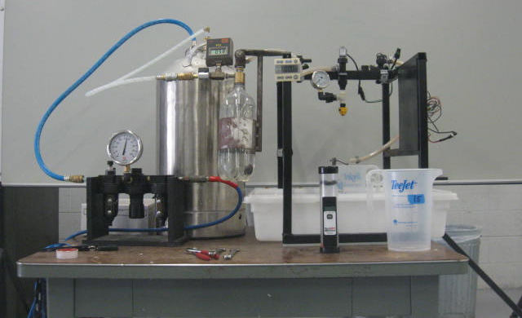
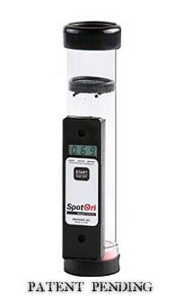
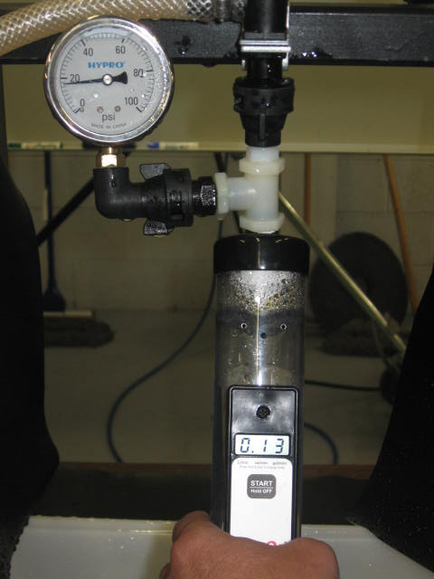
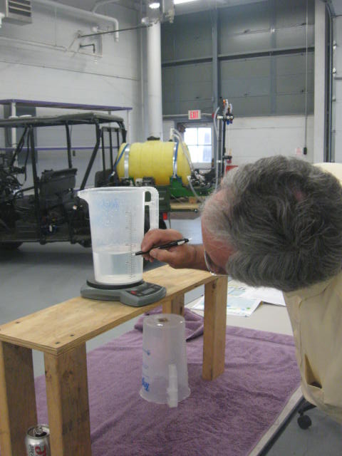
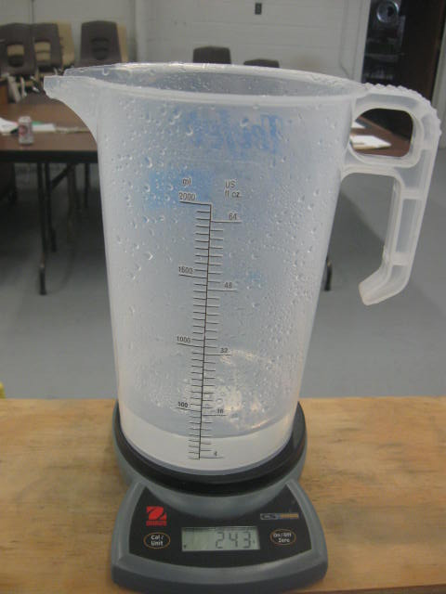
SpotOn Electronic Calibration Tool
Successful Farming Sponsored and will publish findings.
Scott Bretthauer - U of I
Jim Wilson - SDSU
Randy Taylor - OSU
Bobby Grisso & Pat Hipkins - VTU
Mark Hanna – ISU
Bob Wolf – KSU

Slide 38
Checking for accuracy
Check several new nozzles
  flow rate within 5-7% of desired output?
Check flow rate frequently
  adjust pressure to compensate for small changes output due to wear
Replace nozzles & recalibrate when:
  output > 7% change from new nozzle
  when pattern becomes uneven
Notes:
EQU 45

Slide 39
2. Set up for Uniformity:
Goal is to put the material on evenly from nozzle to nozzle, end of boom to end of boom, and across the entire field. A 20-inch spacing requires 17-19” above target for 50-60% overlap. Nozzle mount angle?

Slide 40
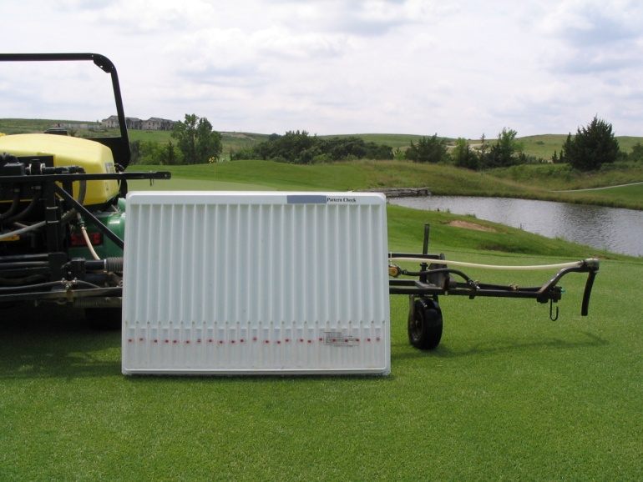
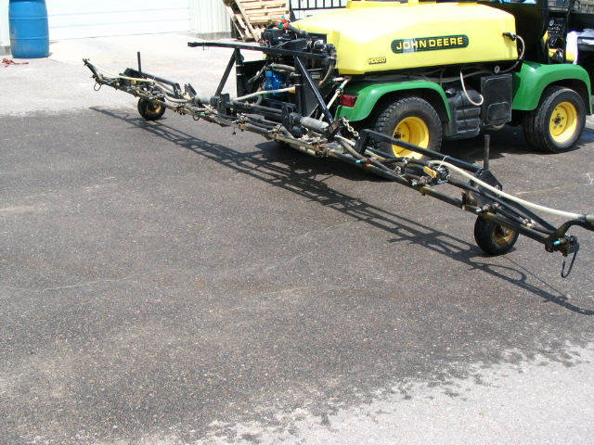
Replacement decision:
Pattern quality

Slide 41
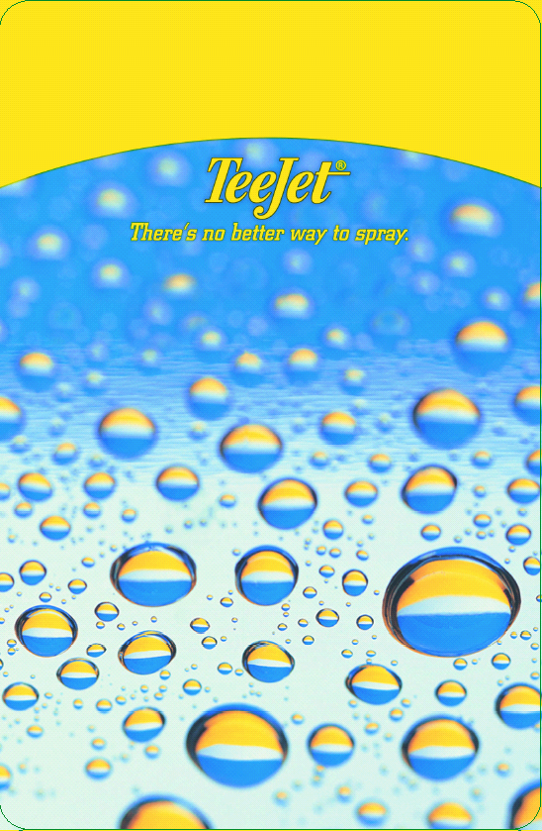

Slide 42
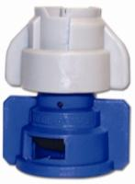
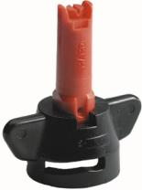
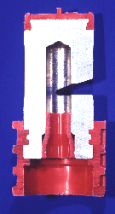











Nozzle Technology
Nozzles designed to reduce drift
Improved drop size control
Emphasis on ‘spray quality’
Notes:
Beginning with the ‘extended range’ flat fan nozzle (all major manufactures have one), continuing with the design of ‘preorifice inserts’ and ‘turbulation chambers’, and now with the ‘venturi’ style nozzle design, nozzle manufacturer's have worked to develop nozzles that are improving the quality of spray emitted.

Slide 43

Spray Characteristics are Important
Demonstrates Turbo Flat vs TurboDrop-5 MPH Wind

Slide 44
Nozzle Efficacy/Drift Slope
1980
30 years
Reducing Spray Drift
Extended Range
Nozzle development timeline
XR, TR
Turbo Flood
Turbo TeeJet
Wilger Designs
Air Mix
AI XR
GuardianAir
AI
Ultra Low Drift
Turbo Drop
TTI
Chamber Design
Venturi Design - II
Venturi Design - I
Efficacy
2010

Slide 45

Is this tip good or bad?

Slide 46
Demo – Pattern check

Slide 47





Nozzles Types?
air induced
Flat Spray Patterns
flat-fan
chamber
Notes:
Beginning with the ‘extended range’ flat fan nozzle (all major manufactures have one), continuing with the design of ‘preorifice inserts’ and ‘turbulation chambers’, and now with the ‘venturi’ style nozzle design, nozzle manufacturer's have worked to develop nozzles that are improving the quality of spray emitted.

Slide 48

Nozzles Types?
Notes:
Beginning with the ‘extended range’ flat fan nozzle (all major manufactures have one), continuing with the design of ‘preorifice inserts’ and ‘turbulation chambers’, and now with the ‘venturi’ style nozzle design, nozzle manufacturer's have worked to develop nozzles that are improving the quality of spray emitted.

Slide 49
Demo – extended range flat-fan

Slide 50

Extended Range Flat-Fan
Tapered edge pattern
80 and 110 degree fan
Requires overlap - 50 to 60%
15-60 psi range
Unless - working with higher application volumes
10 GPA and above - Fungicides

Slide 51
Nozzles Types?
Notes:
Beginning with the ‘extended range’ flat fan nozzle (all major manufactures have one), continuing with the design of ‘preorifice inserts’ and ‘turbulation chambers’, and now with the ‘venturi’ style nozzle design, nozzle manufacturer's have worked to develop nozzles that are improving the quality of spray emitted.

Slide 52


Turbo Flat-fan:
chamber
See Page 9, TeeJet Catalog 50A
Pre-orifice
Turbulence chamber as in the Turbo Flood
Tapered edge, wide angle flat pattern
Designed to work in flat-fan nozzle holder
Uniform spray distribution, 50-60% overlap
Wide pressure range, 15 – 90 psi
Large, drift resistant droplets
Plastic with superior wear characteristics
Exit orifice
Notes:
18

Slide 53



New Release In 2006
See Page 10, TeeJet Catalog 50A
Dual outlet
Superior leaf coverage
Droplet range slightly larger that comparable TT flat-fan
Turbo TwinJet

Slide 54
Demo – turbo flat-fan

Slide 55

Nozzles Types?
Notes:
Beginning with the ‘extended range’ flat fan nozzle (all major manufactures have one), continuing with the design of ‘preorifice inserts’ and ‘turbulation chambers’, and now with the ‘venturi’ style nozzle design, nozzle manufacturer's have worked to develop nozzles that are improving the quality of spray emitted.

Slide 56



Air-Induction/Venturi Nozzles
Where air is drawn into the nozzle cavity and exits with the fluid.
Notes:
Several venturi style nozzles are manufactured and used for the application of crop protection products. Please refer to manufacture recommendations for information on how to use the venturi tips correctly. Also be aware that research is ongoing to learn more about the operating parameters for venturi nozzles.

Slide 57







Pre-Orifice VENTURI Nozzles
See Page 15, TeeJet Catalog 50A
Pre-orifice
Air induction
Mixing Chamber
Exit orifice

Slide 58



Air Induction Nozzle for Maximum Drift Control:
See Page 11, TeeJet Catalog 50A
More compact
Larger drops
Operates at lower pressures
Percentage of fines do not increase with pressure
Turbo Injection - TTI
AITTJ60
Turbo TwinJet Induction

Slide 59
Demo –venturi flat-fan

Slide 60
Demo –turbo venturi flat-fan

Slide 61
Wind Tunnel Drift Results:
Flat-fans
40 PSI
Chamber's
Venturi's
70 PSI
20 PSI
LSD = 12.7

Slide 62
Improving Potential
For Efficacy

Slide 63



Slide 64


New release in 2007:
See Page 14, TeeJet Catalog 50A
XR outlet with venturi air aspirator design
More compact than AI style
2-piece with removable pre-orifice
AI XR TeeJet

Slide 65




GuardianAir Induction:
More consistent droplet
All-in-one cap and screen
Wide angle with 15 degree incline toward the rear
Aim forward or rearword – alternate?
See Page 16, Hypro Spray Tip Guide
GuardianAir

Slide 66
Demo –AM, AIXR Guardian

Slide 67







Slide 68
Demo – TDHSTF

Slide 69


Off-Center Venturi Flat-fan

Slide 70



Boom Buster

Slide 71


XP BoomJet

Slide 72

Boom Extender:

Slide 73
Demo – ROW Nozzles

Slide 74

Nozzles-Recommended Use
flat spray
20-25 PSI
chamber
30-40 PSI
IN BETWEEN VENTURI
40 PSI
air induced/venturi
50-80 PSI
Notes:
Beginning with the ‘extended range’ flat fan nozzle (all major manufactures have one), continuing with the design of ‘preorifice inserts’ and ‘turbulation chambers’, and now with the ‘venturi’ style nozzle design, nozzle manufacturer's have worked to develop nozzles that are improving the quality of spray emitted.

Slide 75
Break

Slide 76





3. Spray Droplet Management!
Need knowledge of the product being used.
Herbicide, Fungicide, Insecticide
  Systemic
  Contact
What is the target?
  Soil
  Grass
  Broadleaf (smooth, hairy, waxy)
  Leaf orientation – time of day
  Penetration into canopy

Slide 77


4. Will affect drift:
Movement of spray particles off-target.
Creating smaller spray drops will result in increased drift.
Is it Coverage vs Drift?
What is the answer?
$64,000 Question?
Notes:
And of course the nozzle will influence drift. There is a magic line to separate drift from good coverage.

Slide 78
Calibration!!!!
The next phase!
A new concept for applicators!
Ensuring that the spray droplet spectrum is what it is supposed to be to maximize efficacy while minimizing drift!
Droplet Size Calibration: A New Approach to Effective Spraying – MF2869

Slide 79

2009
ASABE S-572.1 Droplet Size Standard

Slide 80

www.asabe.org

Slide 81
Spray Quality Categories
ASABE Standard S-572.1
Category (symbol) | Color Code
Extra Fine (XF) | Purple
Very Fine (VF) | Red
Fine (F) | Orange
Medium (M) | Yellow
Coarse (C) | Blue
Very Coarse (VC) | Green
Extra Coarse (XC) | White
Ultra Coarse (UC) | Black
2009
NEW
S572
NEW

Slide 82

ASABE Standard
>150
Fungicides/Insecticides
151-250
251-350
351-450
Herbicides
451-550
>551
Source: Crop Life – July 2002
Notes:
Summary chart with descriptions and approximate droplet sizes recommended. Important to mention the relative size so they can keep it in perspective.

Slide 83


Slide 84

Page 4

Slide 85



Slide 86
- 15 GPA
- Generate MEDIUM spray droplets (ASABE S-572)
- Do not use nozzles and pressures that result in COARSE sprays

Slide 87


See Page 182, TeeJet Catalog 50A

Slide 88

Droplet Selection/Calibration:
p. 15

Slide 89





Slide 90

Selecting The Proper Nozzle
Page 9, 12, 14, 15
Calculate GPM (formula)
Look under GPM column
Choose the size needed
Match pressure(psi) and Droplet Classification
Operate at given pressure and speed used in formula to achieve GPA and the desired droplet size
MEDIUM
0.30 gpm
Notes:
Select the pressure to suit the nozzle type. Bigger the orifice the lower the pressure. Pressure gage is used to emphasize that the pressure should be monitored at the nozzle for the most accurate flow rate measurement.

Slide 91



Fact Sheet: MF2869
www.bae.ksu.edu/faculty/wolf

Slide 92


www.hypropumps.com

Slide 93


Slide 94

www.turbodrop.com

Slide 95





Slide 96




Slide 97





Slide 98





Slide 99



Slide 100


Slide 101
Comparing Droplet Spectra – Example
Nozzle | PSI | DSC | Nozzle | PSI | DSC |  | Nozzle | PSI | DSC
TT 11002 | 90 | F | AI 11002 | 90 | C |  | GA11002 | 90 | M
TT 110025 | 59 | M | AI 110025 | 59 | VC |  | GA110025 | 59 | C
TT 11003 | 40 | C | AI 11003 | 40 | VC |  | GA11003 | 40 | C
TT 11004 | 23 | VC | AM11002 | 90 | F |  | CP65T-SL (3-6) | 35 | XC
TTI 11002 | 90 | XC | AM100025 | 59 | M |  | CP65T-SL (3-4) | 40 | XC
TTI 110025 | 59 | XC | AM11003 | 40 | C |  | Wilger SR80-025 | 41 | M
XR 80025 | 40 | M | TDXL11002 | 90 | F |  | Wilger DR110-02 | 64 | M
XR 110025 | 59 | F | TDXL110025 | 59 | M | C | Wilger SR110-03 | 28 | M
XR 8003 | 40 | M | TDXL11003 | 40 | VC |  | Wilger MR100-025 | 41 | M
XR 11003 | 40 | F | ULD12002 | 90 | M
XR 8004 | 23 | C | ULD120025 | 59 | C
XR 11004 | 23 | M | ULD12003 | 40 | C
AIXR 11002 | 90 | M
AIXR 110025 | 59 | C
0.30 gpm
MEDIUM
Ignite

Slide 102
Selected Nozzle Manufacturer Websites
Hypro Pumps | www.hypropumps.com
Greenleaf Technologies | www.turbodrop.com
Spraying Systems – TeeJet | www.teejet.com
Wilger | www.wilger.net
CP Products | www.cpproducts.com
Hardi – North America | www.hardi-us.com
Delavan Ag Spray | www.delavanagspray.com
Lechler | www.lechlerusa.com
ABJ Agri Products | www.abjagri.com

Slide 103

Strategies to Reduce Drift:
Select nozzle to increase drop size
Increase flow rates - higher application volumes
Use lower pressures
Use lower spray (boom) heights
Avoid high application speeds/rapid speed changes
Avoid adverse weather conditions
  High winds, light & variable winds, calm air
Consider using buffer zones
Consider using new technologies:
  drift reduction nozzles
  drift reduction additives
  shields, electrostatics, air-assist
Notes:
This list of ways to reduce drift is designed to encourage applicators to include as many of the strategies as possible into their daily application routine. One item alone may not prove successful. Many have thought the addition of drift control additives alone would be the cure all. Technological advancements are occurring that are showing promise in reducing drift. Encourage operators to be open minded regarding adoption even though many are coming with hefty price tags. The price of a drift claim as a comparison should always be kept in mind.
We can not eliminate drift, but by using good management and adopting spray practices with drift reduction in mind, improvements will occur.

Slide 104

Drift Reduction Additives:
Many available!
Not EPA regulated
Long chain polymers
Soluble powders
Reduction in off-target movement documented
Not all will work!!!!
Pump shear problems
Effect on the pattern?
Deposition Aids

Slide 105


Chemical Producers & Distributors Association

Slide 106
Total Drift Ranked:
water average
g
fg
ef
ef
bcd
cde
cde
de
abc
ab
a
a
a

Slide 107




Volume Median Diameter (VMD)
% less than 210 Microns
37
51
36
35
45
23
30
14
15
26
19
22
14
13
22
10
17
29
29
15
Percent fines
40 psi 40 psi 40 psi 70 psi
Bob Klein, U of Nebraska

Slide 108


Slide 109




Need to evaluate droplets of solutions:

Slide 110






Slide 111
Disclaimer
Brand names appearing in this presentation are for identification and illustration purposes only.
No endorsement is intended, nor is criticism implied of similar products not mentioned.

Slide 112
Thank You
Questions?

Slide 113

Wolf Consulting & Research LLC
Robert E. Wolf, PhD.
Professional Applicator Training / Technology Transfer
Contract Research
  Equipment Field Trials
  Drift Assessment
Applicator Management Services
15805 Stonington Drive
Wamego, KS 66547
Cell Phone: 785-770-7027
rewolf@ksu.edu
Understanding Application Technology

