Slide 1
NAAA/ASABE
Technical Session
Utilization of Additives to help Reduce Drift Potential
Robert E. Wolf
Associate Professor - Extension Specialist Application Technology
Biological and Agricultural Engineering

Slide 2
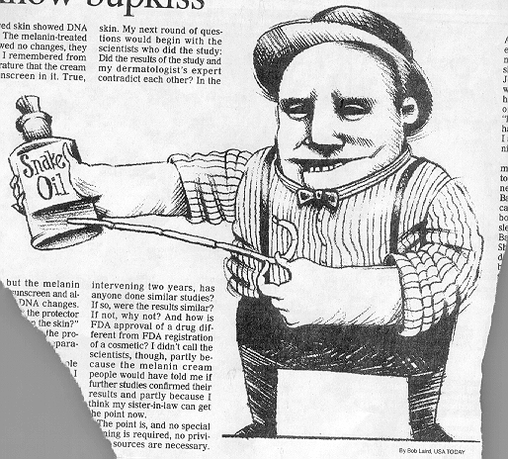
Drift Reduction Additives:
Many available!
Not EPA regulated
Long chain polymers
Soluble powders
Reduction in off-target movement documented
Not all will work!!!!
Pump shear problems
Effect on the pattern?
Deposition Aids

Slide 3
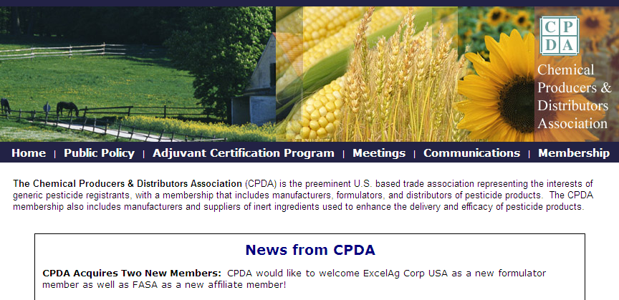
Chemical Producers & Distributors Association

Slide 4
Field Analysis of Drift Reducing Adjuvants…..deposition aids.
Goodland, KS – 2002
Burdett, KS - 2008

Slide 5
Participants in the Study:
Companies
Products
United Suppliers
Helena Chemical
Garrco
Loveland
Wilber-Ellis
Rosen’s
Precision Labs
SanAg
41-A
Formula One
AMS 20/10
Border EG 250
Control
INT VWZ
Inplace
Garrco Exp-3
INT YAR
Border XTRA 8L
HM2005-C
HM0226
Liberate
Target LC
HM2052
INT HLA
HM 0230
Valid
Double Down
20 & 21. water
Some worked & some didn’t!!!

Slide 6
Product Name | Product Company | Mixing rateª
Tap water 1 | Local supply | X-77 only
Superb HC + Interlock | Winfield Solutions | 133 oz + 33 oz / 50 gal
Formula 1 | United Suppliers | 1.5 qt / 50 gal
#PX056-Z | Precision Labs, Inc | 5 qt / 50 gal
Tap water 2 | Local supply | X-77 only
Ag 06037 | Winfield Solutions | 64 oz / 50 gal
Ag 08050 | Winfield Solutions | 80 oz / 50 gal
Interlock 1.25 | Winfield Solutions | 80 oz / 50 gal
Control | GarrCo Products, Inc | 2 oz /50 gal
Tap water 3 | Local supply | X-77 only
INT 908 | Rosen’s | 5 gal / 45 gal
Tap water + Prime Oil^{b} | Local supply + Winfield Solutions | 266 oz / 50 gal
Interlock 0.8 | Winfield Solutions | 50 oz / 50 gal
ª All tank mixes included X-77 at .25% v/v (16 ounces per 50 gallon load).
^{b}Oil to simulate a suggested tank mix with fungicide (Prime Oil @ 1 pint/acre).

Slide 7
Materials and Methods (2008):
AT 502A(Rucker Flying Service)
Drop booms
CP-11TT #15 straight stream nozzles w/8° deflection
44 PSI
156 mph ground speed by GPS
Droplet spectrum: Medium, %volume <200 = 7.65%
Aircraft calibrated for 3 GPA

Slide 8
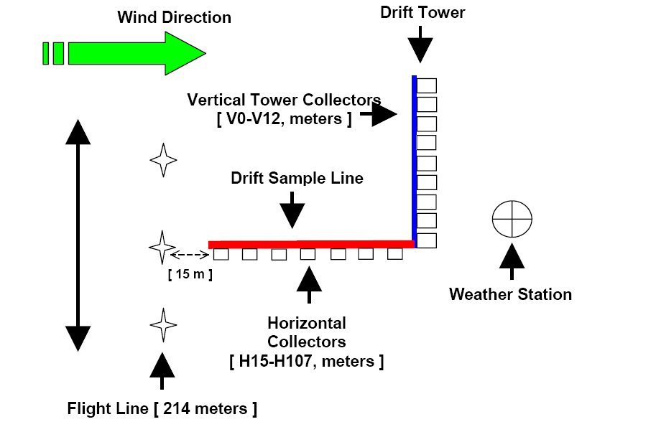

Slide 9
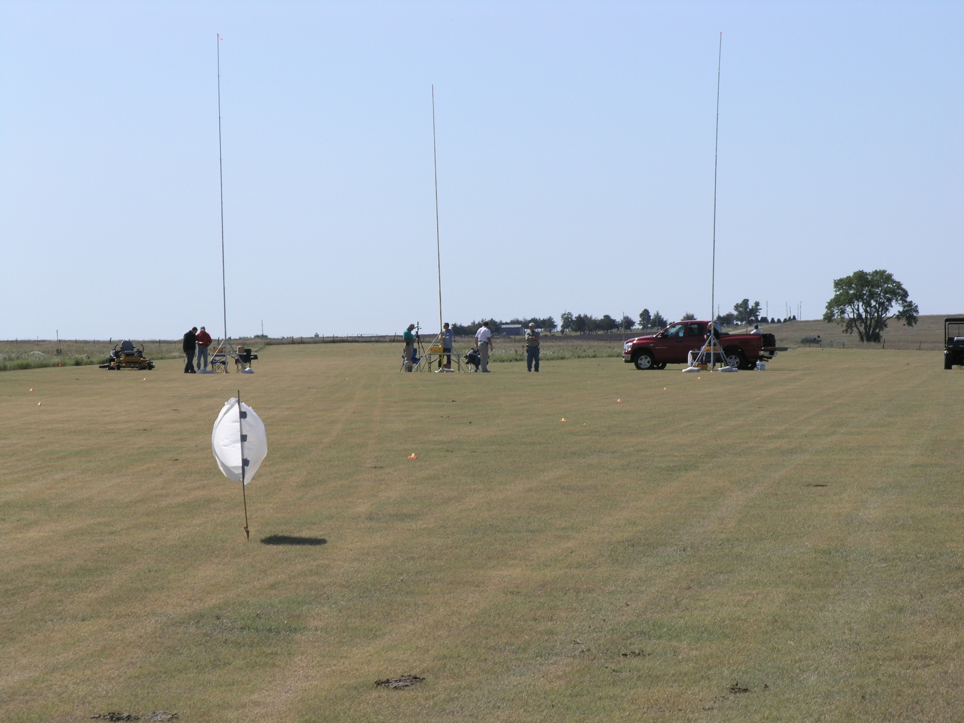
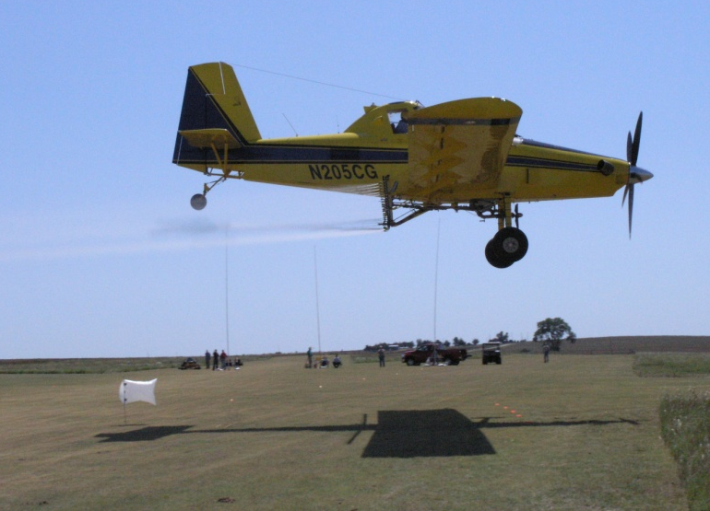
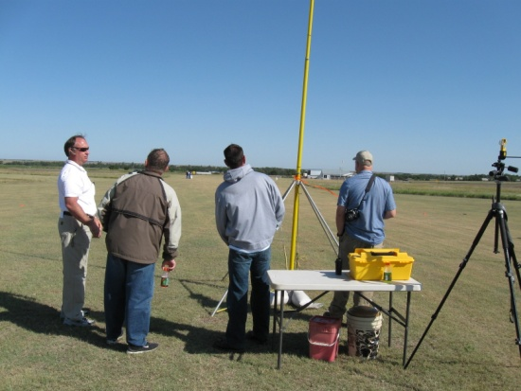

Slide 10
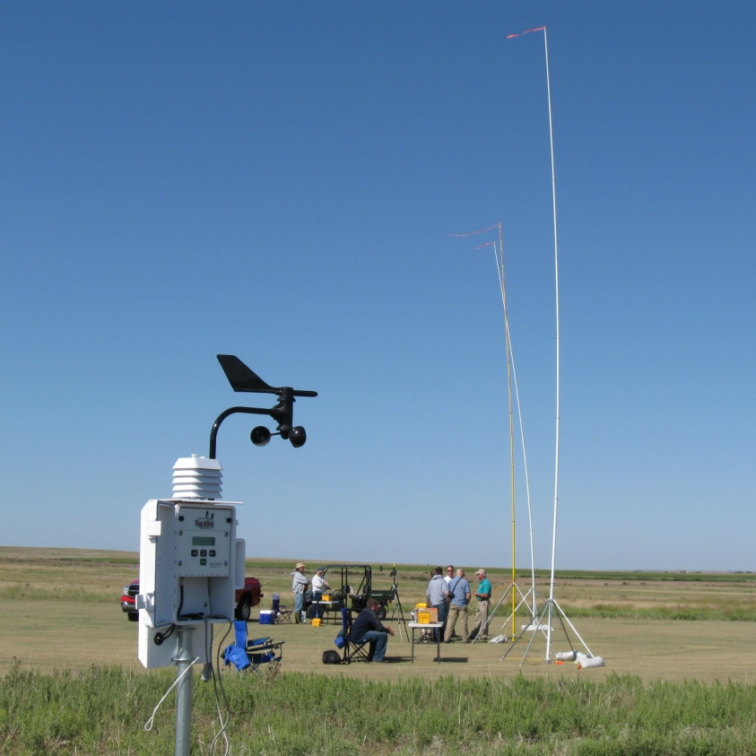
Weather Data:
Sept. 4, 2008 from 10:00am – 1:45pm
Wind speed range: 6.3 – 8.8 MPH
Average wind speed: 7.8 MPH
Temperature: 67.2 F
Humidity: 44.9%

Slide 11
Treatment VMD’s:

Slide 12
Horizontal Drift Summary:
abcd
abc
abc

Slide 13
Vertical Drift Summary:
de
e
cde
cde
cd
bc
bc
ab
ab
a
a
a
a

Slide 14
Vertical Drift Profile:

Slide 15
Total Drift Summary:
fg
g
ef
ef
de
cde
cde
bcd
abc
ab
a
a
a

Slide 16
Total Drift Ranked:
water average
g
fg
ef
ef
bcd
cde
cde
de
abc
ab
a
a
a

Slide 17
Summary
Differences among treatments in coverage representing downwind drift were found at all vertical and horizontal collector locations.
Some products provided significant drift reduction benefits when compared to others.
Many of the products did not provide any drift reduction when compared to water.
Based on mixing, loading, and system cleanout evaluations, some products may hinder good application techniques.

Slide 18
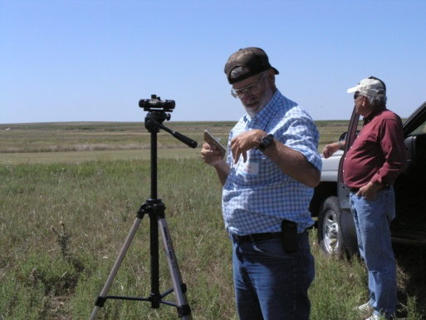
Acknowledgements:
Cary and Jane Rucker
Participating Companies and Reps
Kansas Department of Ag

Slide 19
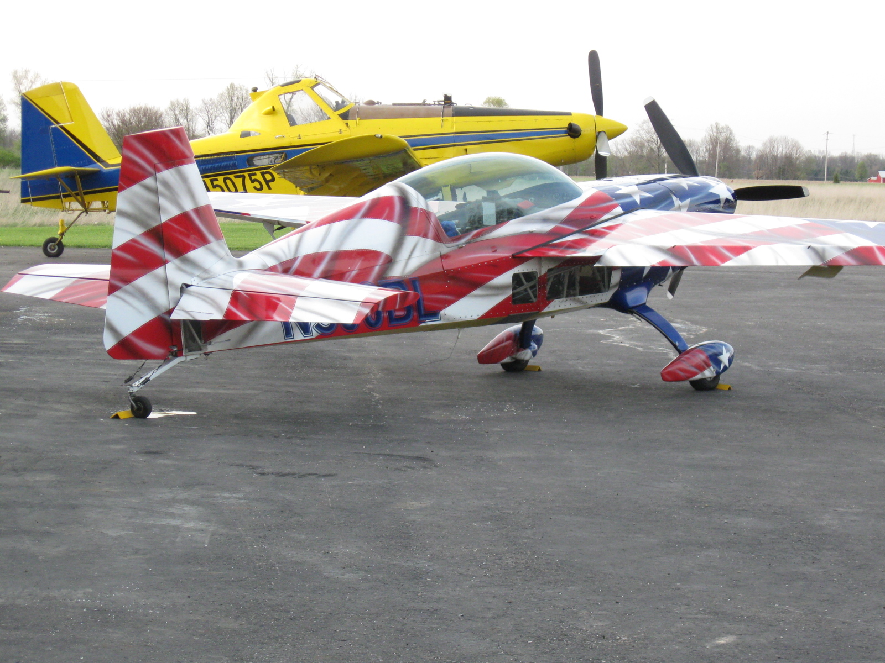
rewolf@ksu.edu
For more information contact:
Thanks!
www.bae.ksu.edu/faculty/wolf/

