Slide 1
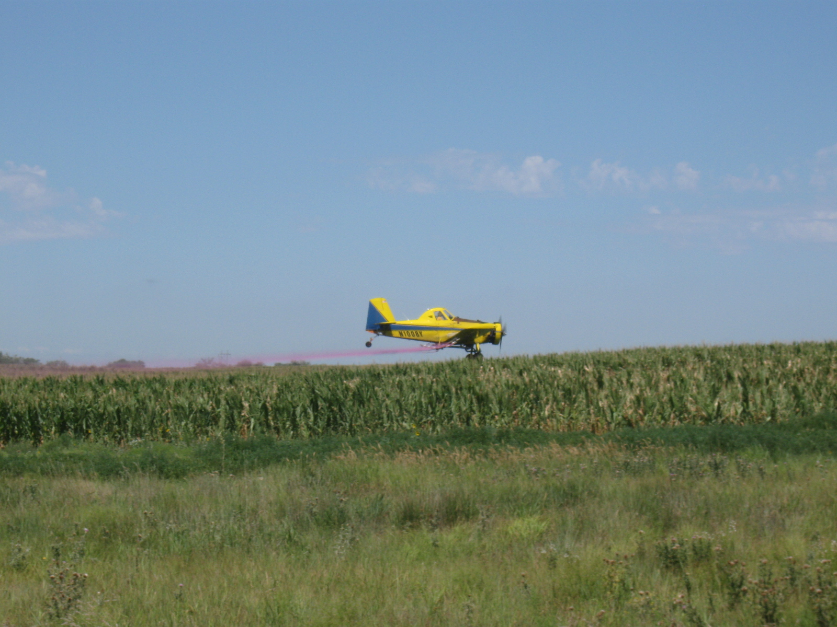
BASF Project – Meade, KS July 28, 2009
Spray Solution Effects on Fungicide Application to Corn

Slide 2
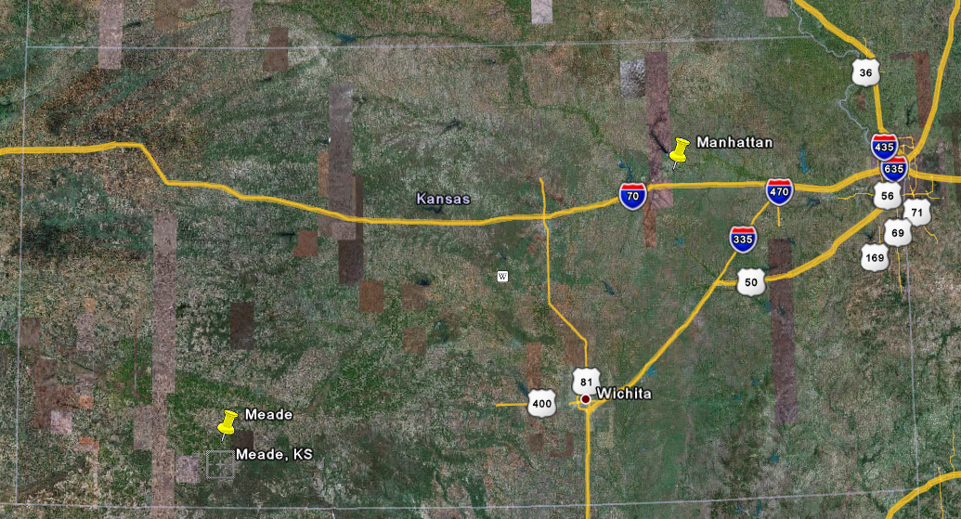
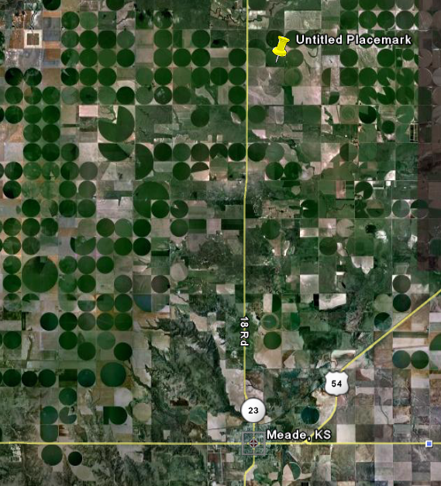
Meade, KS

Slide 3
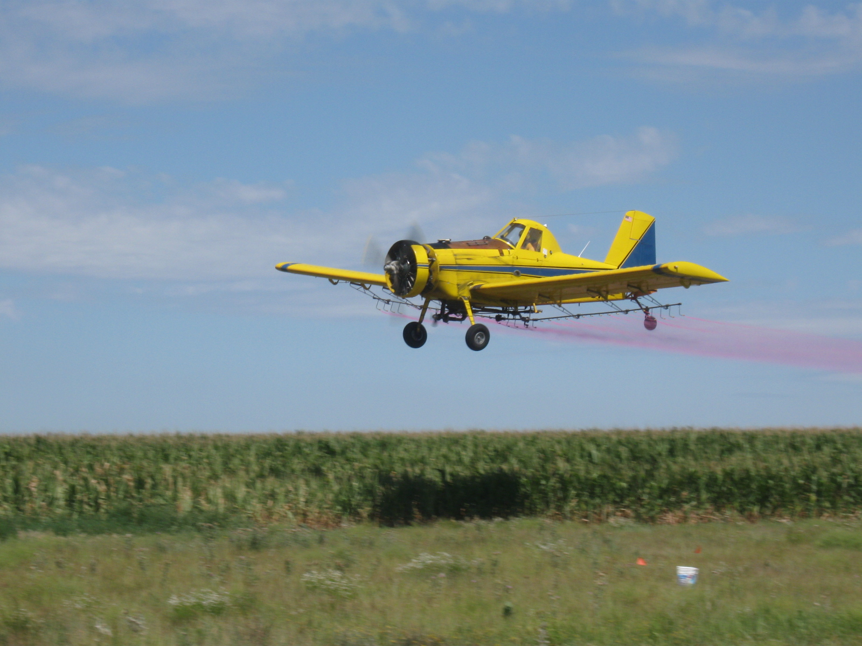
Materials and Methods:
AT 401(Bringham Flying Service, Craig Stratton - Pilot)
Drop booms
CP-09 (29 - .078 and 9 - .125) w/5° deflection
36 PSI
67 foot swath, 120 mph ground speed by GPS
Droplet spectrum - Medium
Aircraft calibrated for 3 GPA

Slide 4
Treatments
Trt # | Treatment¹ |  | Rate/Acre
1 | Headline EC + water + Vision Pink² | COC | 6 oz + 16 oz
2 | Untreated check
3 | Headline SC + water + Vision Pink² | COC | 6 oz + 16 oz
4 | Untreated Check
5 | Headline SC + Caramba + water + VP | X | 5.8 oz + 6.1 oz
6 | Untreated check
7 | Quilt + water + Vision Pink² | COC | 14 oz + 16 oz
¹All treatments were applied at 28 L/Ha (3 GPA) using tap water.
²Vision Pink added at 1 quart (16 oz) per 50 gallons of water.

Slide 5
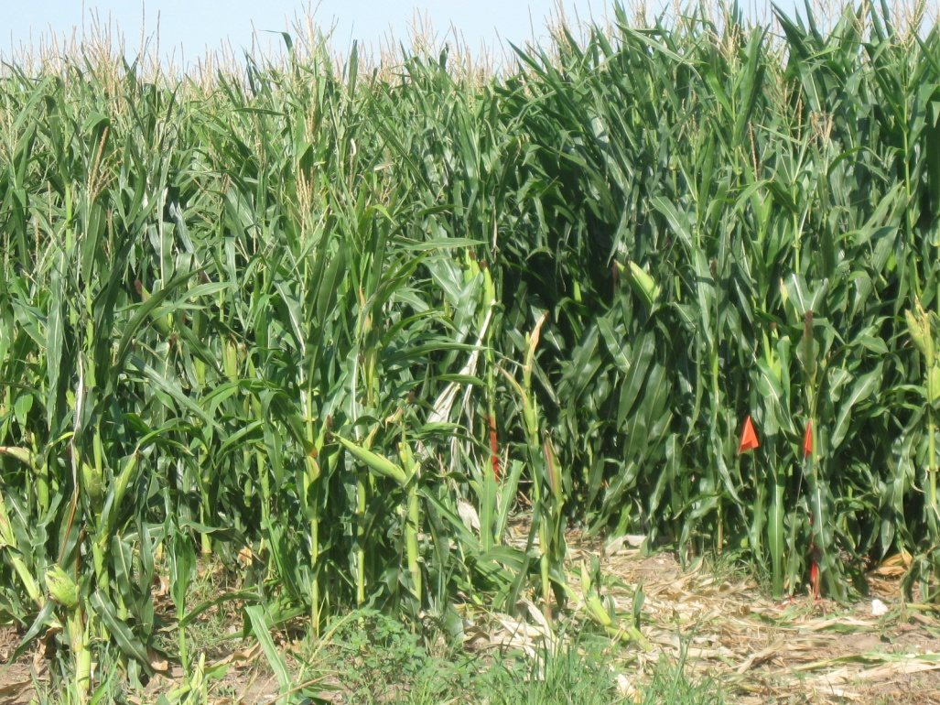

Slide 6
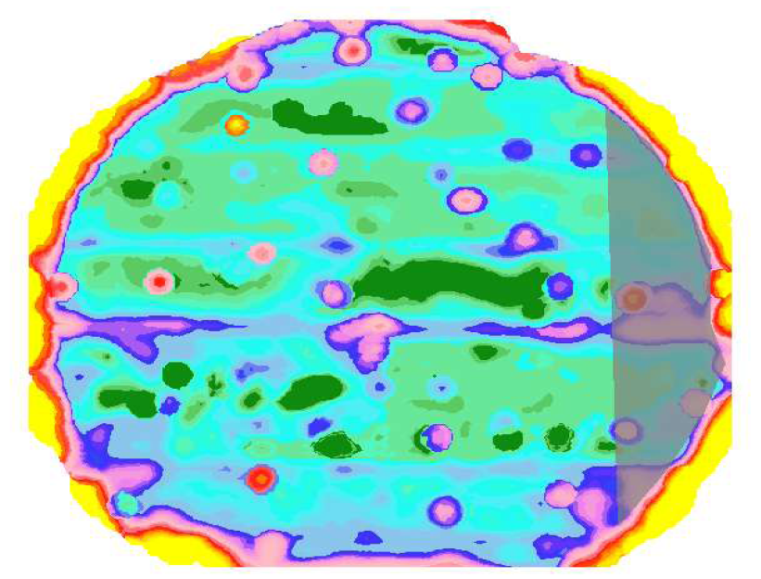
N
Headline SC (5.8 oz/ac) + Caramba (6.1 oz/ac)
Headline SC (6 oz/ac) + COC (1 pt.ac)
Headline EC (6 oz/ac) + COC (1 pt/ac)
Quilt (14 oz/ac) + COC (1 pt/ac)
Untreated Check
Untreated Check
Untreated Check
1
7
3
5

Slide 7
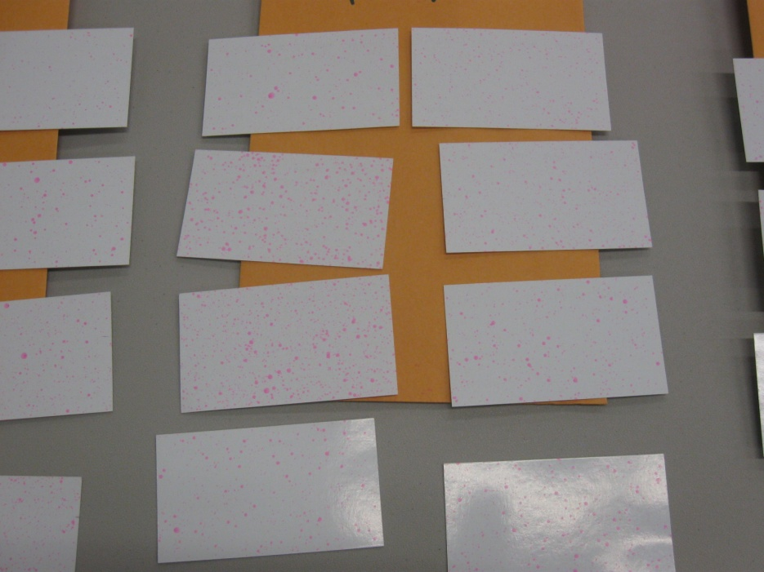
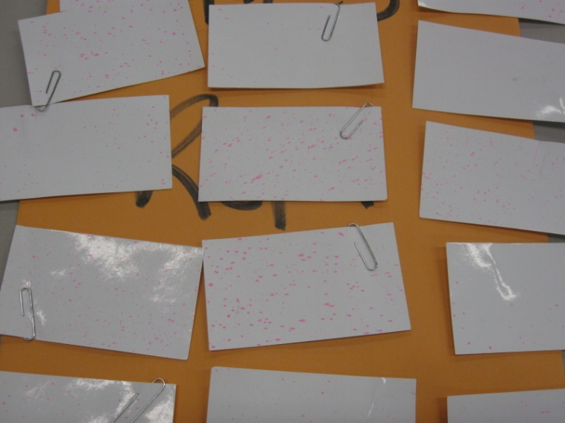

Slide 11
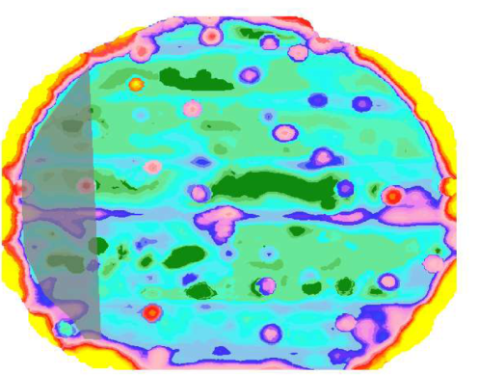
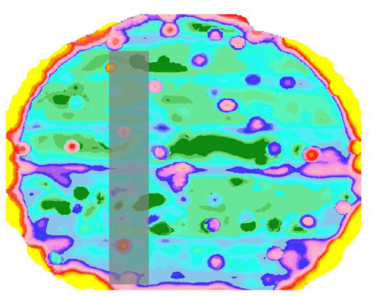
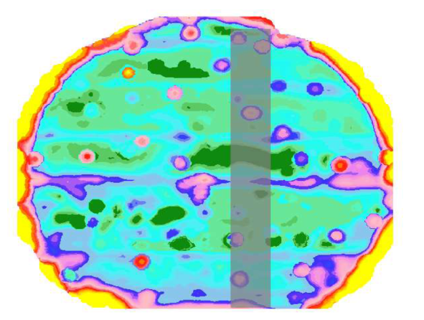
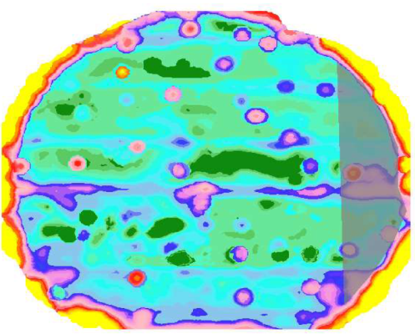
APEX Farm Management Software

Slide 12
Summary
Differences were found in coverage among treatments within the corn canopy.
Treatments had little effect on droplet size
Yield differences were minimal.
Disease control varied by treatment, timing, and field location.
Damage from disease increased over time.

Slide 13
Treatment VMD’s:

