Slide 1
Calibrating Sprayers for Droplet Size…. ….according to the label
Robert E. Wolf
Extension Specialist Application Technology
Biological and Agricultural Engineering
Notes:
Use either title slide. Hide the one you do not want to use.

Slide 2
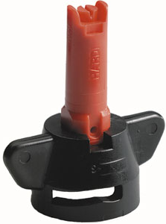
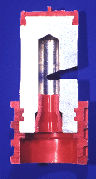
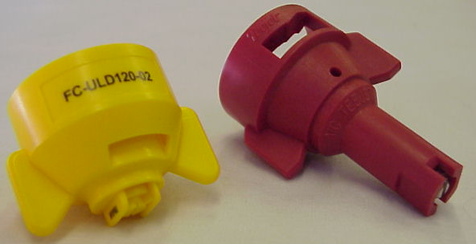
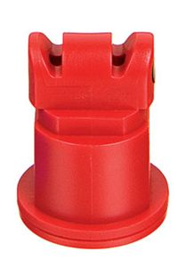
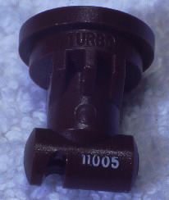
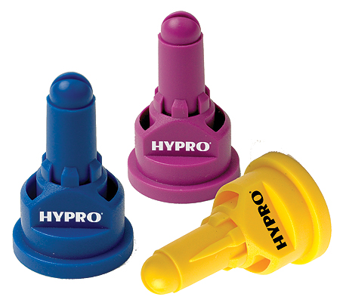
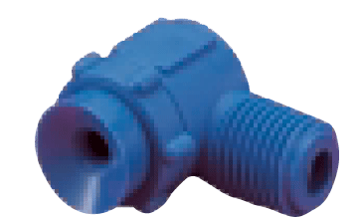
Nozzle Technology……
Nozzles designed to reduce drift
Improved drop size control
Emphasis on ‘Spray Quality’
Notes:
Beginning with the ‘extended range’ flat fan nozzle (all major manufactures have one), continuing with the design of ‘preorifice inserts’ and ‘turbulation chambers’, and now with the ‘venturi’ style nozzle design, nozzle manufacturer's have worked to develop nozzles that are improving the quality of spray emitted.

Slide 3
Nozzle Efficacy/Drift Slope
1980
30 years
Reducing Spray Drift
Extended Range
Nozzle development timeline
XR, TR
Turbo Flood
Turbo TeeJet
Wilger Designs
Air Mix
AI XR
GuardianAir
AI
Ultra Low Drift
Turbo Drop
TTI
Chamber Design
Venturi Design - II
Venturi Design - I
Efficacy
2010

Slide 4
Nozzles-Recommended Use
flat spray
20-25 PSI
chamber
30-40 PSI
IN BETWEEN VENTURI
40 PSI
air induced/venturi
50-80 PSI
Notes:
Beginning with the ‘extended range’ flat fan nozzle (all major manufactures have one), continuing with the design of ‘preorifice inserts’ and ‘turbulation chambers’, and now with the ‘venturi’ style nozzle design, nozzle manufacturer's have worked to develop nozzles that are improving the quality of spray emitted.

Slide 5
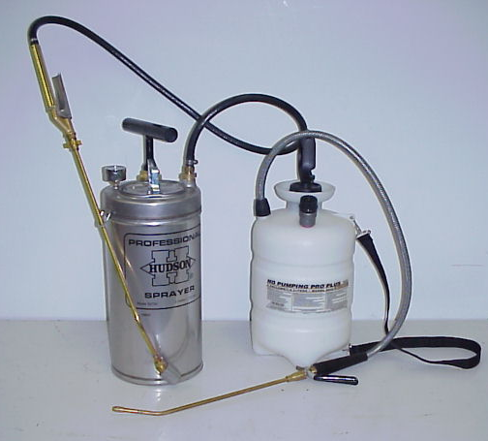
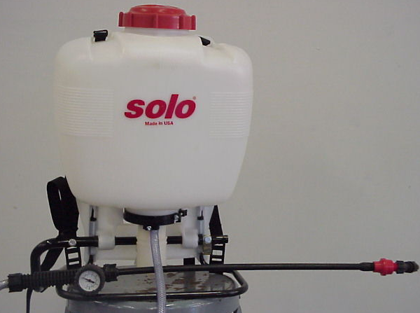
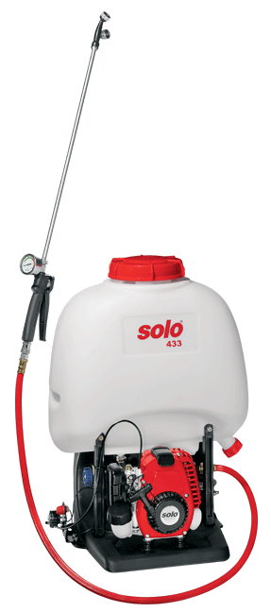
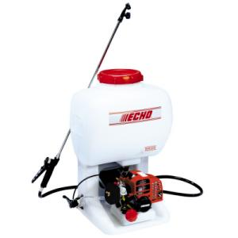
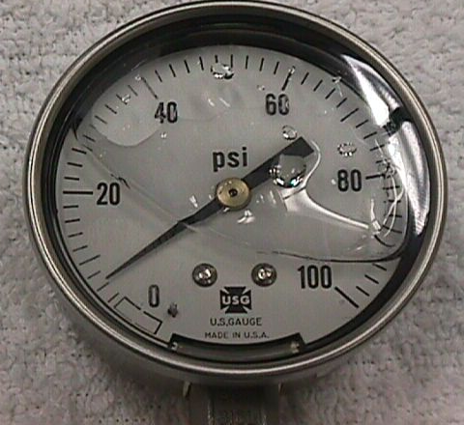
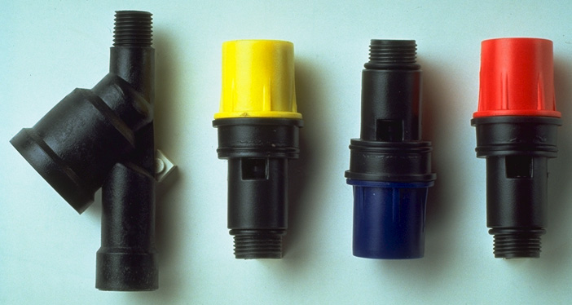
Spray Management Valves

Slide 6
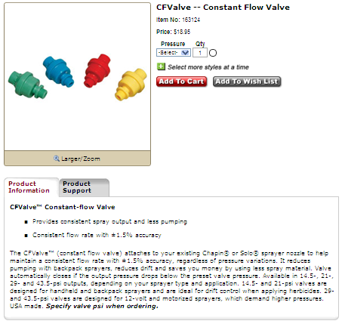
Spray Management Valve

Slide 7
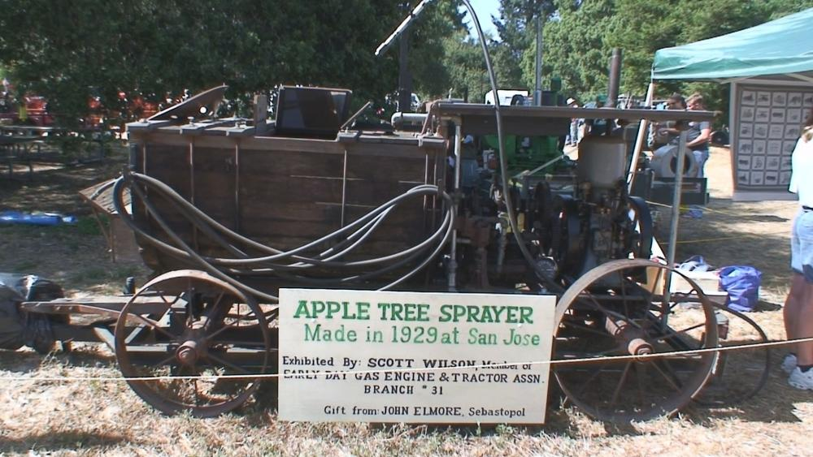
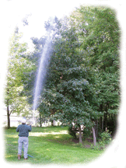

Slide 8
Vertical Reach at Various Pressures (Spray Gun)

Slide 9
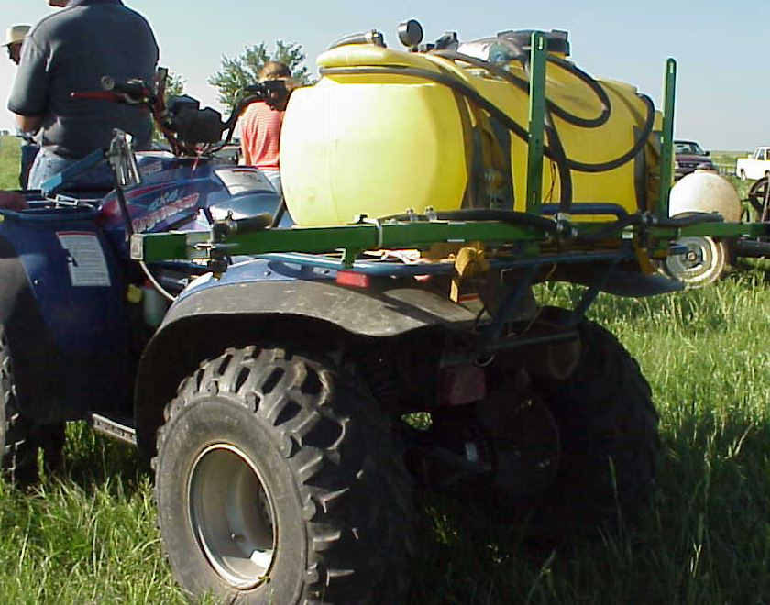
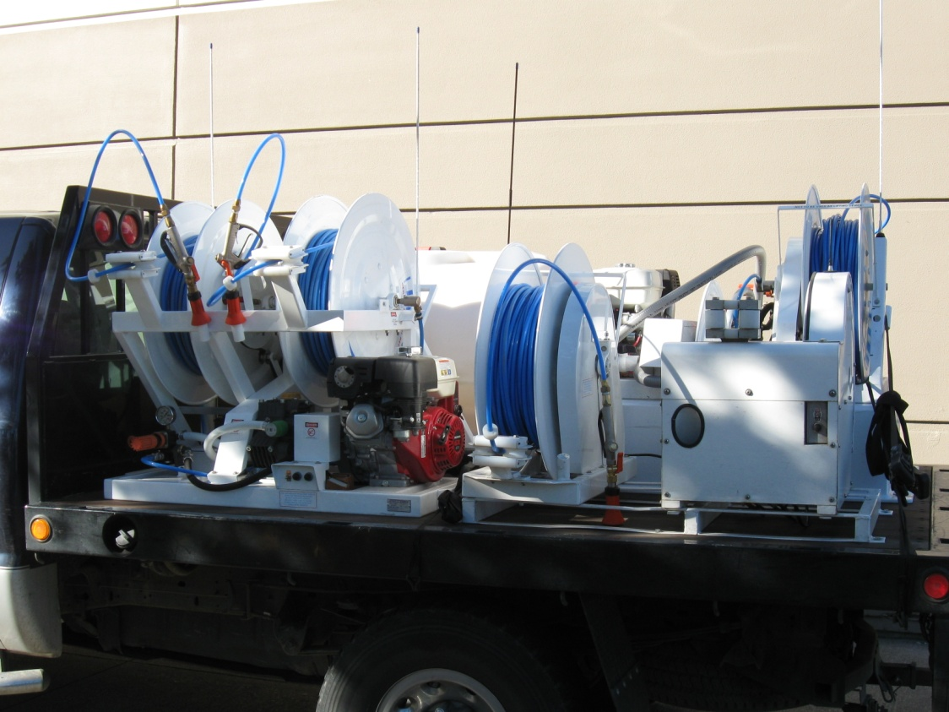
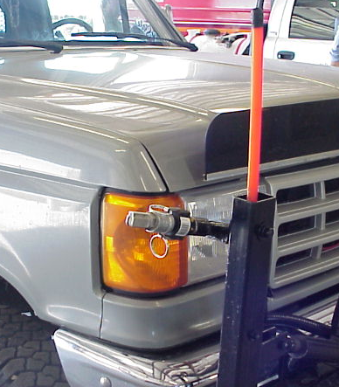
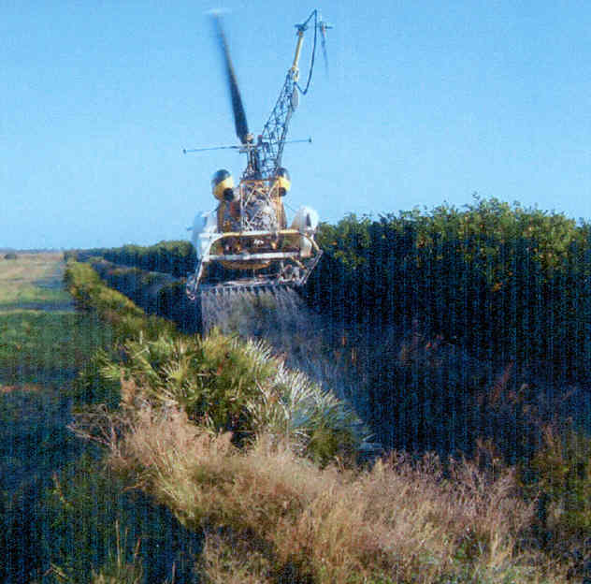
Accurate and efficient applications: Increase Efficacy – Minimize Drift
Notes:
Many technological changes have occurred in the spray industry in recent years. Much attention has been given to application equipment to increase efficiency and minimize spray drift. This presentation is designed for you to share some of these application technologies in ground application with your applicator audiences. Equipment design changes have occurred in all forms of ground application. Much of the improvements has been directed at the reduction of spray drift.

Slide 10
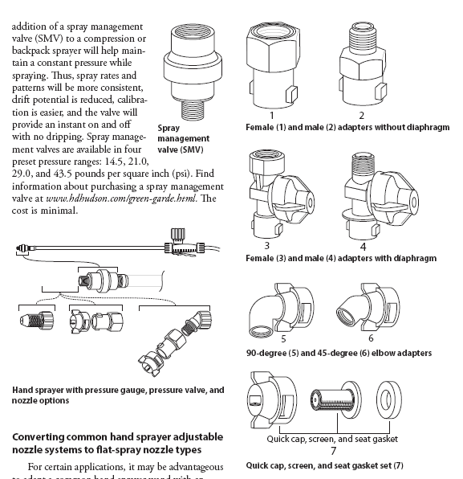
Converting to a flat-fan and/or drift reducing nozzle

Slide 11
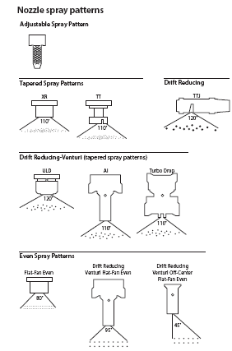
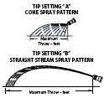
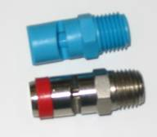
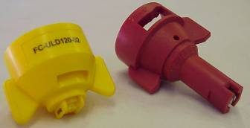
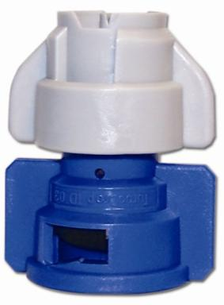
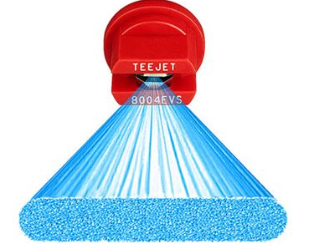
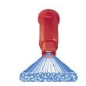
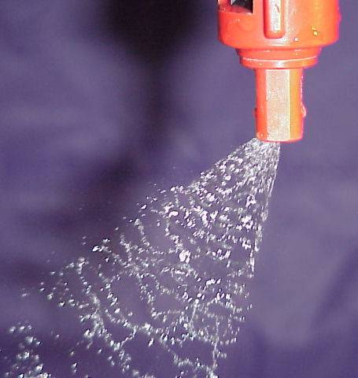

Slide 12
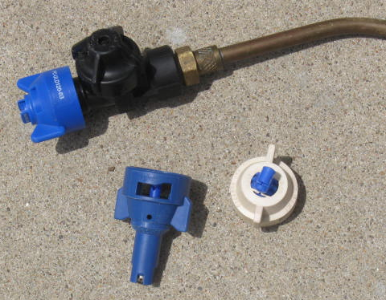
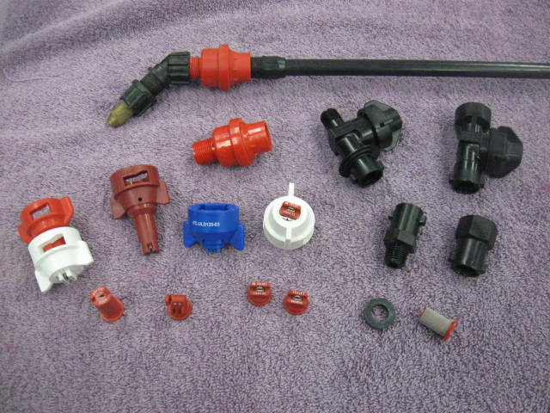
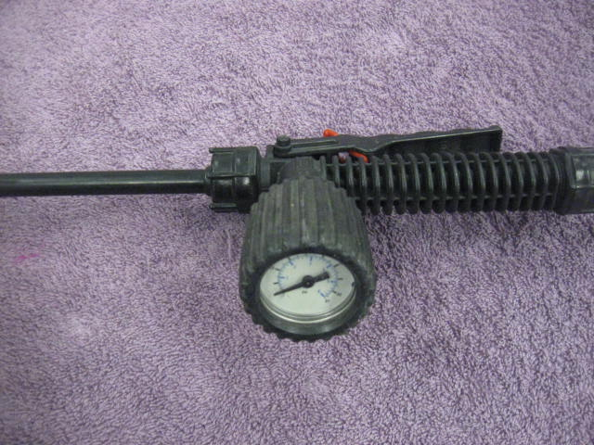

Slide 13
Nozzles are important because:
Control the amount – GPA.
Determine uniformity of application.
Affects the coverage.
Influences the drift potential.
Notes:
These are my points to emphasize the nozzles importance. The next several slides will explain or highlight each point in more detail.

Slide 14
Calibration!!!!
GPA
Ensuring that the spray output is what it is supposed to be!
Calibrating Boom Sprayers – MF2894

Slide 15
Calibration/Nozzle Selection:
What is the first step?
Use label to select the
application volume
product rate
Choose an appropriate travel speed - MPH
Effective width of application
nozzle spacing
Calculate GPM – Flow rate per nozzle
Select the correct size of nozzle!
Notes:
This emphasizes my philosophy on calibration and leads into selecting the correct nozzle size. Begins with the label (the law), then based on travel speed. Nozzle spacing is used but typically does not change – usually 20-inches. Formula on next slides with example of a calculation.

Slide 16
Flow Rate Equation:
Equation
See Page 173, TeeJet Catalog 50A
Calculates for amount of flow from one nozzle
Represents the size of nozzle to put on the sprayer
Notes:
This is the key formula.

Slide 17
GPM Example Solution:
.30gpm
Answer
Notes:
Example of 12 gpa at 12 MPH. Will need an orifice to deliver 0.48 gpm. Pressure to be determined on following slide.

Slide 18
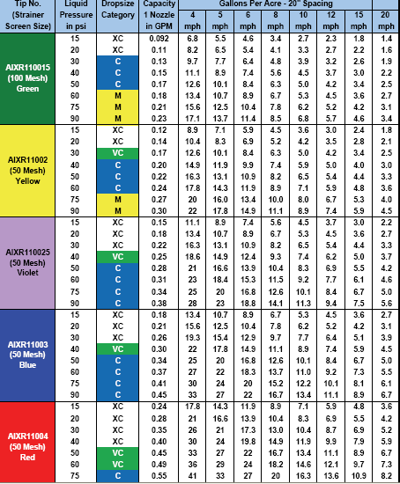
Selecting the proper nozzle….
Page 9, 12, 14, 15
Calculate GPM (formula)
Look under GPM column
Match to pressure-psi
Choose the size needed
Operate at given pressure and speed used in formula to achieve GPA
.30
Notes:
Select the pressure to suit the nozzle type. Bigger the orifice the lower the pressure. Pressure gage is used to emphasize that the pressure should be monitored at the nozzle for the most accurate flow rate measurement.

Slide 19
Notes:
Final check for accuracy. The container over a time collection is the most valid and easy method.

Slide 20
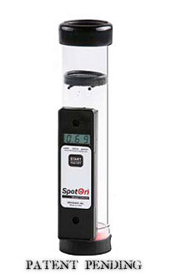
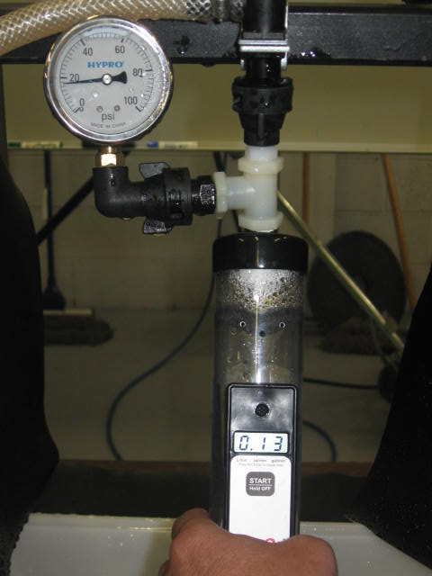
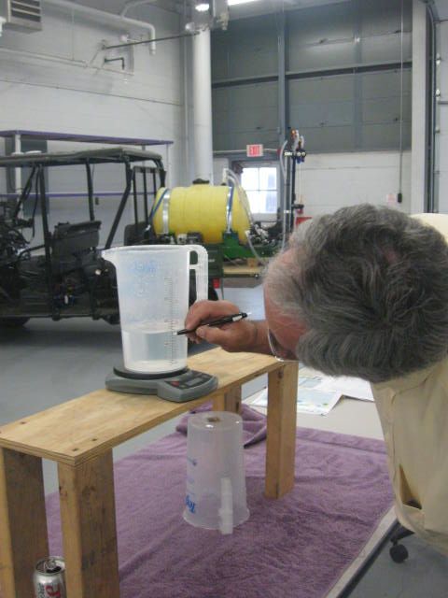
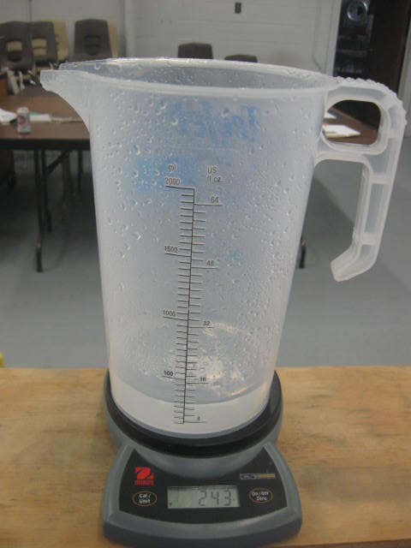
SpotOn Electronic Calibration Tool
Successful Farming Sponsored and will publish findings.
Scott Bretthauer - U of I
Jim Wilson - SDSU
Randy Taylor - OSU
Bobby Grisso & Pat Hipkins - VTU
Mark Hanna – ISU
Bob Wolf – KSU

Slide 21
Calibration!!!! The next phase!
A new concept for applicators!
Ensuring that the spray droplet spectrum is what it is supposed to be to maximize efficacy while minimizing drift!

Slide 22
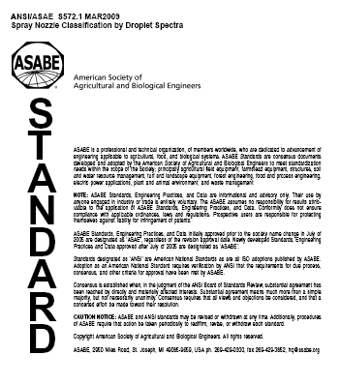
2009
ASABE S-572.1 Droplet Size Standard

Slide 23
Spray Quality Categories
ASABE Standard S-572.1
Category (symbol) | Color Code
Extra Fine (XF) | Purple
Very Fine (VF) | Red
Fine (F) | Orange
Medium (M) | Yellow
Coarse (C) | Blue
Very Coarse (VC) | Green
Extra Coarse (XC) | White
Ultra Coarse (UC) | Black
2009
NEW
S572
NEW

Slide 24
ASABE Standard
>150
Fungicides/Insecticides
151-250
251-350
351-450
Herbicides
451-550
>551
Source: Crop Life – July 2002
Notes:
Summary chart with descriptions and approximate droplet sizes recommended. Important to mention the relative size so they can keep it in perspective.

Slide 25
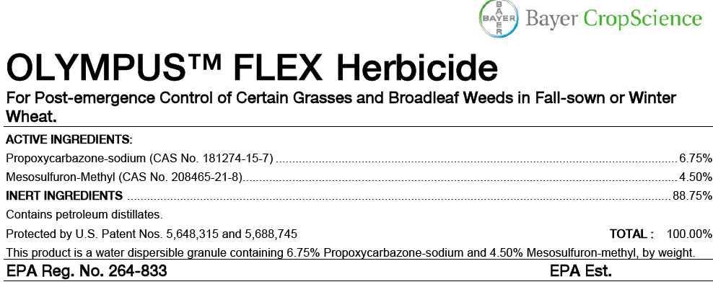

Slide 26
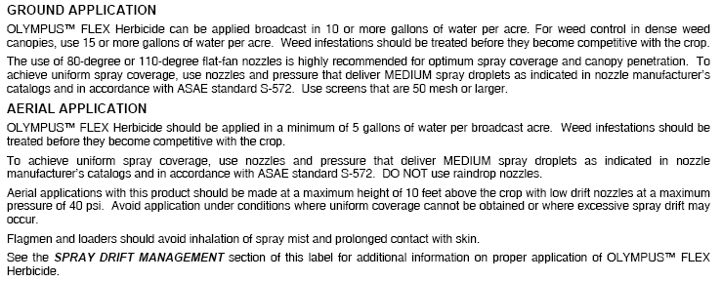
Page 4

Slide 27
Page 6

Slide 28
- Sole ingredient is 2,4-D: Generate COARSE or COARSER spray droplets (ASABE S-572)
- When mixed with other actives that require a medium or fine spray apply as MEDIUM or COARSER spray.

Slide 29
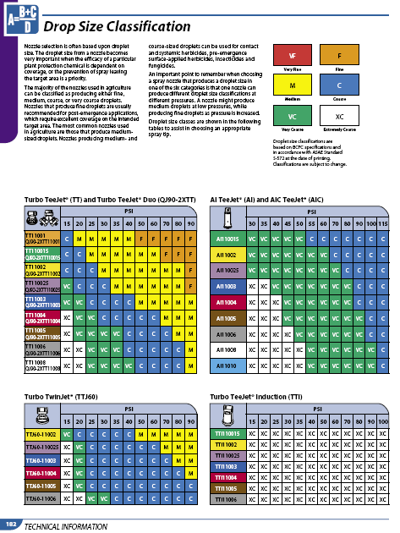
See Page 182, TeeJet Catalog 50A

Slide 30
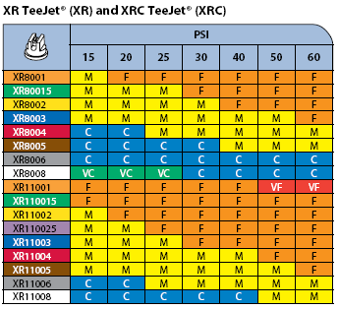
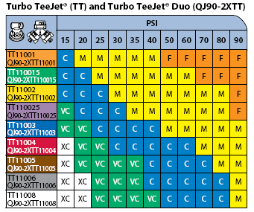
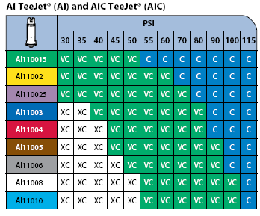
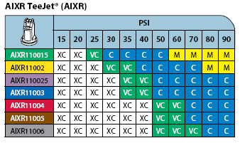

Slide 31
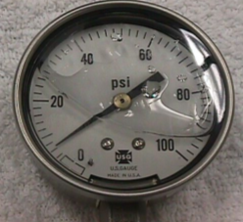
Selecting The Proper Nozzle
Page 9, 12, 14, 15
Calculate GPM (formula)
Look under GPM column
Choose the size needed
Match pressure(psi) and Droplet Classification
Operate at given pressure and speed used in formula to achieve GPA and the desired droplet size
MEDIUM
0.30 gpm
Notes:
Select the pressure to suit the nozzle type. Bigger the orifice the lower the pressure. Pressure gage is used to emphasize that the pressure should be monitored at the nozzle for the most accurate flow rate measurement.

Slide 32
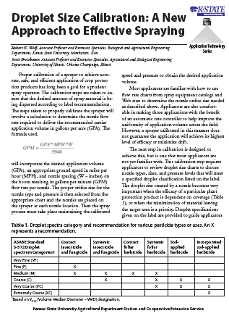
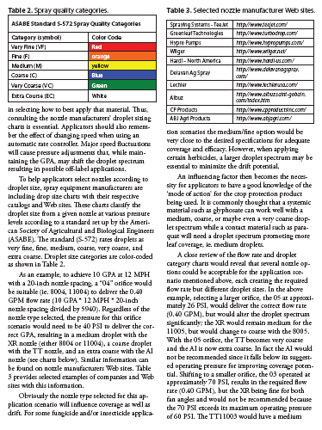
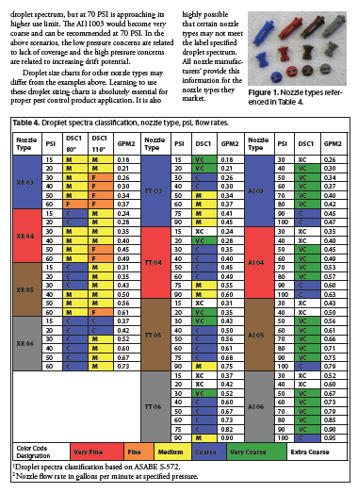
Fact Sheet: MF2869
www.bae.ksu.edu/faculty/wolf

Slide 33
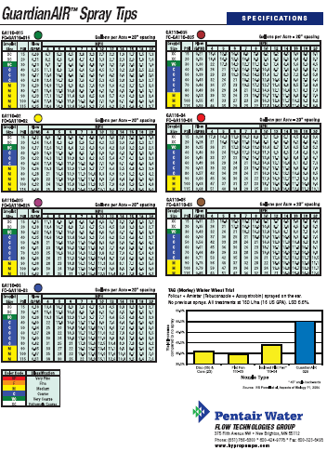
www.hypropumps.com

Slide 35
www.turbodrop.com

Slide 42
Boom Buster – Evergreen Products

Slide 43
XP BoomJet TeeJet

Slide 44
Boom Extender: Hypro

Slide 46
Total Drift Ranked:
water average
g
fg
ef
ef
bcd
cde
cde
de
abc
ab
a
a
a

Slide 47
Volume Median Diameter (VMD)
% less than 210 Microns
37
51
36
35
45
23
30
14
15
26
19
22
14
13
22
10
17
29
29
15
Percent fines
40 psi 40 psi 40 psi 70 psi
Bob Klein, U of Nebraska

Slide 49
Disclaimer:
Brand names appearing in this presentation are for identification and illustration purposes only.
No endorsement is intended, nor is criticism implied of similar products not mentioned.

Slide 50
rewolf@ksu.edu
For more information contact:
Thanks!
www.bae.ksu.edu/faculty/wolf/

