Slide 1
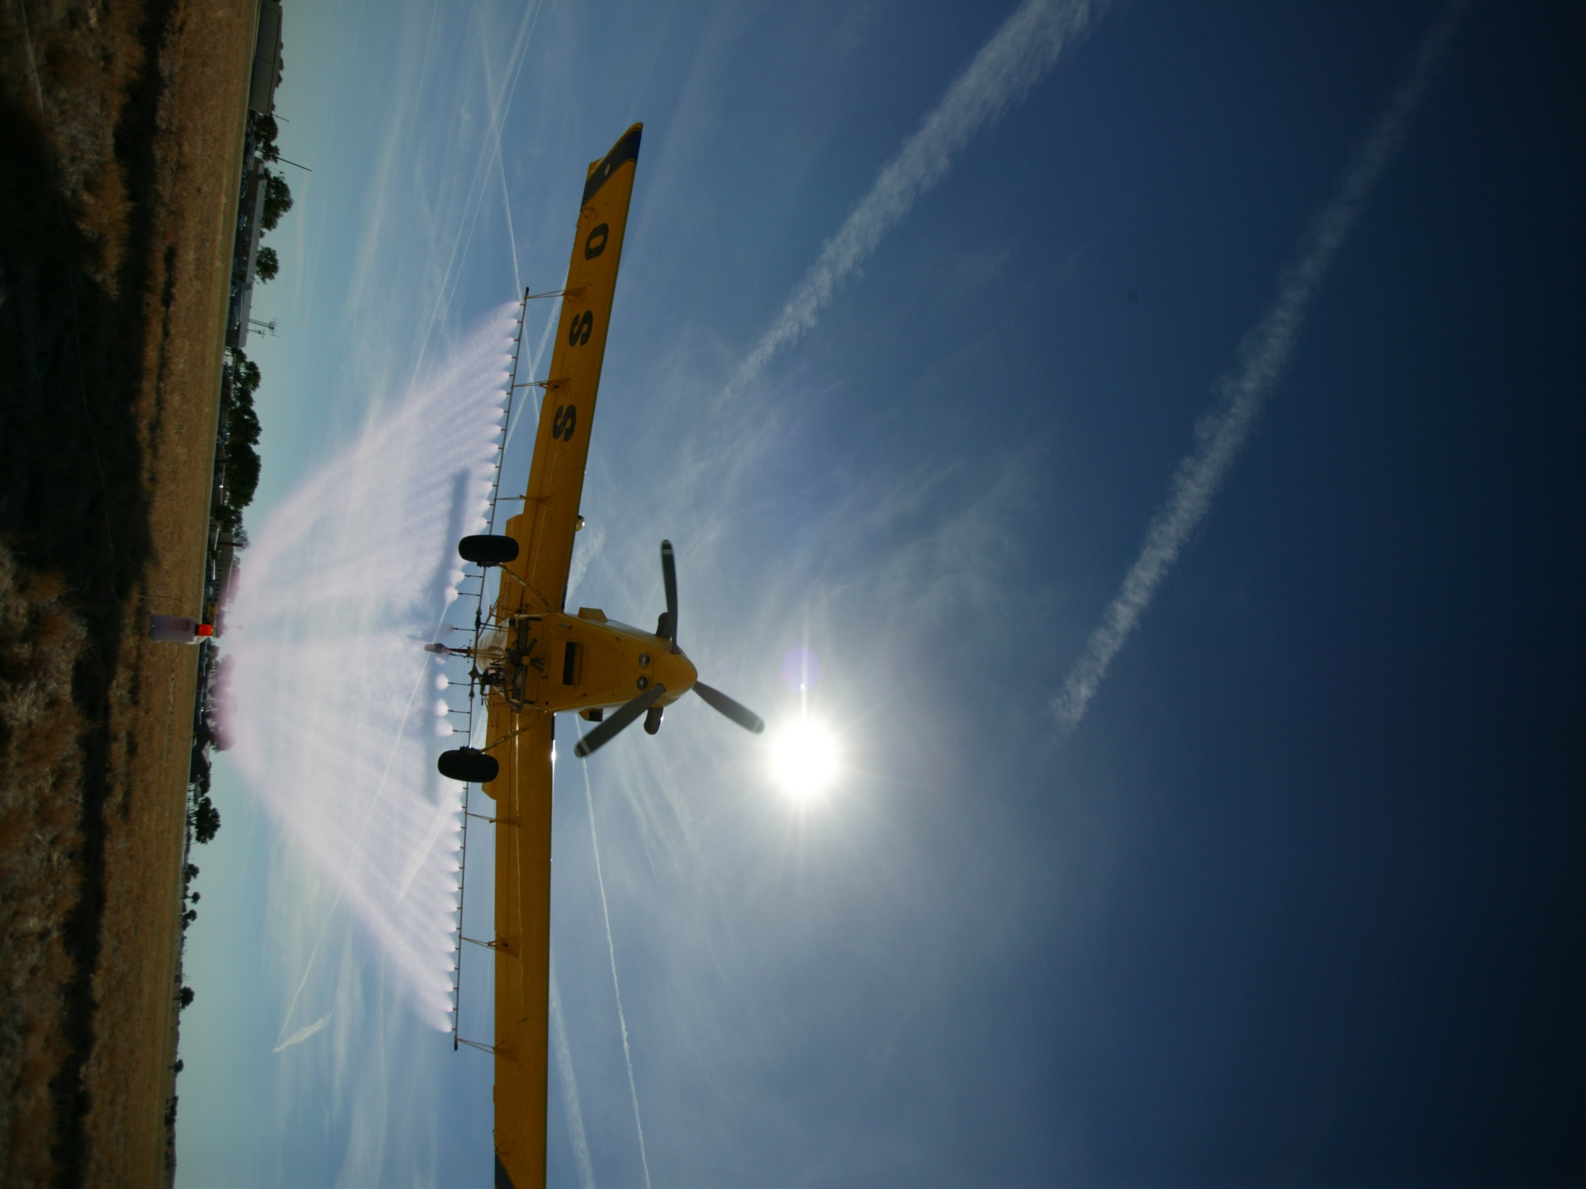
KAAA Convention
Robert E. Wolf
Extension Specialist
Application Technology
Biological and Agricultural Engineering

Slide 2
NAAA Membership
Program’s designed to help your application business
Strong presence in WDC
Education and Safety Training
PAASS
S.A.F.E.
Leadership Training
Pilot Mentoring
Support Aerial Research
Magazine
Web site
Meeting and Trade Show

Slide 3
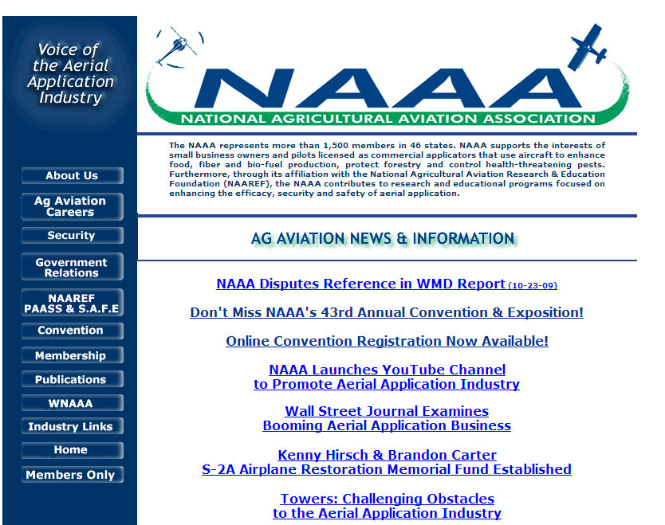
http://www.agaviation.org/

Slide 4
NAAA Convention
Silver Legacy Casino, Reno
Dec. 7-10, 2009
ASAE Papers – Monday
Welcoming breakfast
United Captain – Dennis Fitch Sr.
Trade Show
Workshops
Banquets
CP Breakfast
Auction

Slide 5
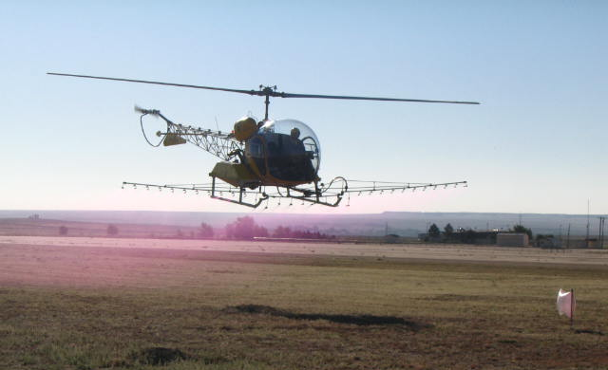
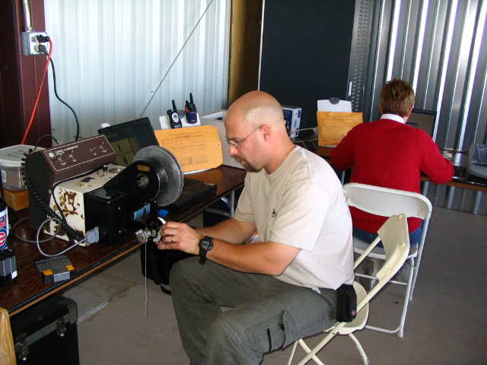
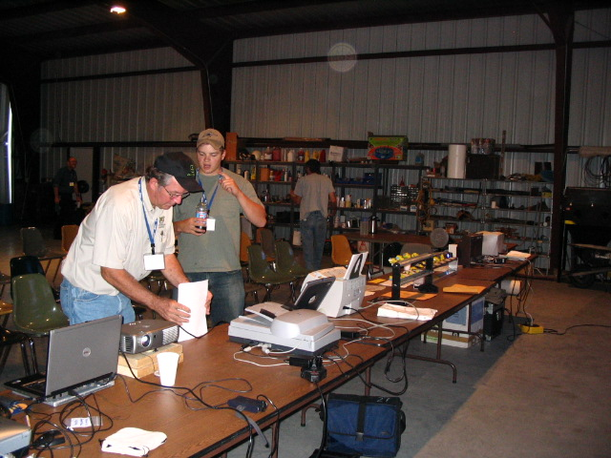
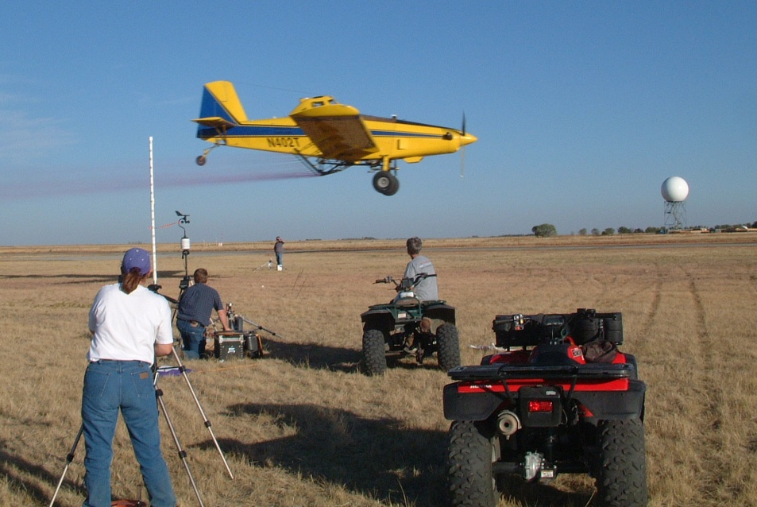
Operation S.A.F.E.
Notes:
This is a good transition slide emphasizing what the module is all about.
Self-regulating Application & Flight Efficiency
NAAA has an excellent explanation of this on the web page. Analysts and participants are both posted.
Presenters Note: Recommend Operation S.A.F.E. to all operators and pilots. Encourage them to ask their state association to conduct/sponsor an Operation S.A.F.E.

Slide 6
Operation S.A.F.E.
Self-Regulating Application and Flight Efficiency
Comprehensive program of education,
Professional analysis of application, and
Commitment to the principles outlined by the NAAA Board of Directors which includes:
Demonstration of responsibility to minimize the potential for adverse health and environmental effects from applying crop protection chemicals.
Professional Applicator Analysis Clinic
S.A.F.E. Flyin Workshop
Swath/Pattern and droplet analysis – open to all licensed operators or agricultural aviators
Receive S.A.F.E. Emblem – current NAAA member
Emblem given when aircraft, pilot, and the operator meet S.A.F.E. guidelines

Slide 7
Flyins For 2009 in Kansas:
Burlington – April 7-8
Ingalls – May 5-6
Lincoln – Nov. 2
Notes:
Properly configured aircraft do not exhibit spray moving up into the air, the spray simply falls as if the aircraft is rolling out a carpet.

Slide 8
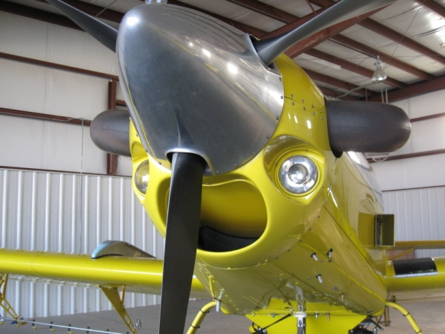
Burlington April 7-8, 2009
6 ‘N’ numbers
23416 - Warner
402T - Martinez
5092J - McElwain
61481 - Pence
6175S - Rucker
78416 - Gaul
10 series

Slide 9
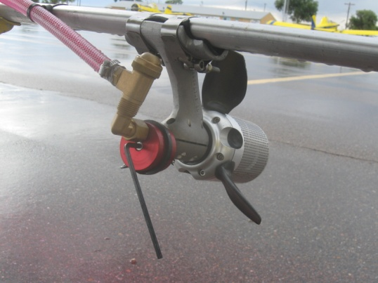
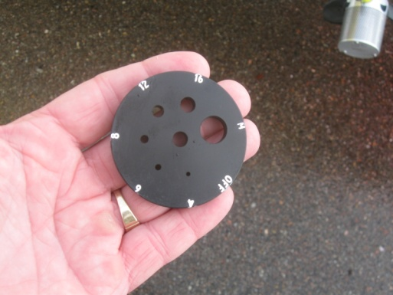
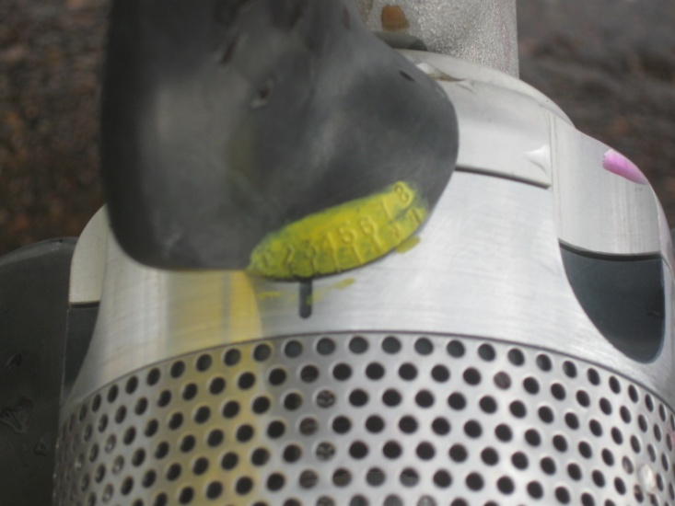
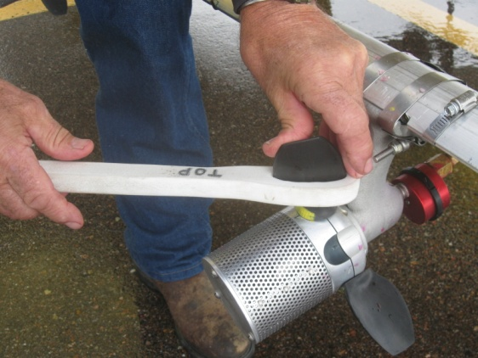
Ingalls May 5 – 6, 2009
5 ‘N’ numbers
2042V - Smith
9190Q - Miller
45472 – Root
5006G – Faust
5008L – Felix
14 series

Slide 10
LaJunta Sept. 24-25, 2009
15 ‘N’ numbers
45472 – Root
6175S – Rucker
55 series
WRK – NAAA Operation S.A.F.E. Analyst Training
– new category established…..Technician

Slide 11
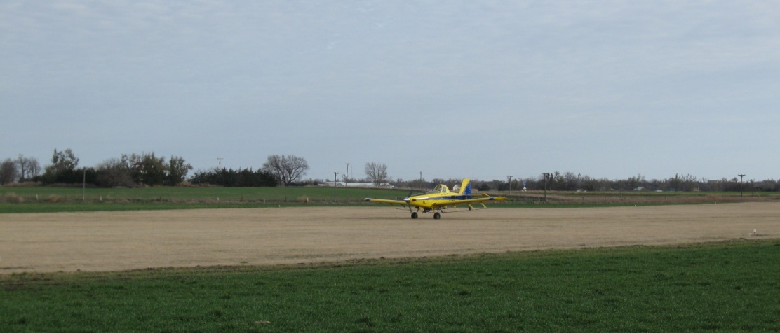
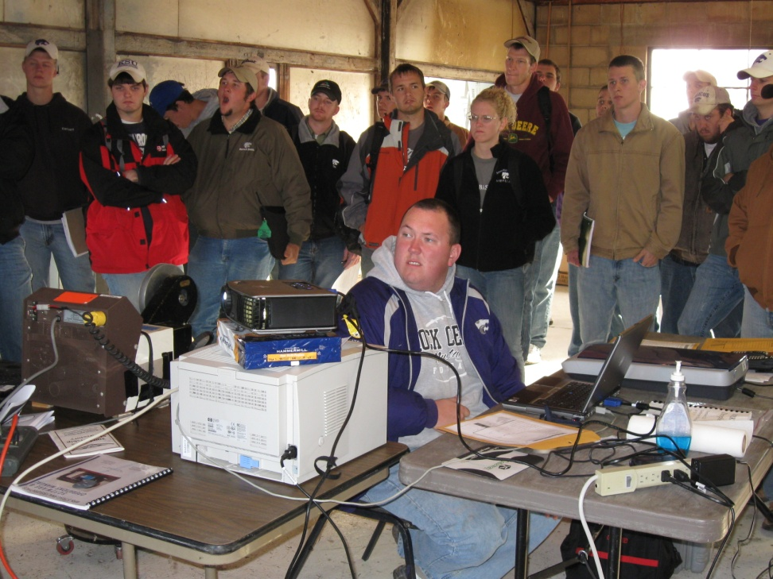
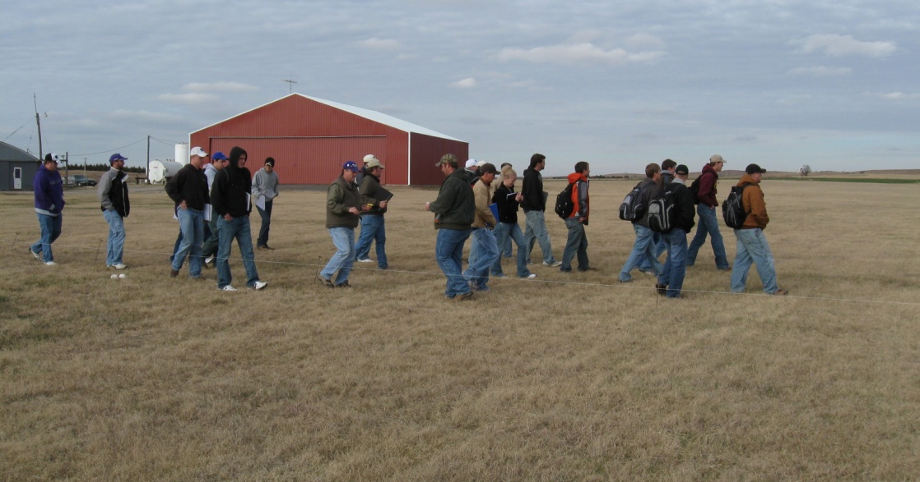
Lincoln Nov 10, 2008 – Nov. 2, 2009

Slide 12
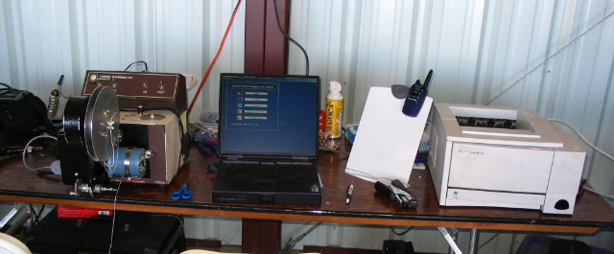
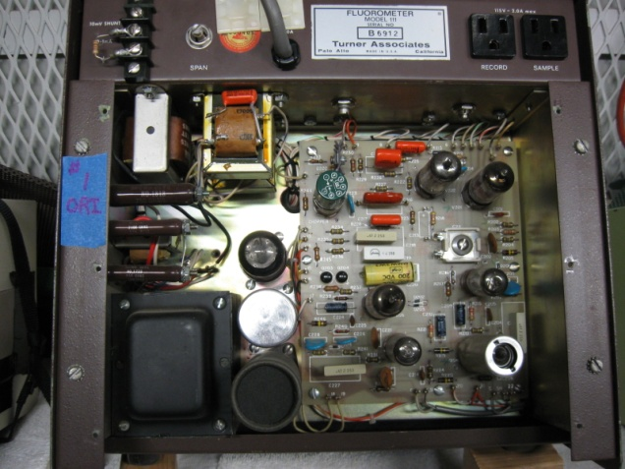
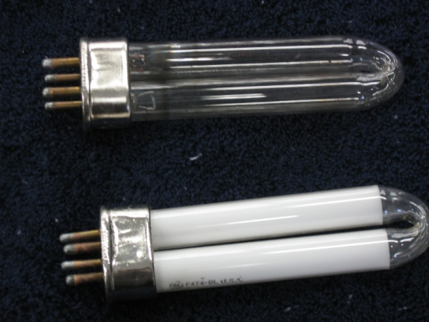
Flourometer Issues in the past!

Slide 13
Two sources of data – two reports
Spray pattern analysis
Fluorescent dye applied to string
Relative concentration measured using fluorometer
Used to measure spray pattern uniformity and determine appropriate swath width
Droplet size analysis
Spray droplets stain water sensitive paper cards
Stains measured using computer scanner
Used to measure droplet size and determine risk of drift and effects on efficacy

Slide 14
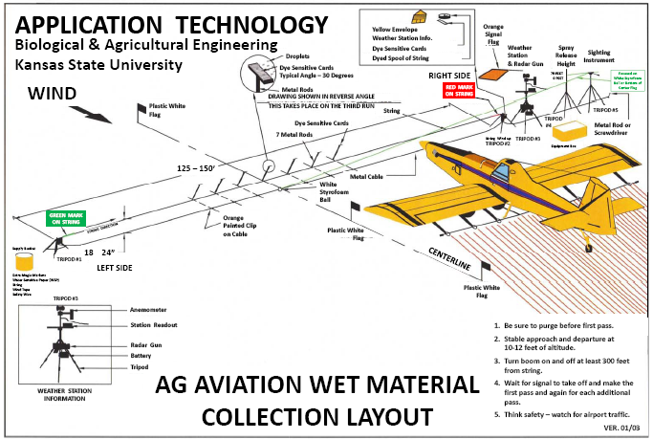
String
7 cards

Slide 15
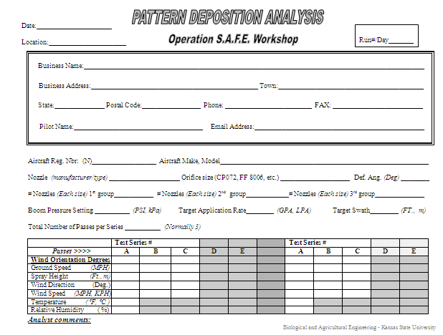
Fly-in data sheet
Fill out Pattern Deposition Analysis data sheet completely

Slide 17
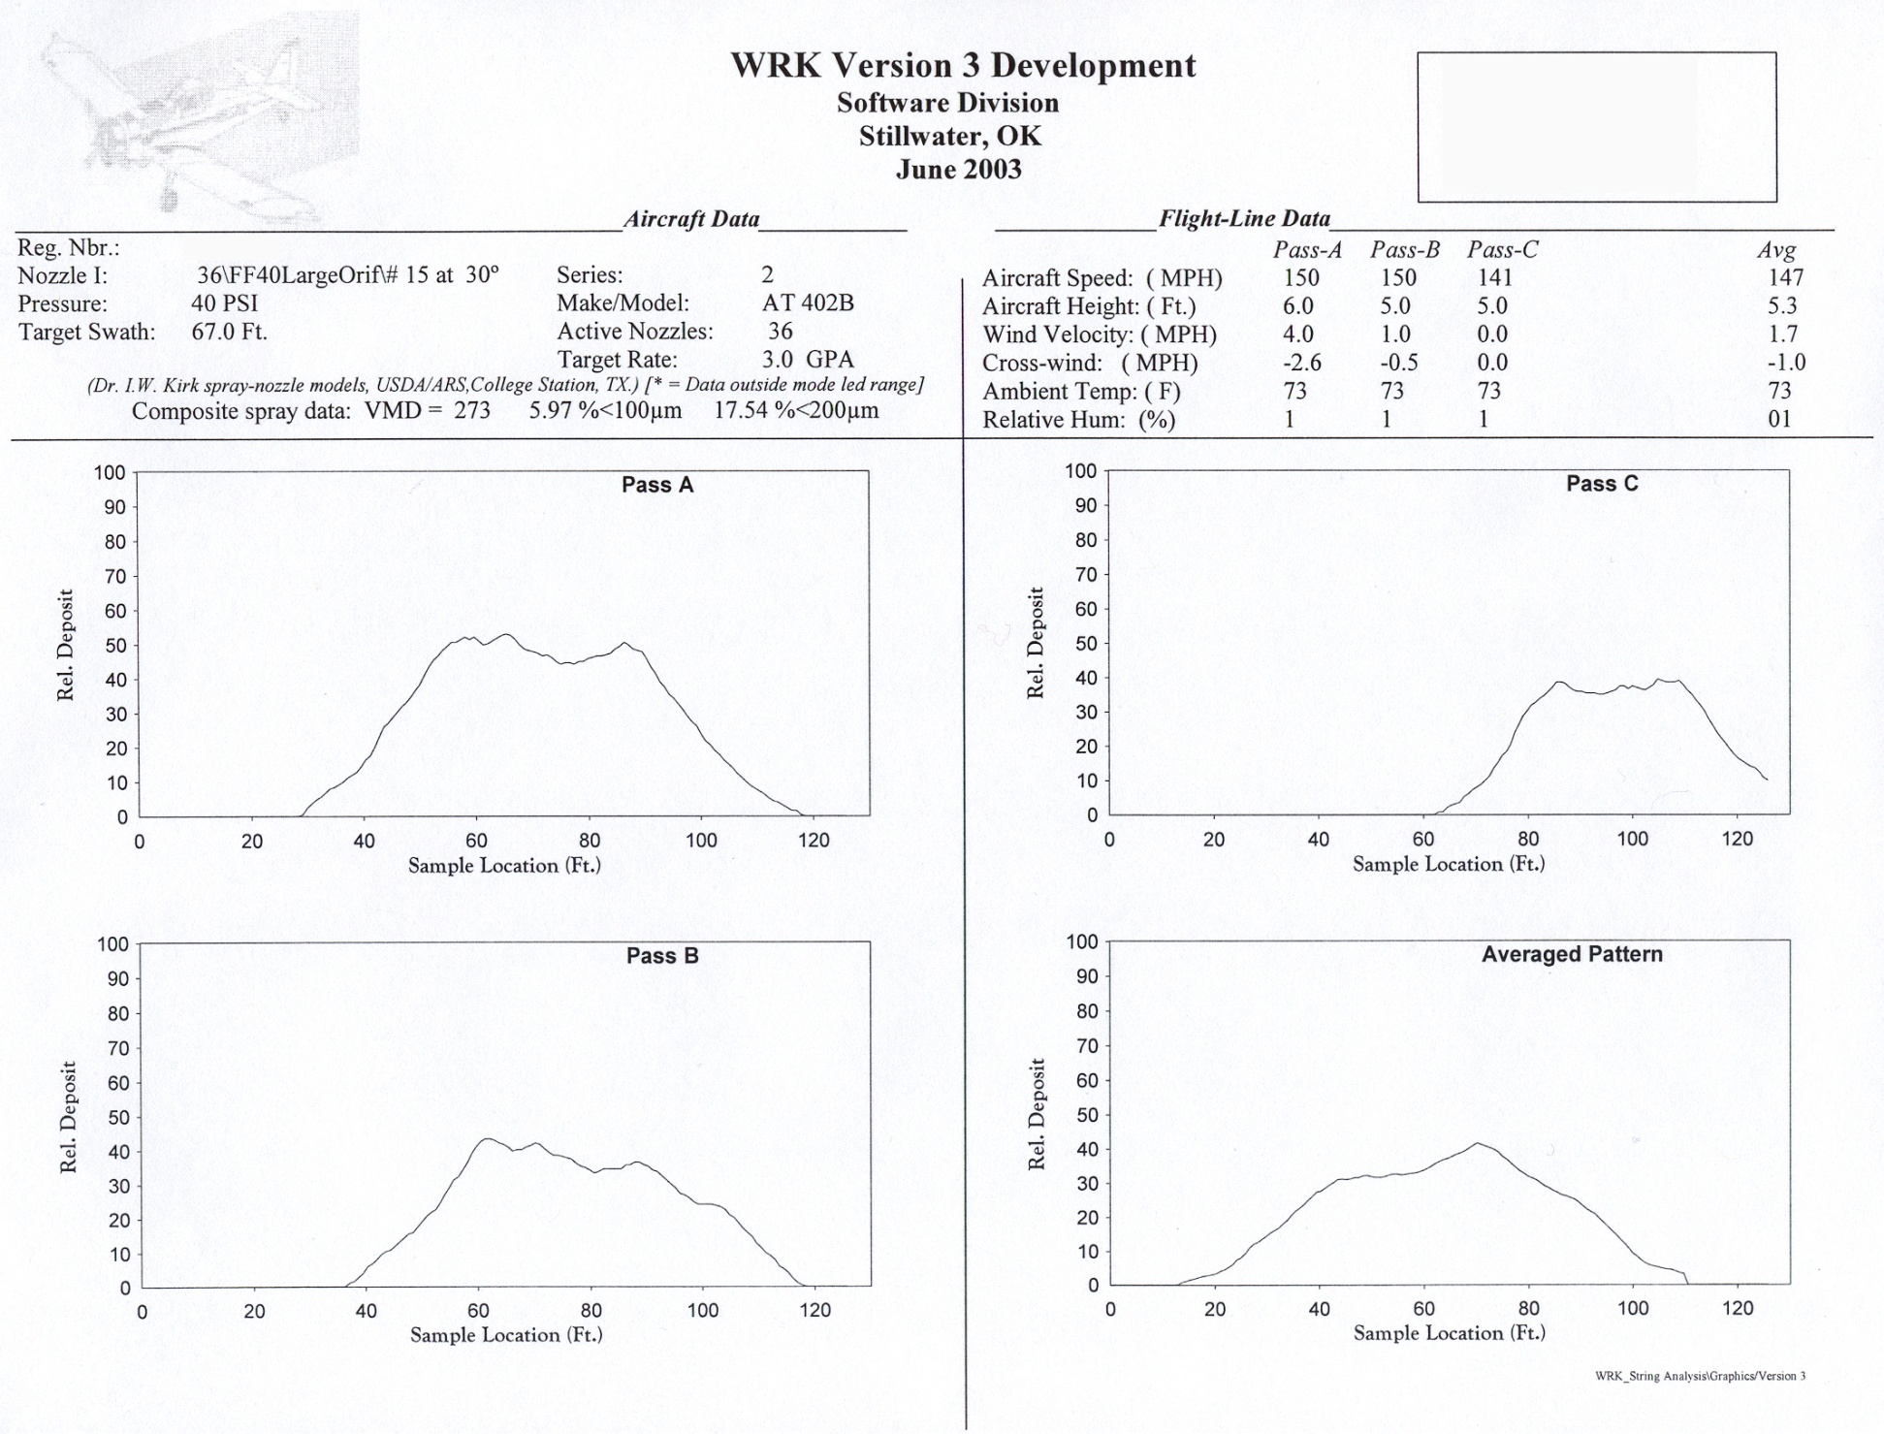
Spray pattern analysis

Slide 18
Aircraft data
1
2
3
Aircraft number
Series number – not pass number
Aircraft type

Slide 19
Aircraft data
1
2
3
Target swath – chosen by pilot
Number of active nozzles
Target GPA – chosen by pilot

Slide 20
Aircraft data
1
2
3
Nozzle type, size, and deflection angle
Operating pressure
USDA ARS droplet size model data

Slide 21
Individual passes
+ Pass B and C
Aircraft is flying INTO paper
Center
Left
Right
Relative deposition – not GPA deposition: 0 to 100%

Slide 22
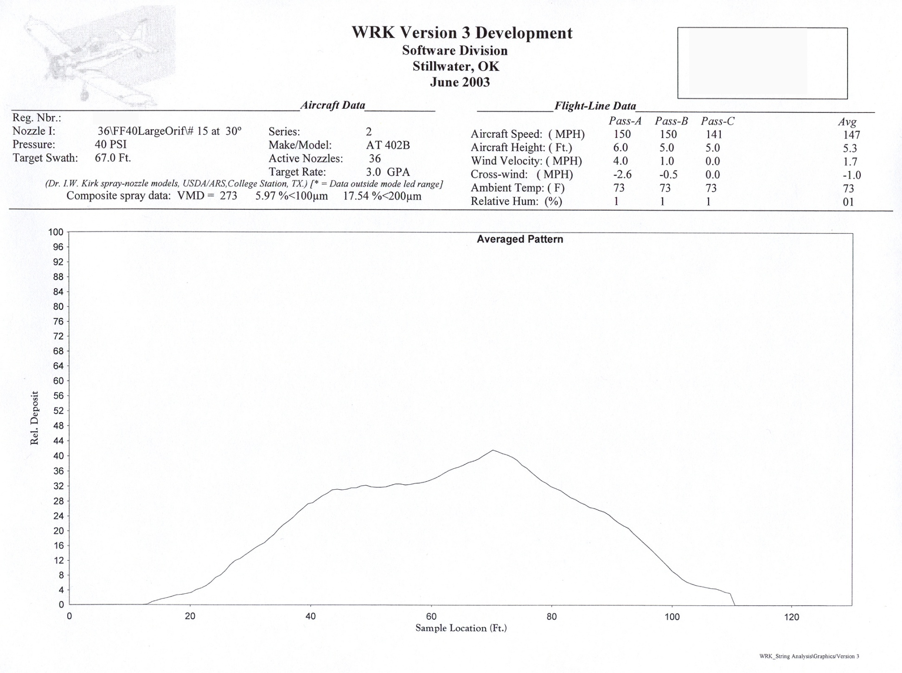
Averaged pattern
Aircraft flying into paper

Slide 23
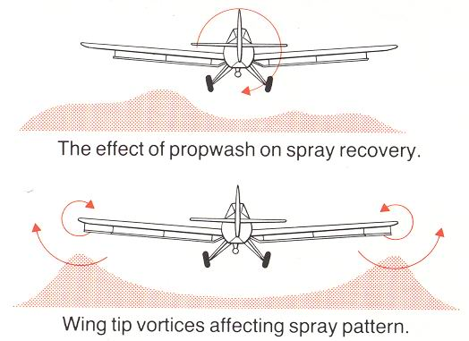
Spray pattern analysis

Slide 25
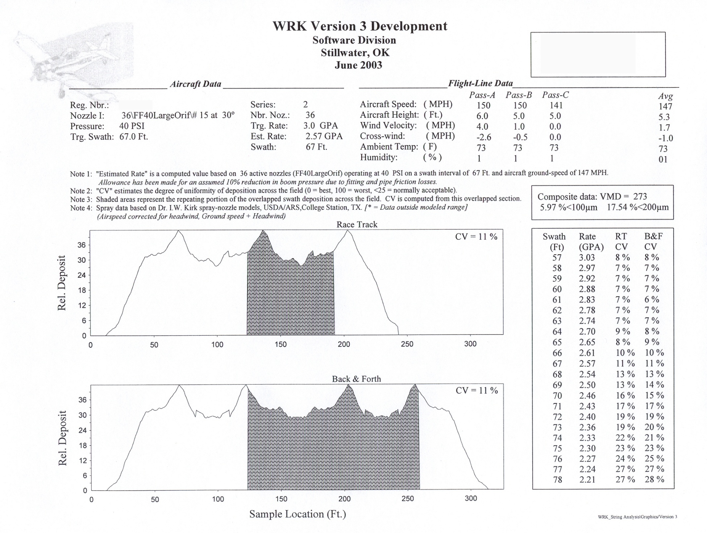
Spray pattern analysis

Slide 26
Aircraft data
1
2
Target rate – desired rate entered by pilot
Estimated rate – rate calculated by software using nozzle flow rate, number of nozzles, speed, and swath width

Slide 27
Aircraft data
1
2
Target swath – desired swath entered by pilot
Swath – swath setting in program and displayed in the race track and back and forth pattern graphs below (adjustable)

Slide 28
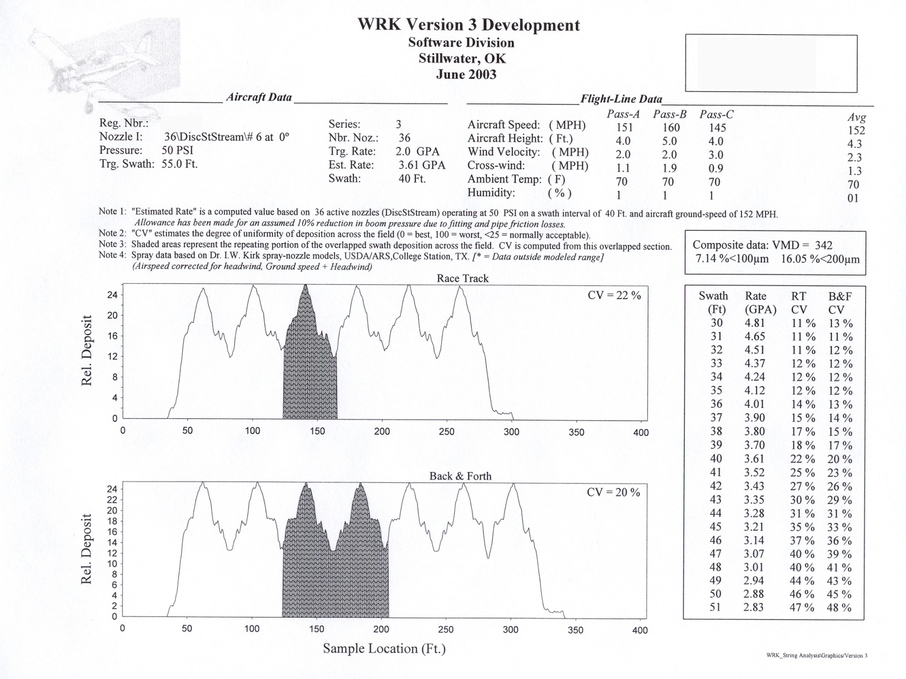
Spray pattern analysis

Slide 29
Race track pattern
Left
Right
Relative deposition across field using race track application
Aircraft flying into paper
Shaded area = repeating portion of the overlapped swath deposition based on the swath width set in program using the average pattern

Slide 30
Race track pattern
CV = coefficient of variation
Mathematical calculation of how uniform deposition is across field
The lower the better – more uniform
CV needs to be 25% or lower

Slide 31
Race track pattern
CV = 0
Perfectly uniform – no variation across field

Slide 32
Back and forth pattern
Right
Left
Relative deposition across field using back and forth application
Aircraft flying into and out of paper
Shaded area = repeating portion of the overlapped swath deposition based on the swath width set in program using the average pattern

Slide 33
Swaths - CV
This chart allows you to determine how changing your swath width changes your CV
Swath – range given for comparison
Rate – calculated, not measured
RT CV – race track coefficient of variation
B&F CV – back and forth coefficient of variation

Slide 34
Droplet size data
USDA ARS droplet size model data
VMD = volume median diameter
%<100μm = percent of volume in droplets smaller than 100μm
%<200μm = percent of volume in droplets smaller than 200μm

Slide 35
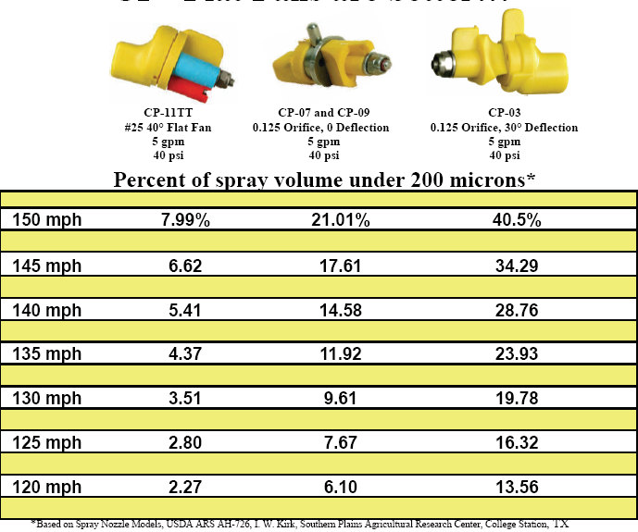

Slide 36
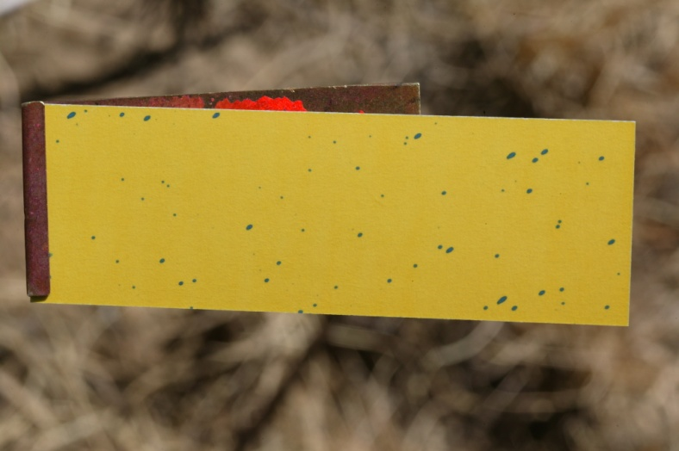
DropletScan

Slide 37
Droplet analysis - summary data

Slide 38
Composite droplet size data
VMD = average volume median diameter in microns
VD (0.1) and (0.9) = average volume diameter in microns for 10% and 90% of volume, respectively
GPA = average gallons per acre measured on cards
Percent coverage = average percentage of card surface area covered by stain

Slide 39
1/2 of spray volume = smaller droplets
VMD
1/2 of spray volume = larger droplets

Slide 40
Other droplet measurement terms
VD(0.1) – droplet diameter where 10% of spray volume is smaller (90% is greater)
VD(0.9) – droplet diameter where 90% of spray volume is smaller (10% is greater)
Relative span (RS) – used to describe the “width” of the spectrum
VD(0.9) – VD(0.1)
RS =
VMD

Slide 41
Important Droplet Statistics:
VMD
(50%)
or
Vd0.5
Operational Area
VD0.1
(10%)
VD0.9
(90%)

Slide 42
Droplet size recommendations
VMD usually should be in 300-350 micron range
A smaller VMD will be required for lower GPA rates
VD(0.1) > 200 microns – reduce the risk of drift
VD(0.9) < 600 microns – prevent large droplets that can reduce coverage by consuming large portions of the total volume
RS should be around 1 - provides suitable variation for differences in target structure

Slide 43
Volume diameter distribution
Percentage of volume in droplet diameter classes

Slide 45
Individual card - volume
1
2
3
4
Card position: negative numbers mean to the left side of aircraft, positive numbers to right side; number indicates distance in feet from center of flightline
GPA for that individual card
VMD for that individual card
Graph of percentage of volume in droplet diameter classes for that individual card

Slide 46
Individual card - number
1
2
3
4
Card position: negative numbers mean to the left side of aircraft, positive numbers to right side; number indicates distance in feet from center of flightline
Percentage of card surface area covered by stain for that individual card
VMD for that individual card
Graph of number of droplets in droplet diameter classes for that individual card

Slide 47
uPDATES

Slide 48
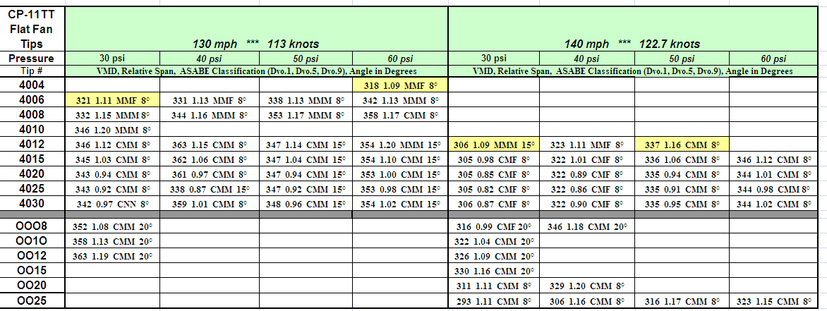
Herbicides

Slide 49
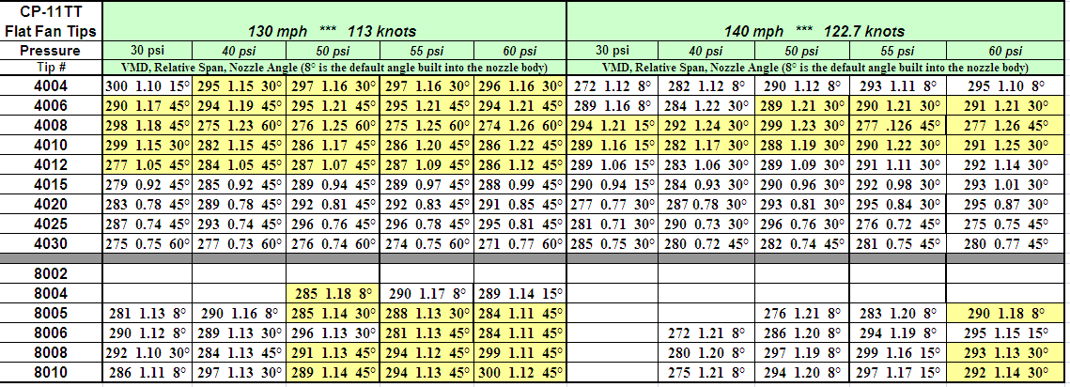
Fungicides

Slide 50
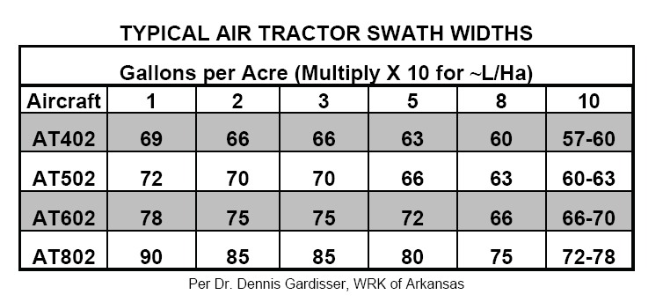

Slide 51
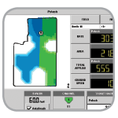
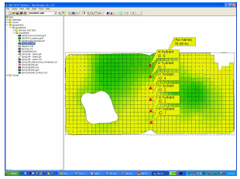
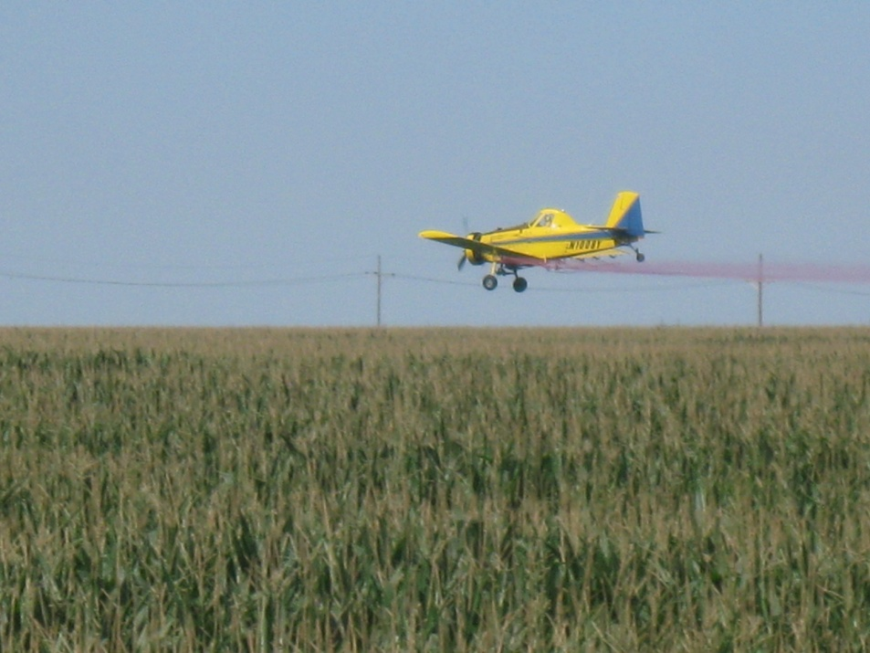
Variable Rate/Mapped Applications
Predeveloped variable rate maps
Dependent on target variables
pest pressures, species, size
Flow and droplet control issues

Slide 52
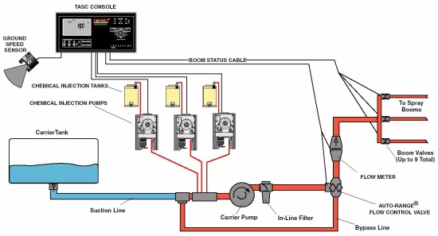
Variable Rate Liquid:
Direct Injection
Complex
Time lag
Fixed orifice nozzles
Flow proportional to square root of pressure
Difficult to achieve range in flow rates
Pulse Width Modulation
Variable orifice nozzles
Pressure/Flow relationship is more complex

Slide 53
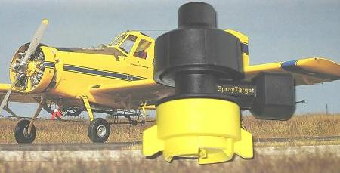
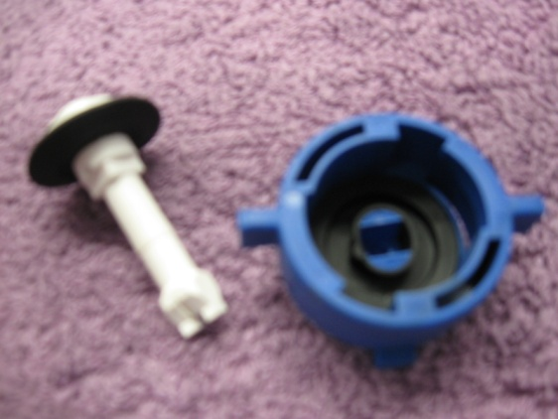
VariRate:
Speed variations in MPH
Application rates variations in GPA
Spring tension
Variable area pre orifice
Variable area spray orifice
Optimize spray droplet size
Maintain efficacy and minimize drift
Very Fine
Fine
Medium
Coarse
Very Coarse
Droplet Control
Notes:
This nozzle has been built for the task. Developed at the U of TN, sold to Delevan (Patent Squabble rumored), AgCo selling it. They are pushing on new sprayers. Most buyers have no idea about it. It has also been marketed in aerial applications and some problems are reported. The varialble orifices (flexible rubber parts) may not hold up to acres and acres of use. Some adjustments have been made to the gaskets but…. I have proposed a study with the KS Corn Board and am in the final screening for a go. There are no research trials showing efficacy and durability of this nozzle. Time will tell but is sorely needed. Priced at $65-85 per nozzle.

Slide 54
www.spraytarget.com

Slide 55
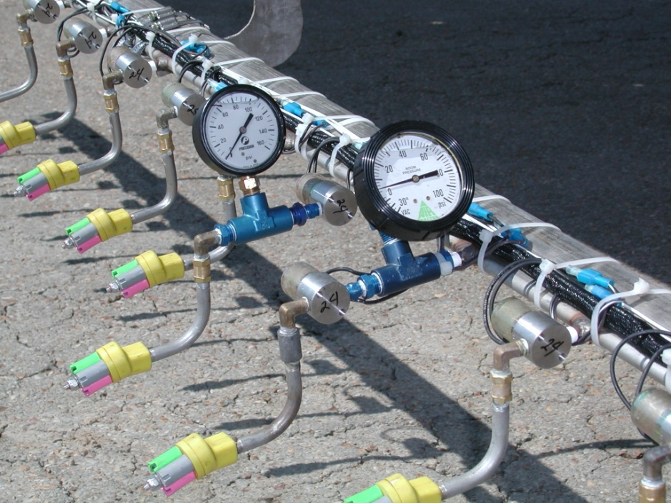
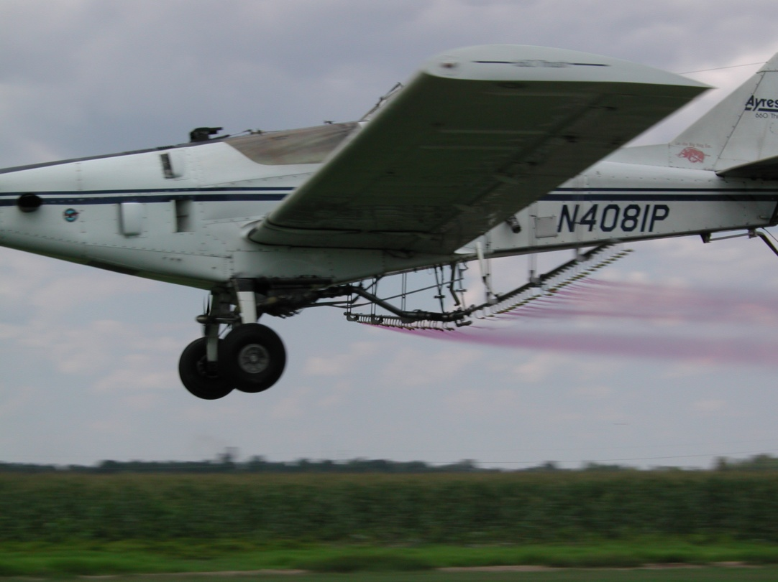
Blended Pulse Technology
Independent Flow Control (1-8X)
Independent Drop Size Control
Separate boom section controls
NEW – Individual nozzle control - paired

Slide 56
How it Works:
Uses high speed solenoid valves to regulate flow
Varies application rate with duty cycle: independently of pressure

Slide 57
What is Pulse Width?
Type of control system
Modulates a DC square wave signal

Slide 58
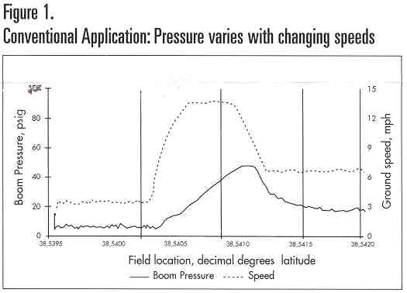
Courtesy of Ken Giles, U of California Davis

Slide 59
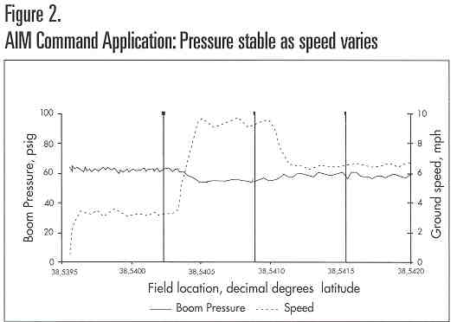
Courtesy of Ken Giles, U of California Davis

Slide 60
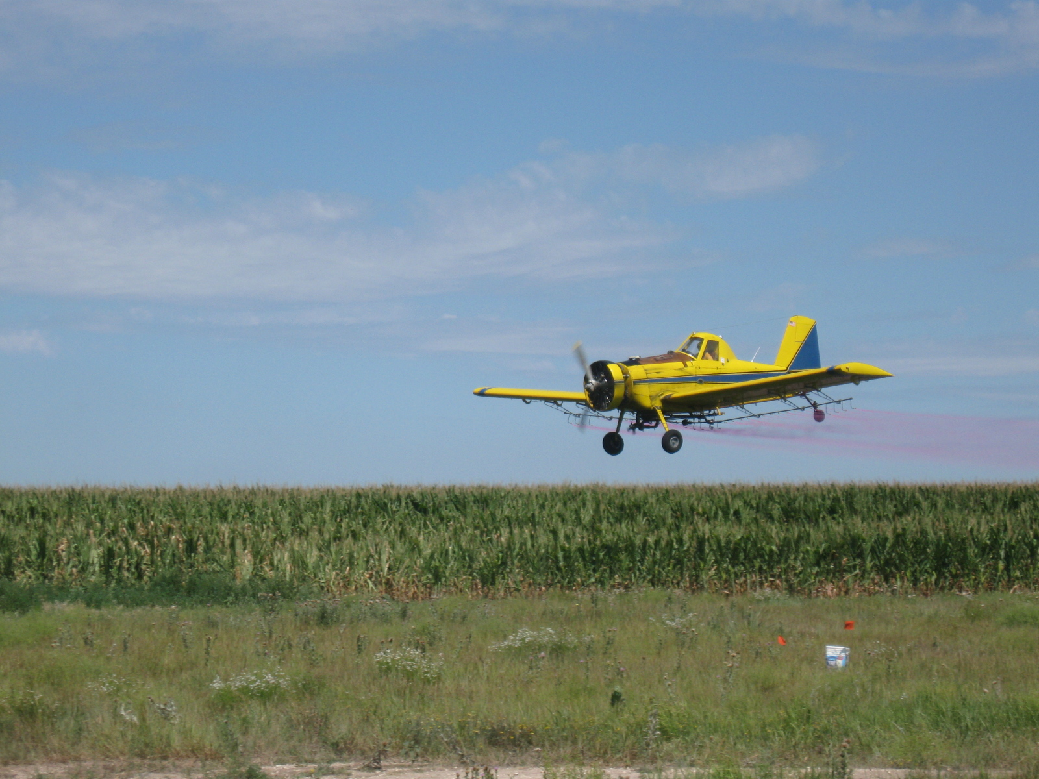
Papers – ASABE/NAAA Mtg – Dec. 7
Paper # AA09-001
Title: Aerial Comparisons of Drift Reducing Tank Mixes
Author(s): Wolf, R., Bretthauer, S., Gardisser, D.
Time: 10:00 AM
Paper # AA09-008
Title: Effects of nozzle type and spray solution on fungicide applications to corn
Authors: Bretthauer, S., Wolf, R.
Time: 1:20 PM

Slide 61
Materials and Methods (2008):
AT 502A(Rucker Flying Service)
Drop booms
CP-11TT #15 straight stream nozzles w/8° deflection
44 PSI
150+ mph ground speed by GPS
Droplet spectrum:
Aircraft calibrated for 3 GPA

Slide 62
Participants in the Study:
Products
Formula One
Control
INT 908
#PX056-Z
Interlock 0.8
Interlock 1.25
AG 06037
AG 08050
Super HC + Interlock
Tap Water
Tap Water + oil
Companies
United Suppliers
Garrco
Rosen’s
Precision Labs
Winfield Solutions

Slide 63
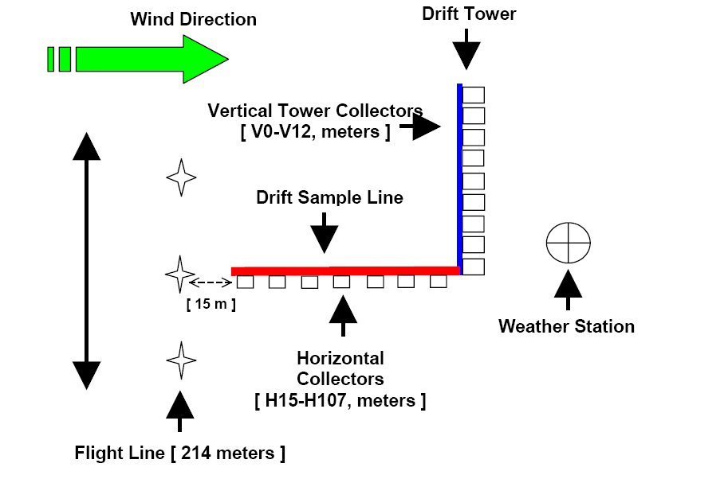

Slide 64
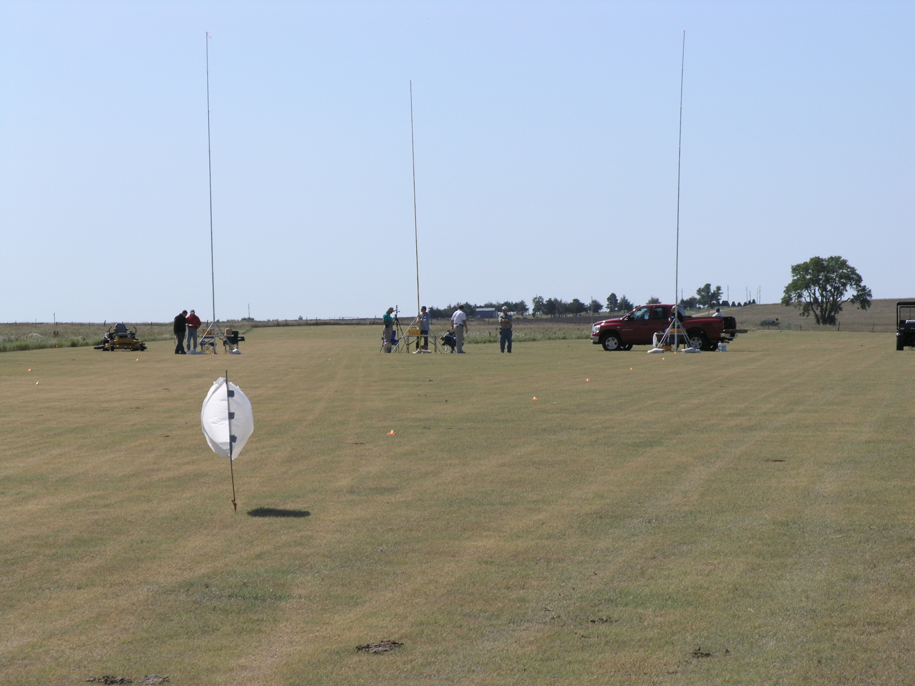
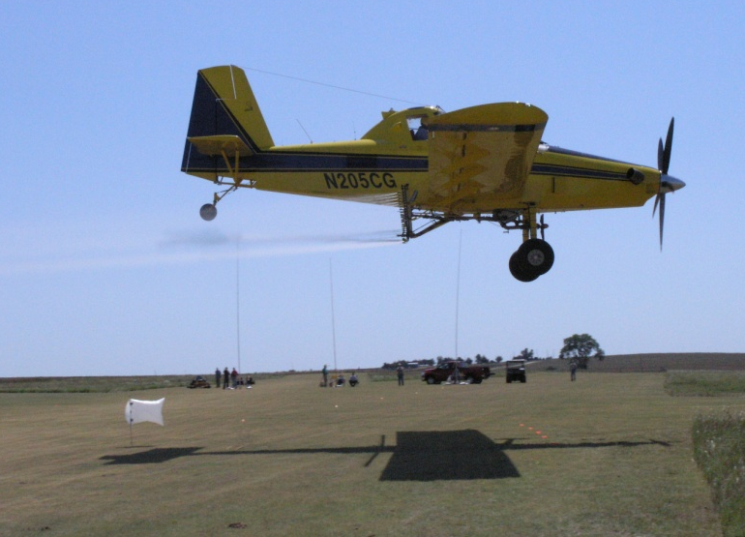
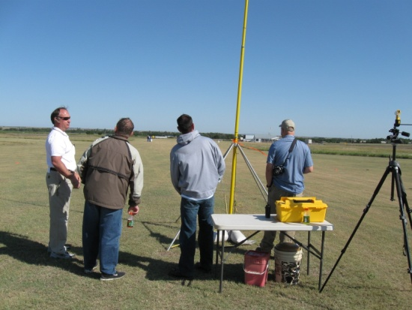

Slide 66
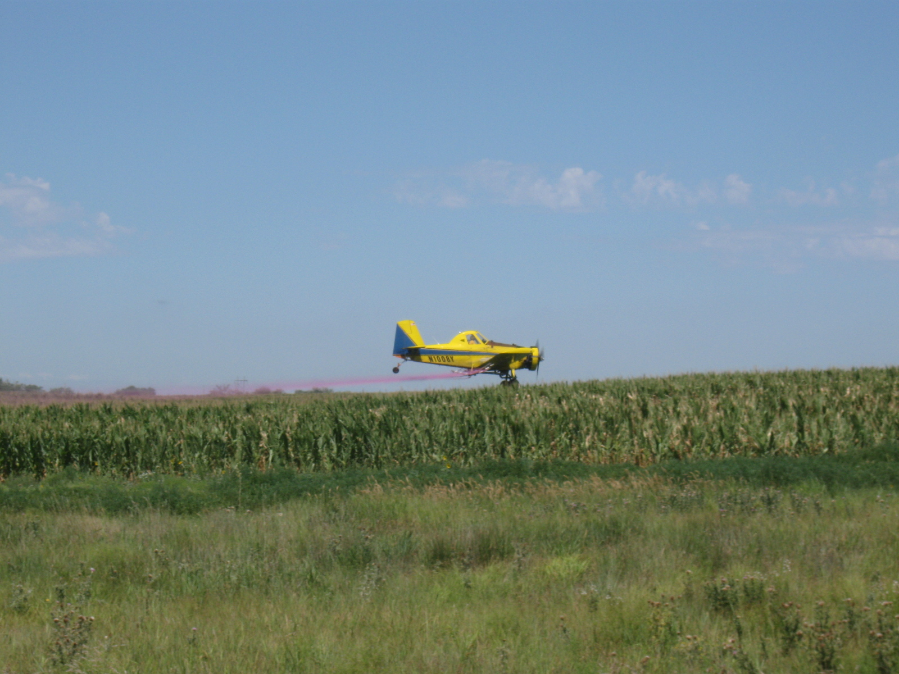
BASF Project – Meade, KS
Treatments @ 3 GPA
Headline EC + COC
Headline SC + COC
Headline SC + Caramba
Quilt + COC

Slide 67
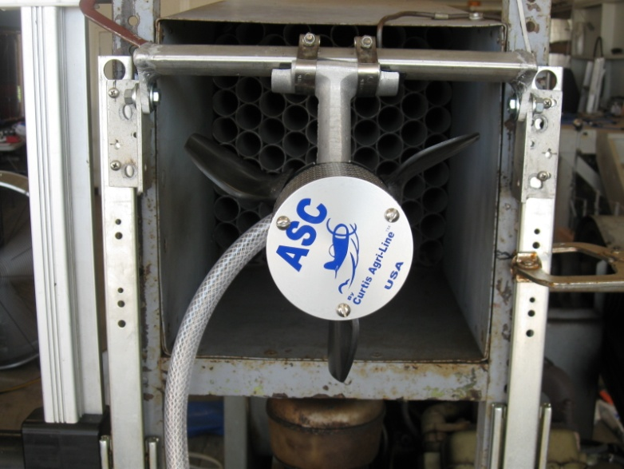
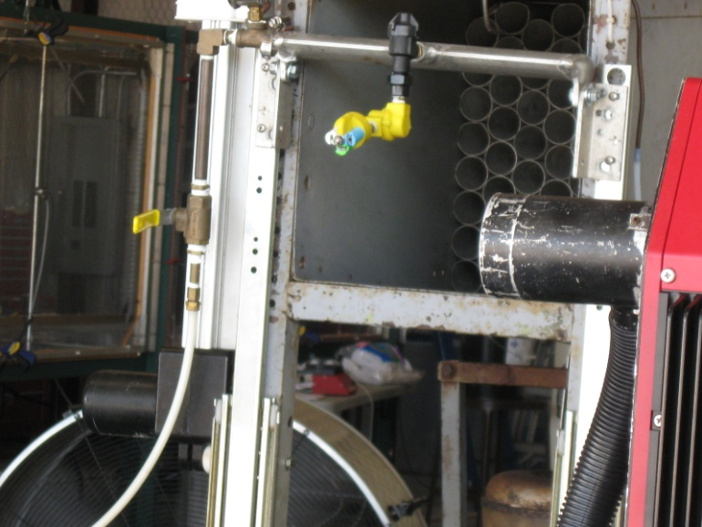
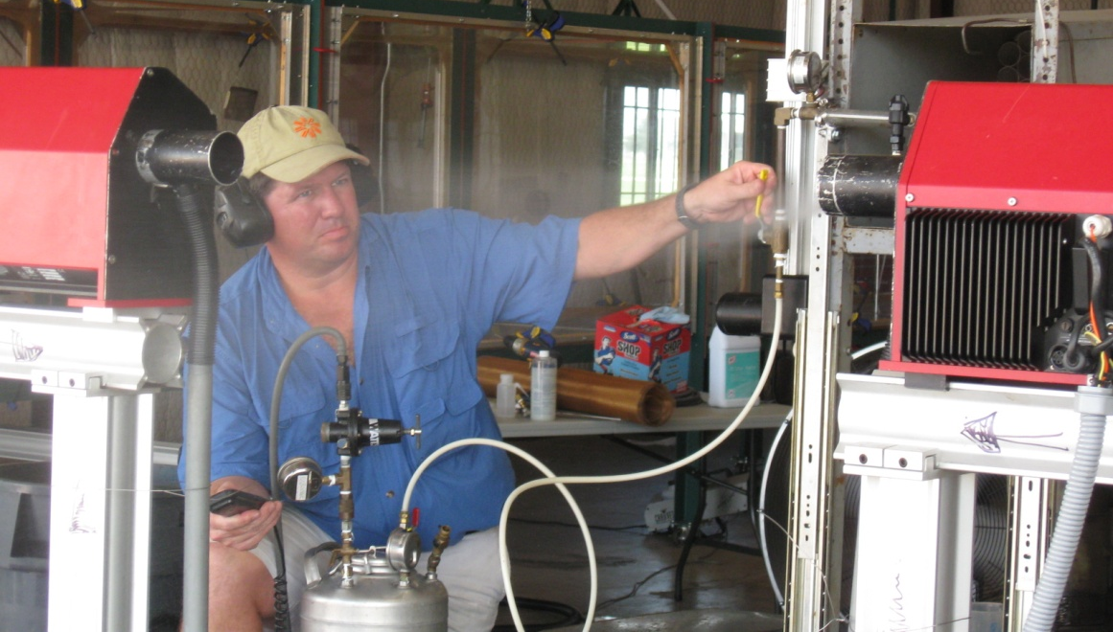
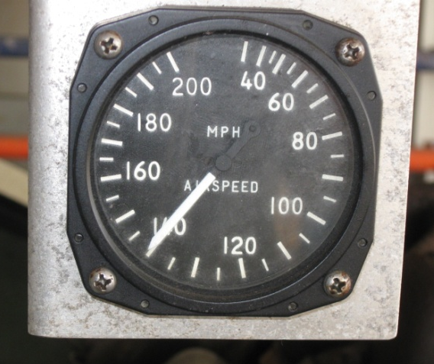
Droplet Testing with Tank Mixes

Slide 68
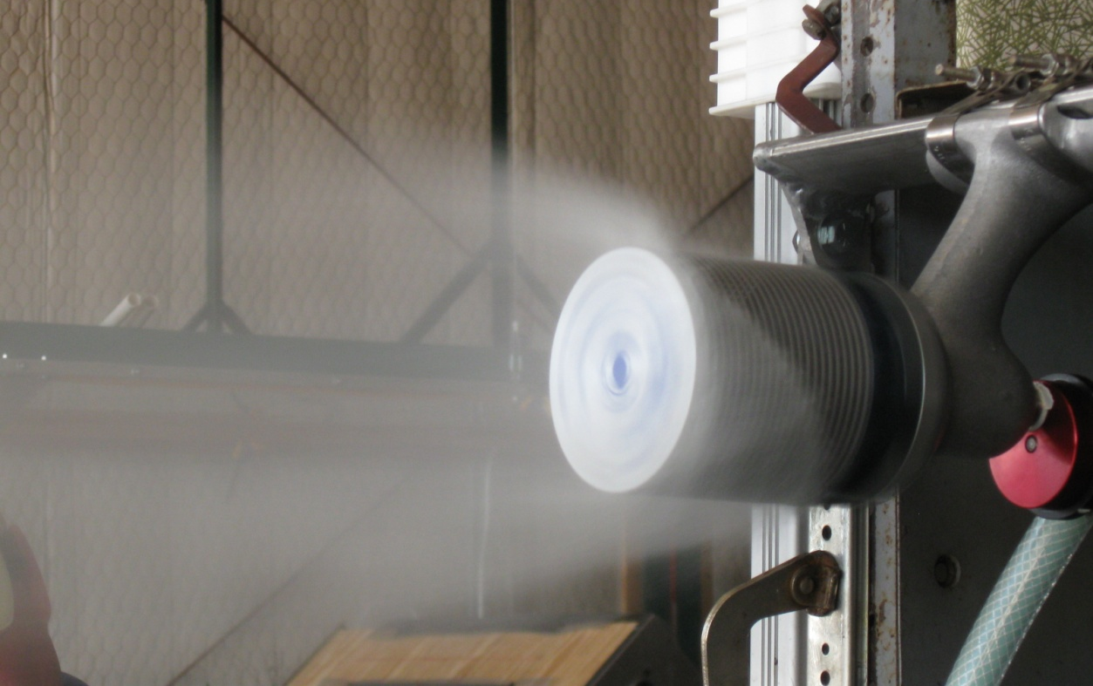

Slide 71
Spread Factor Testing

Slide 73
Volume Median Diameter (VMD)
% less than 210 Microns
37
51
36
35
45
23
30
14
15
26
19
22
14
13
22
10
17
29
29
15
Percent fines
40 psi 40 psi 40 psi 70 psi
Bob Klein, U of Nebraska

Slide 74
Disclaimer:
Brand names appearing in this presentation are for identification and illustration purposes only.
No endorsement is intended, nor is criticism implied of similar products not mentioned.

Slide 75
rewolf@ksu.edu
For more information contact:
Thanks!
www.bae.ksu.edu/faculty/wolf/

