Slide 1
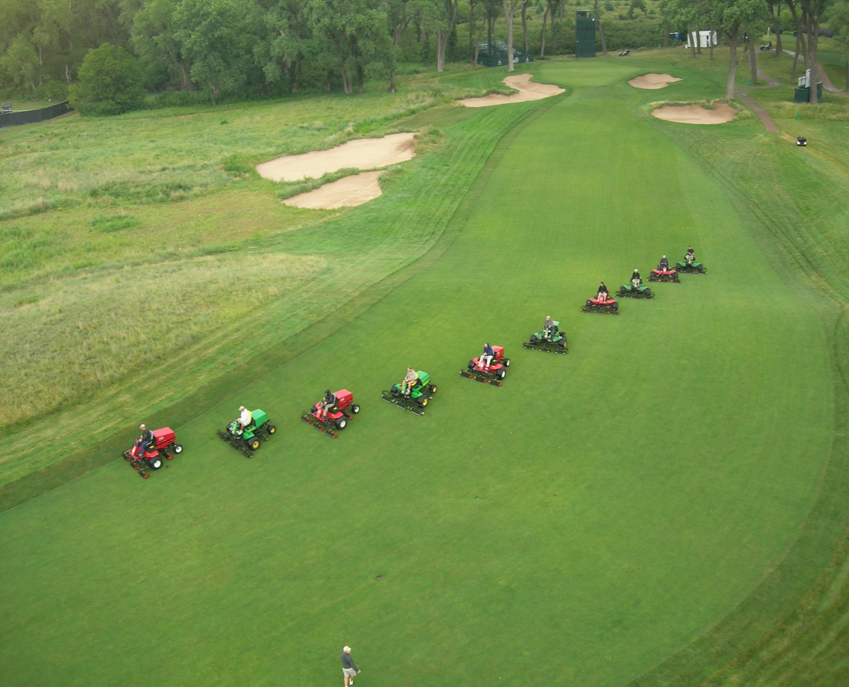
Turf and Ornamental Equipment and Calibration
Robert E. Wolf
Biological and Agricultural Engineering Dept.
Kansas State University

Slide 2
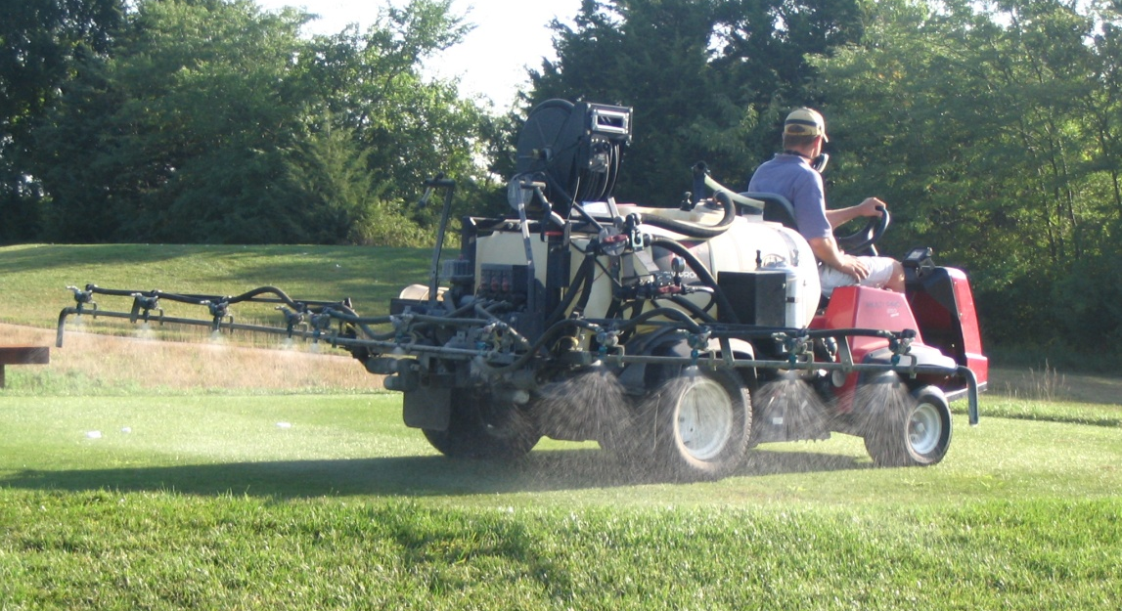
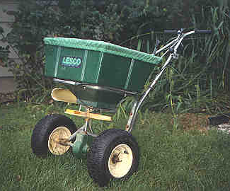
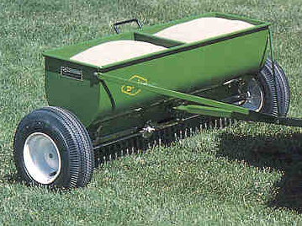
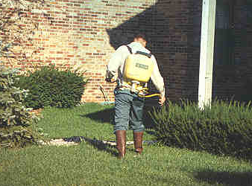
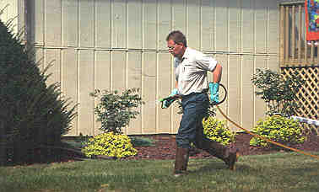
Application Equipment:
Two basic types of application systems:
  Liquid (sprayers)
  Granular

Slide 3
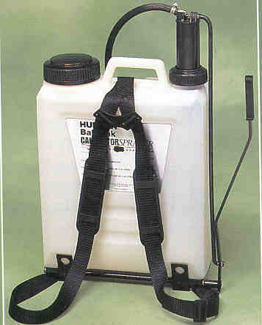
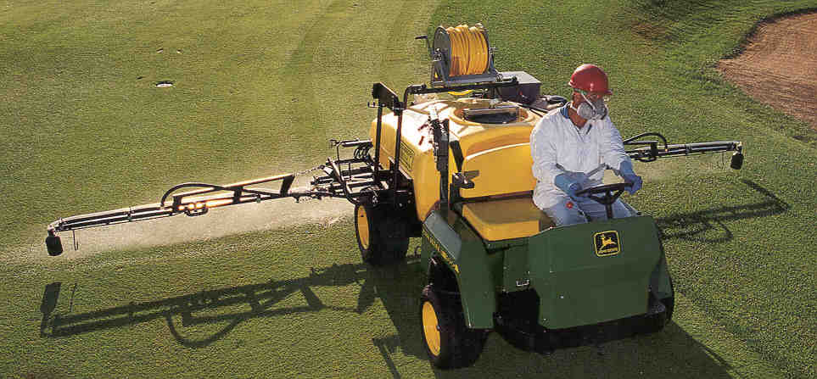
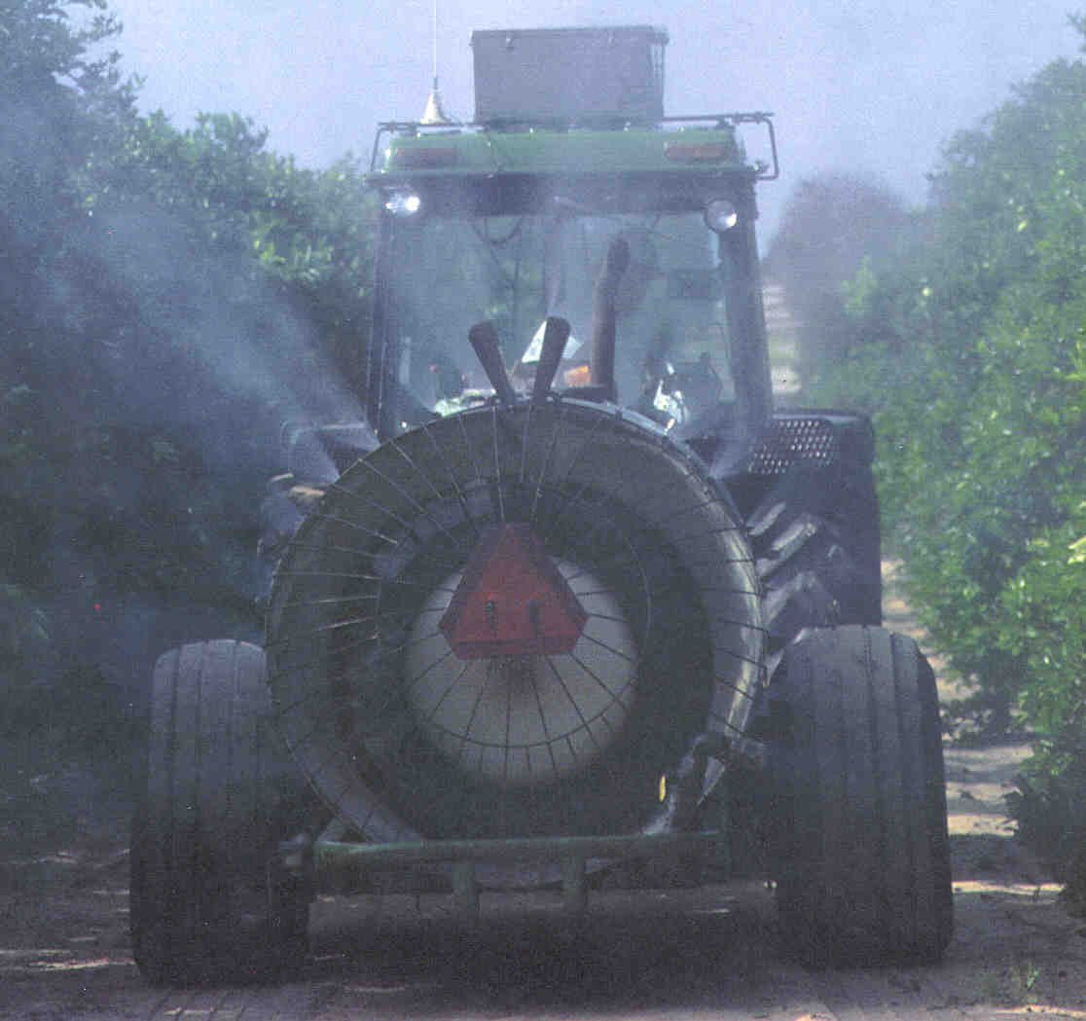
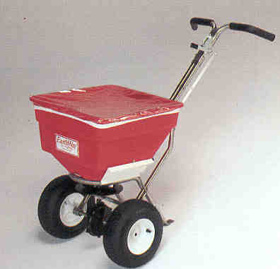

Basic application devices:
Hand-can pump sprayers
Backpack sprayers
Boom sprayers
High pressure sprayers
Air-assist sprayers
Aerial (spray and granular)
Granular

Slide 4
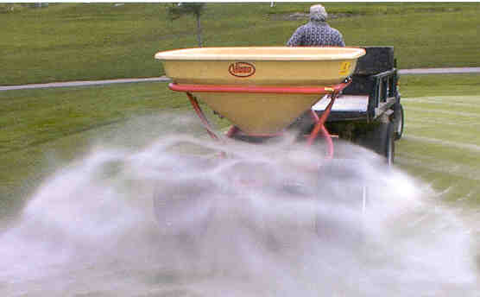
Dry application devices:
Centrifugal, rotary, or broadcast
Drop
Pendulum
Pneumatic

Slide 5
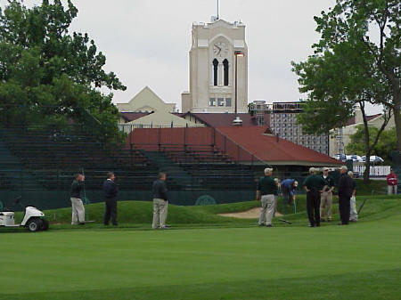
Calibrating Granular Applicators

Slide 6
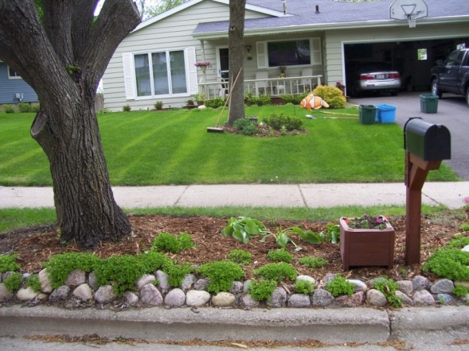
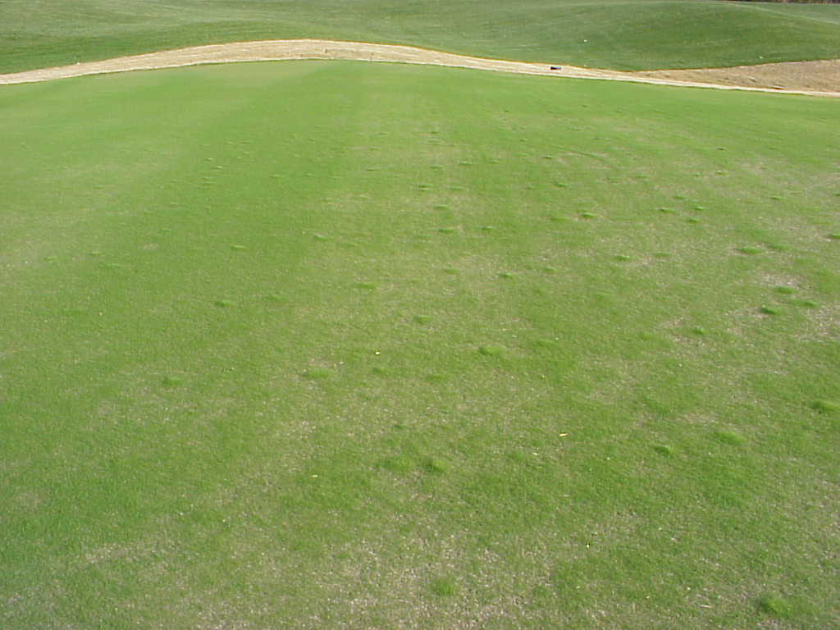
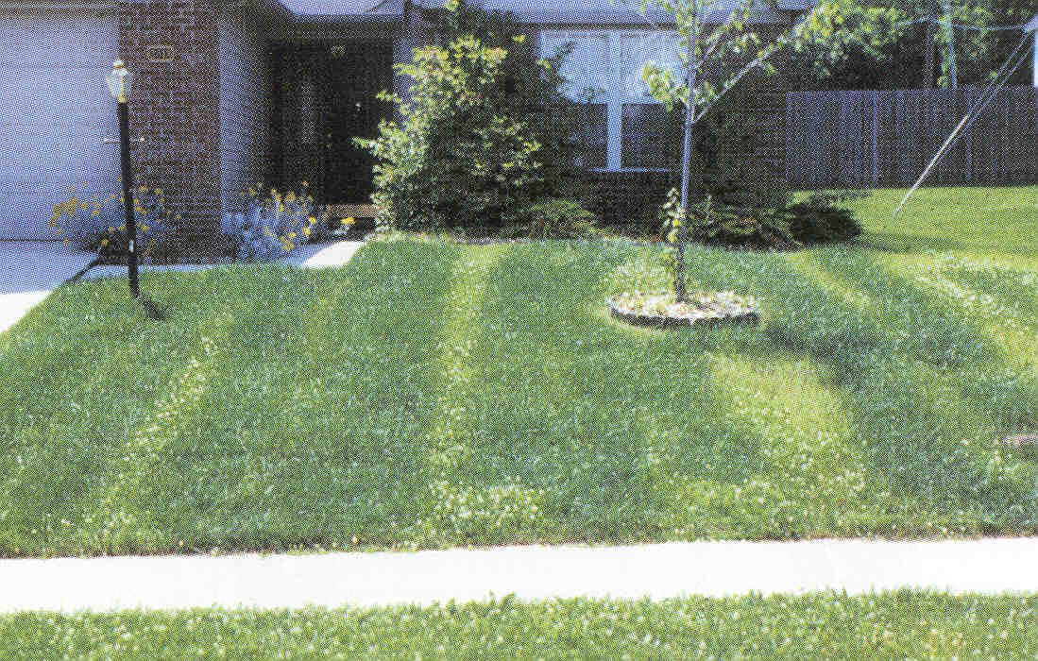
Calibrating granular spreaders:
Reduces complaints about weed, insect, and disease control.
Lowers incidences of using wrong amounts.
Minimizes potential problems to the environment.

Slide 7
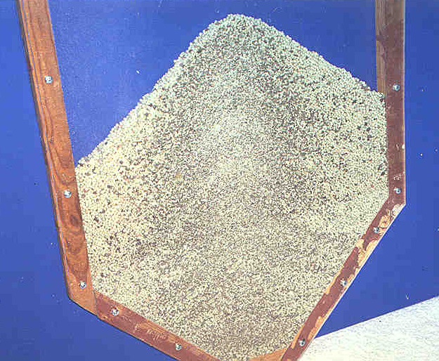
Factors influencing granular rates:
Size of metering orifice.
Speed of the agitator or rotor.
Travel speed
Roughness of the application area.
Topography of the application area.
Flowability of the granules.
Quality of the granules/mix.
Temperature and humidity.
Wind

Slide 8
Checking distribution pattern:
Open area – bounce and scatter.
Preferred method – use collection containers on a line perpendicular to the direction of travel.
Enough boxes to cover 1½ times the anticipated swath width.
Make several passes over the boxes – in the same direction.
Empty contents from containers into a tube or bottle.

Slide 9
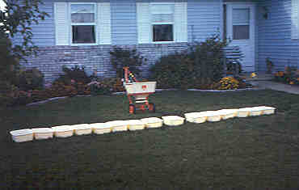
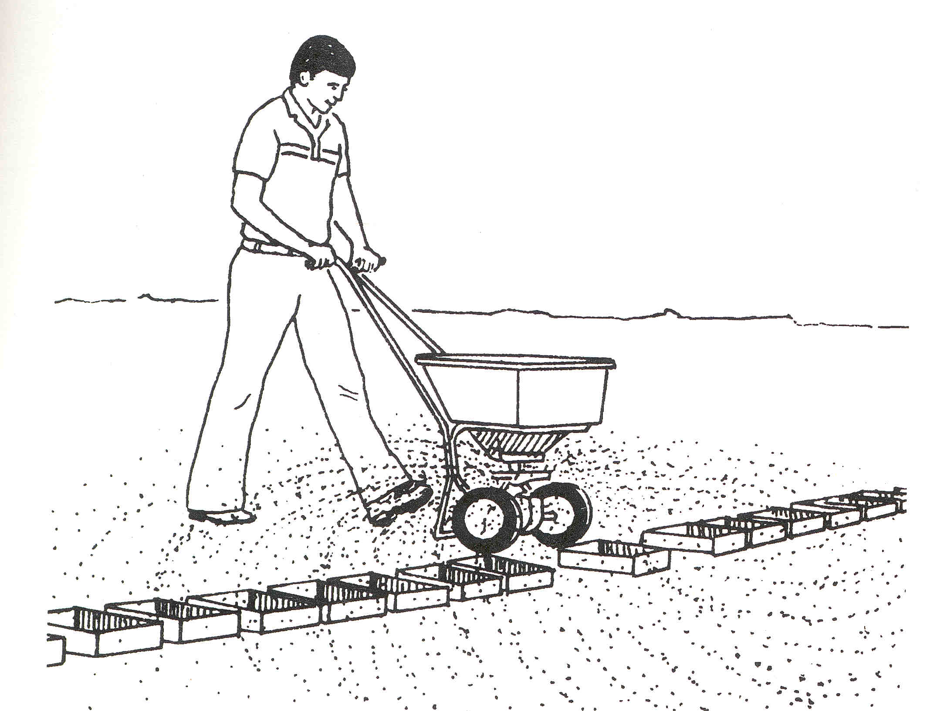
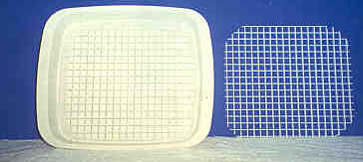

Slide 10
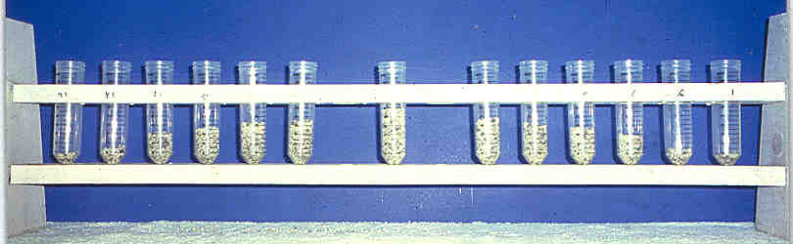
Pattern distributions:
Primary collection

Slide 11
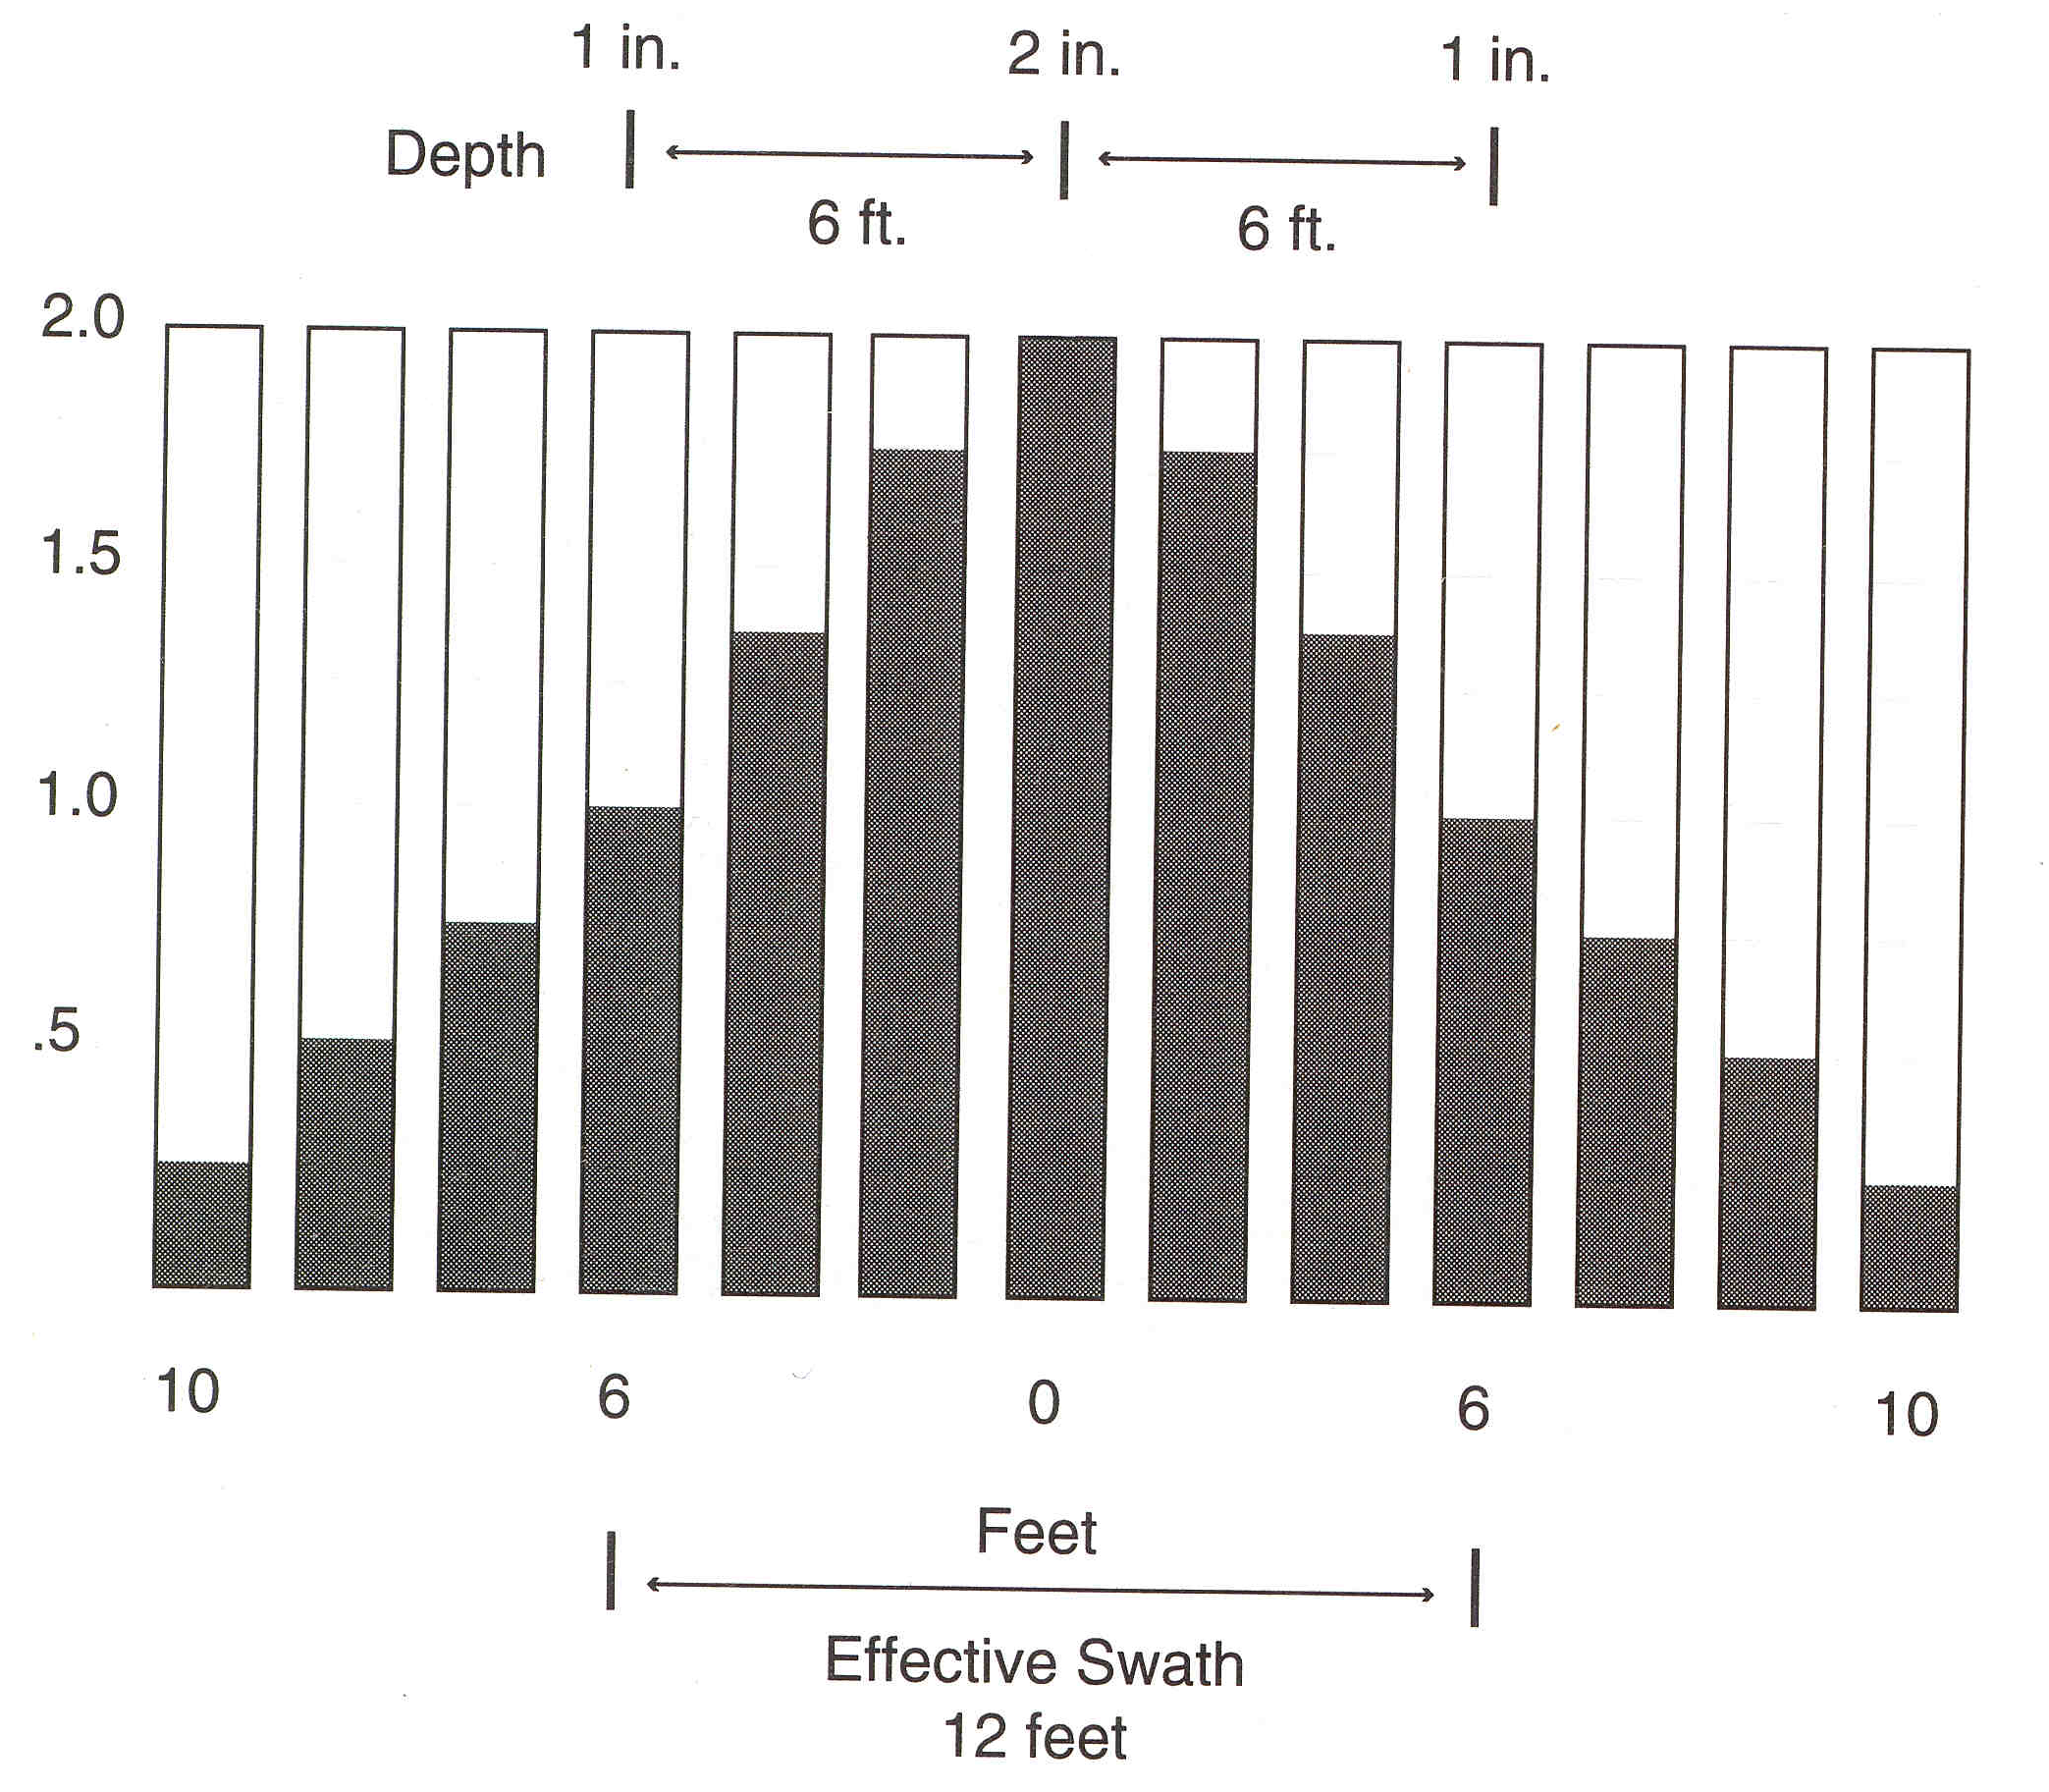
Determining the swath width using the tube method:
Compare the tubes.
Determine the tube that is ½ the amount of the center tube.
These two tubes determine the boundaries
5 ft.
5 ft.
5
5
10 feet

Slide 12
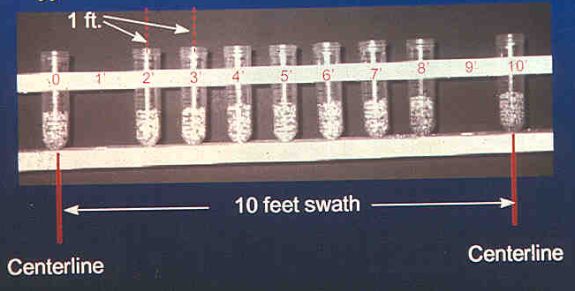
Effective swath width:

Slide 13
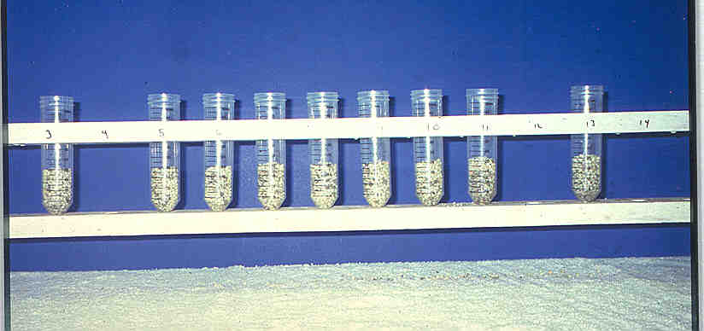
Final pattern:

Slide 14
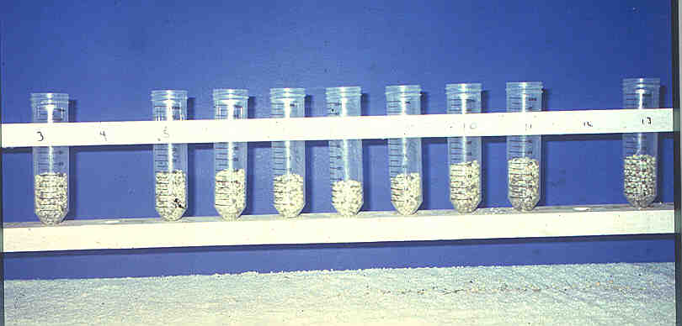
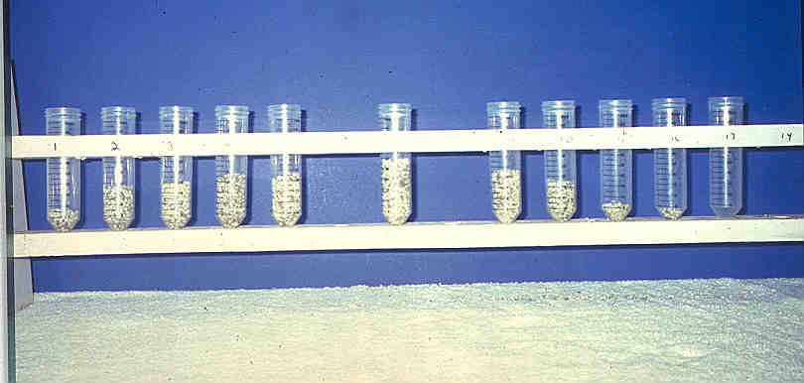
Pattern distributions:
Swath To Wide
Side Wind

Slide 15
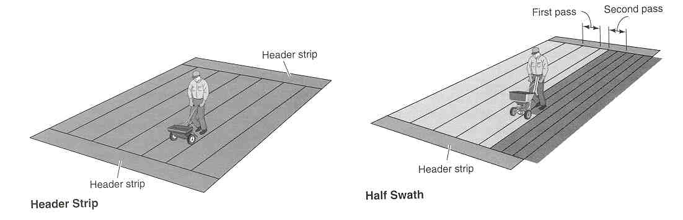
Header strips and swath overlap:
Recommended application method:
  First pass at ½ rate using calibrated swath width
  Second path on centerline of previous pass

Slide 16
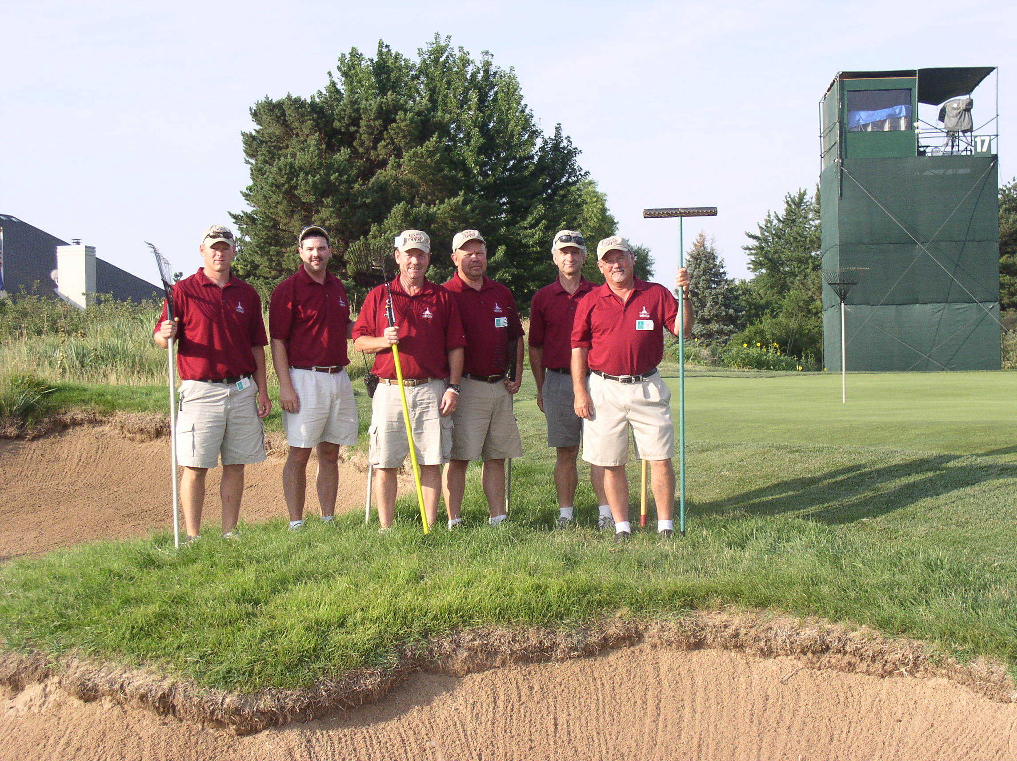
Liquid Application Equipment

Slide 17
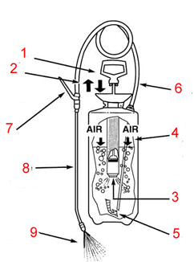
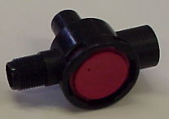
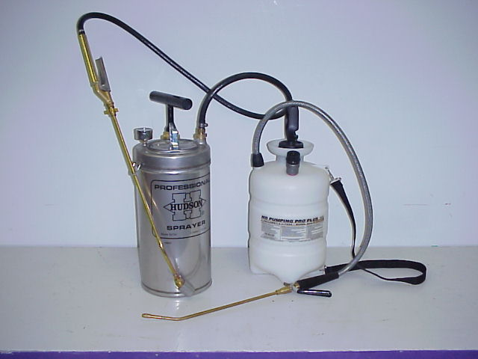
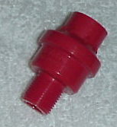
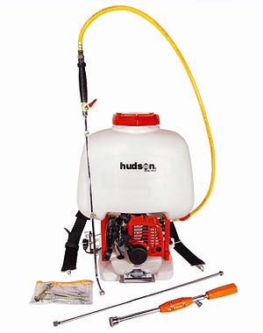
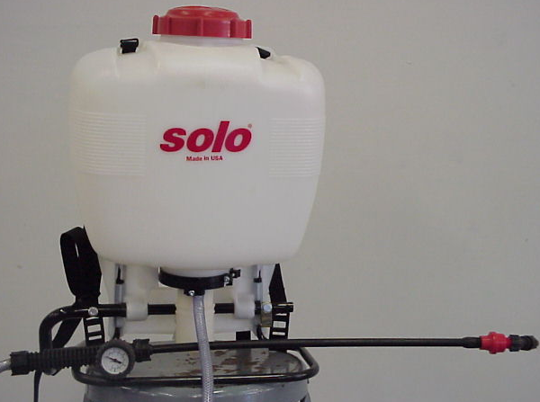
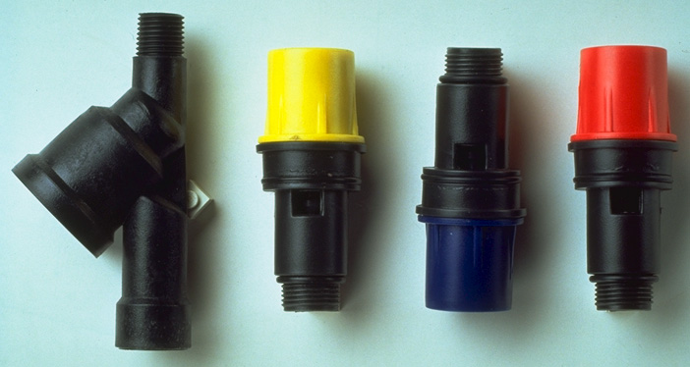
Liquid Application Equipment
Manual Sprayers
  Compressed air
  Knapsack
Easy Spray Valve
CF Valve
Spray Management Valve

Slide 18
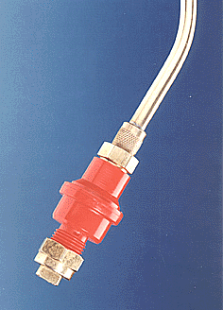
Reduces number of times manual sprayer needs to be pumped.
Regulates pressure for steady, even flow.
Shuts off spray if pressure falls below set amount.
Allows for constant, precisely calibrated spray application.
Reduces drift and spray waste- environmentally sound.
Makes operator training faster and easier.
Available in 15, 21, 29, and 44 psi

Slide 19
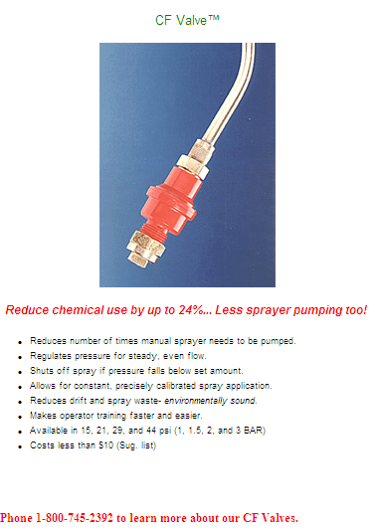
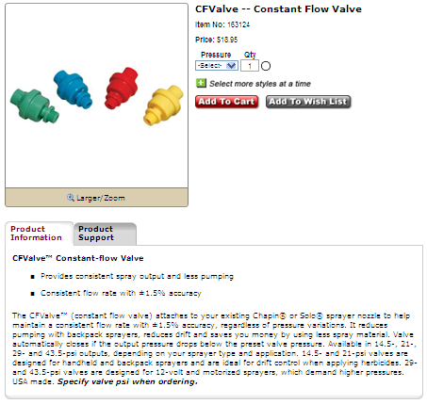


Spray Management Valve

Slide 20
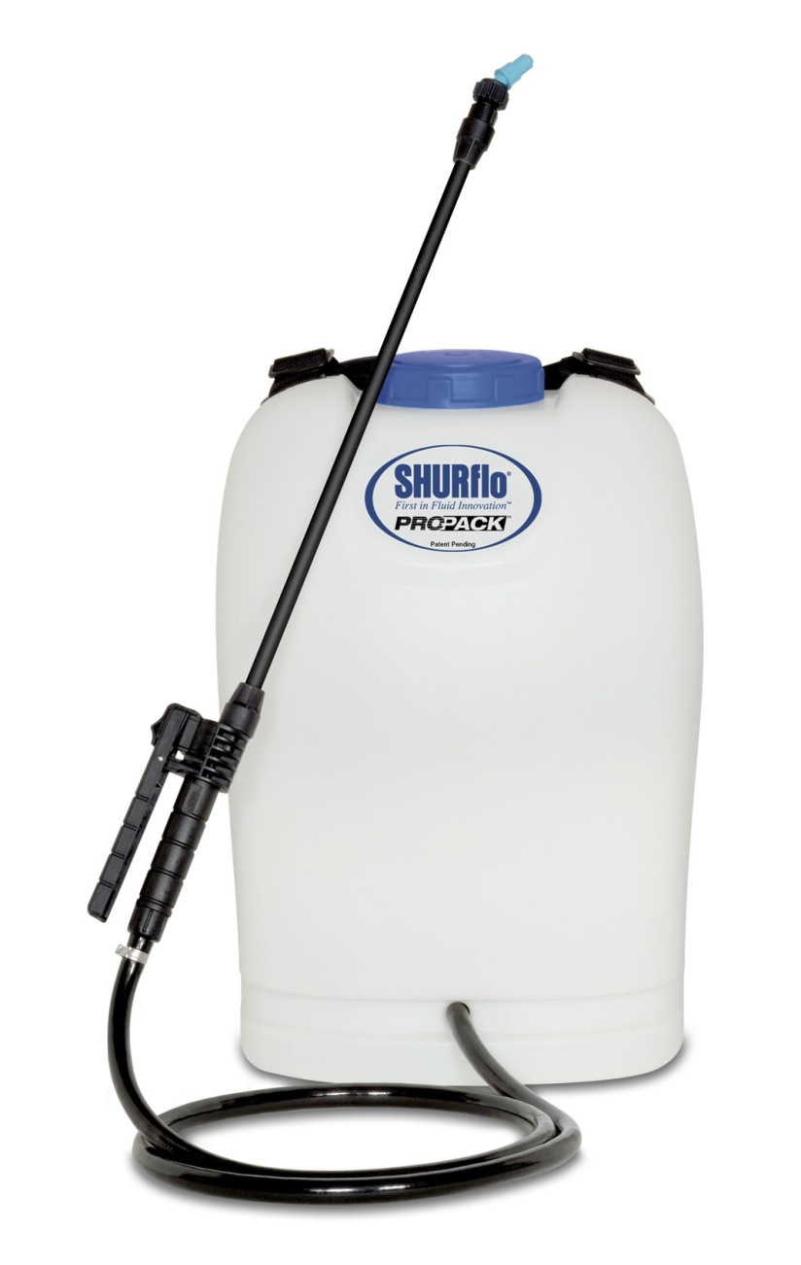
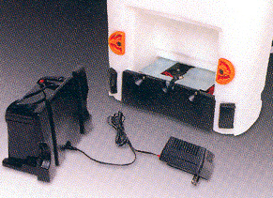
SHURflo SRS-540
4 gallon tank
12 volt, 7.0 Amp/hour sealed battery
120 gallons per charge
12 volt SHURflo pump @ 1.0 GPM @ 40 psi
Microprocessor pump control
Variable speed
Adjustable nozzle

Slide 21
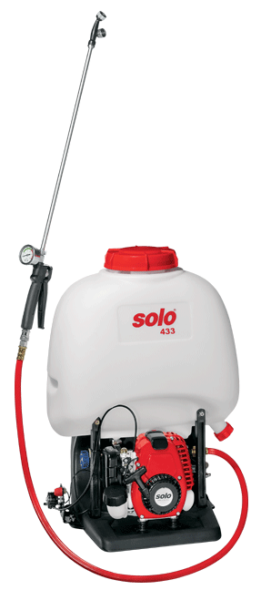
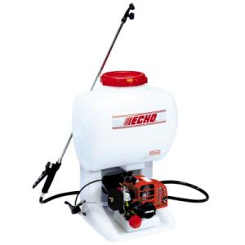
Commercial Back-Pack Power Sprayers
Gasoline powered
Model 18537
1 hp engine
6.5 gallon tank
Gasoline powered
Model SHR-210
21.2 cc engine
5 gallon tank
Recirculating pump
2-cycle power
Model 433
Piston pump
25 cc engine
5.3 gallon tank

Slide 22
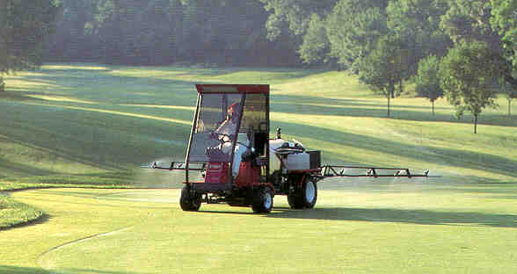
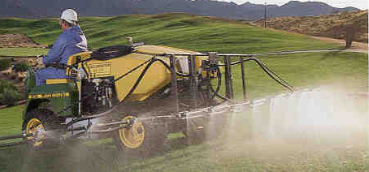
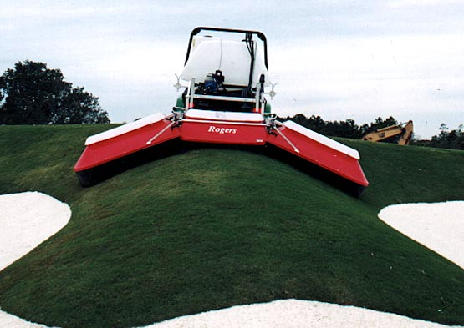
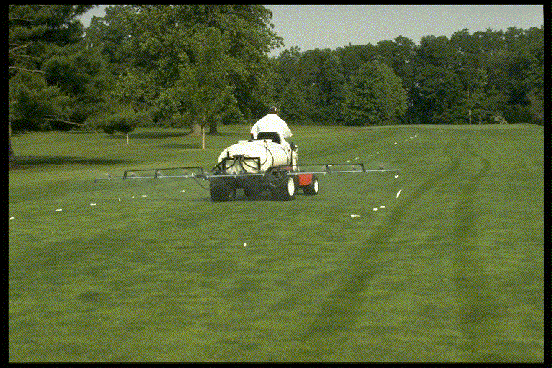
Powered Boom Sprayers

Slide 23
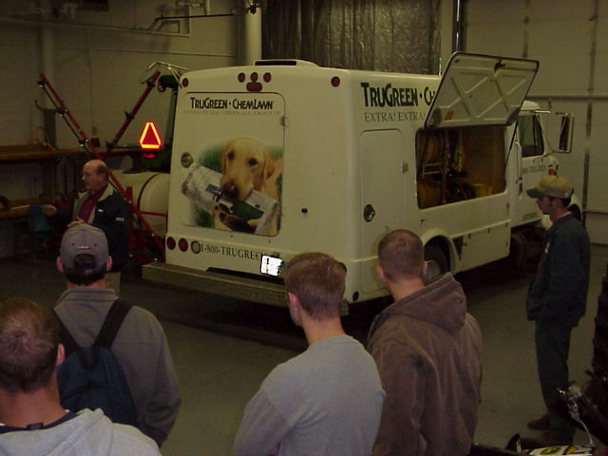
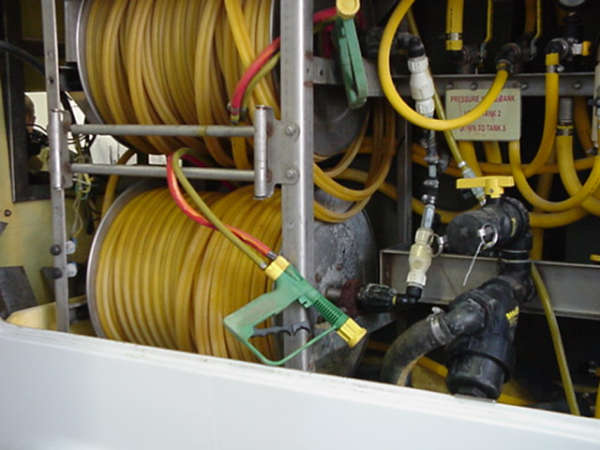
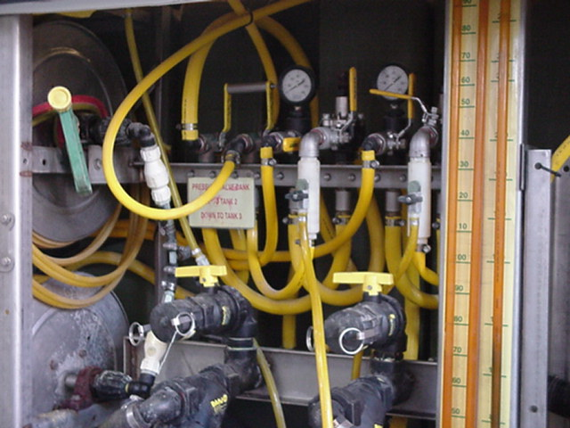
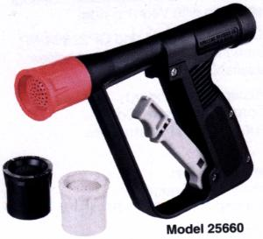
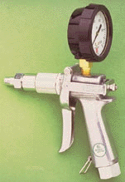

Professional Lawn Care

Slide 24




Slide 25
Vertical Reach at Various Pressures (Spray Gun)

Slide 26









Sprayer Components:

Slide 27









Types of Pumps:
Roller Pump
Centrifugal Pump
Diaphragm Pump
Piston Pump
Peristaltic Pump (Squeeze or hose pump – chemical injection)

Slide 28

Chemical Injection:

Slide 29




Inside the pumps:
Positive displacement
Non-Positive displacement

Slide 30

Plumbing Diagram:

Slide 31

Plumbing Diagram:

Slide 32



Centrifugal Pump Seal Problems:
Run dry seal failure:
Pressure spike seal failure:
Abrasive seal failure:

Slide 33


Misapplication:
Without proper attention to the nozzle, you may end up with a ……
  Misapplication

Slide 34



Nozzles are important because:
Control the amount – GPA.
Determine uniformity of application.
Affects the coverage.
Influences the drift potential.

Slide 35
1. Controls the Amount applied:
Nozzle Flow Rate is affected by:
Orifice size
Pressure
Solution characteristics
Page 19
Page 154

Slide 36


Nozzle Selection Chart:
Page 9 – Turbo Flat-fan
Page 10 – XR Fat-fan
Page 16 – AIC Flat-fan
Notes:
Same for the flat-fans on these 3 pages. Emphasize that nozzle type does not affect flow rate for a given orifice size. However, the droplets will be very different. Pages 160-161 in catalog will show this. This is not covered in detail in this presentation.

Slide 37


Nozzle Selection Chart:
Page 24 – TurfJet
Notes:
Same for the flat-fans on these 3 pages. Emphasize that nozzle type does not affect flow rate for a given orifice size. However, the droplets will be very different. Pages 160-161 in catalog will show this. This is not covered in detail in this presentation.

Slide 38
Calibration!!!!
Ensuring that the spray output is what it is supposed to be!
GPA

Slide 39

Calibration/Nozzle Selection:
What is the first step?
Use label to select the
  application volume
  product rate
Choose an appropriate travel speed
Effective width of application
  nozzle spacing
Calculate GPM – Flow rate per nozzle
Select the correct size of nozzle!
Notes:
This emphasizes my philosophy on calibration and leads into selecting the correct nozzle size. Begins with the label (the law), then based on travel speed. Nozzle spacing is used but typically does not change – usually 20-inches. Formula on next slides with example of a calculation.

Slide 40
Flow Rate Equation:
Page 173
Equation # 2
Calculates for amount of flow from one nozzle
Represents the size of nozzle to put on the sprayer

Slide 41
GPM Example Solution:
Answer
.71

Slide 42
GPM Example Solution:
Answer
.71
60 GPA = 1.38 G/1000
43.56

Slide 43


Selecting the proper nozzle….
Page 24
Calculate GPM (formula)
Look under GPM column
Match to pressure-psi
Choose the size needed
Operate at given pressure and speed used in formula to achieve GPA
.71

Slide 44
MEASURE SPEED
(1 MPH = 88 Feet traveled in 60 seconds)
Measure the ground speed in an area similar to the conditions of the area to be sprayed!
Notes:
15

Slide 45




Electronics/Rate Controllers
How does your system work when speed changes?
Is it pressure based?
What is the effect of going slower?
What is the effect of going faster?

Slide 46


Slide 47


Checking for accuracy!!!

Slide 48

MATERIALS AND WEAR
Percent increase in nozzle flow rate
Flat-fan spray nozzles after 40 hour test
Notes:
8

Slide 49
Nozzle Replacement:
Replacing worn spray nozzles protects against the danger of a chemical misapplication.
A combination of calibration and visual observation can be used to determine whether nozzles need to be replaced.
  Increased flow rate
  Poor patterns

Slide 50
Nozzle Replacement:
Nozzle material
Sprayed solution
Pressure used
Cost of application error vs nozzle replacement cost

Slide 51



Replacement decision:
Calibration
Pattern quality
GCM – October 2004 pp 98-101

Slide 52
Nozzles, tools and information:
Spraying Systems – TeeJet (nozzles and calibration tools)
http://www.teejet.com/ms/teejet/
Greenleaf Technologies (nozzles and calibration tools)
http://www.turbodrop.com/
Hypro Pumps (nozzles, fittings, ect.)
http://www.hypropumps.com/
Redball LLC (pattern check device)
http://www.redballproducts.com/

Slide 53
2. Set up for Uniformity:
Goal is to put the material on evenly from nozzle to nozzle, end of boom to end of boom, and across the entire field. A 20-inch spacing requires 17-19” above target for 50-60% overlap. Nozzle mount angle?

Slide 54



3. Coverage:
Need knowledge of the product being used.
Herbicide, Fungicide, Insecticide
  Systemic
  Contact
What is the target?
  Soil
  Grass
  Broadleaf (smooth, hairy, waxy)
  Leaf orientation – time of day
  Penetration into canopy

Slide 55


4. Will affect drift:
Movement of spray particles off-target.
Creating smaller spray drops will result in increased drift.
Is it Coverage vs Drift?
What is the answer?
$64,000 Question?

Slide 56












Nozzle Technology?
Nozzles designed to reduce drift
Improved drop size control
Emphasis on ‘Spray Quality’
Notes:
Beginning with the ‘extended range’ flat fan nozzle (all major manufactures have one), continuing with the design of ‘preorifice inserts’ and ‘turbulation chambers’, and now with the ‘venturi’ style nozzle design, nozzle manufacturer's have worked to develop nozzles that are improving the quality of spray emitted.

Slide 57


Nozzles Types?
flat spray
chamber
air induced
Notes:
Beginning with the ‘extended range’ flat fan nozzle (all major manufactures have one), continuing with the design of ‘preorifice inserts’ and ‘turbulation chambers’, and now with the ‘venturi’ style nozzle design, nozzle manufacturer's have worked to develop nozzles that are improving the quality of spray emitted.

Slide 58
Extended Range Flat-fan:
Tapered edge pattern
80 and 110 degree fan
Requires overlap - 50 to 60%
15-60 psi range

Slide 59


Available for Turf:
Raindrop
Turbo Turf Flood

Slide 60
Turbo Turf Flood Nozzle
Flat Spray Pattern
Uniform spray distribution
Tapered edge
50% overlap
Turbulation chamber
Pre-orifice design
Large-drift resistant droplets
Notes:
17

Slide 61


Slide 62


Turbo Flat-fan:
chamber
Pre-orifice
Turbulence chamber as in the Turbo Flood
Tapered edge, wide angle flat pattern
Designed to work in flat-fan nozzle holder
Uniform spray distribution, 50-60% overlap
Wide pressure range, 15 – 90 psi
Large, drift resistant droplets
Plastic with superior wear characteristics
Exit orifice
Notes:
18

Slide 63



New Release In 2006
See Page 10, TeeJet Catalog 50A
Dual outlet
Superior leaf coverage
Droplet range slightly larger that comparable TT flat-fan
Turbo TwinJet

Slide 64




Air-Induction/Venturi Nozzles
Where air is drawn into the nozzle cavity and exits with the fluid.
Notes:
Several venturi style nozzles are manufactured and used for the application of crop protection products. Please refer to manufacture recommendations for information on how to use the venturi tips correctly. Also be aware that research is ongoing to learn more about the operating parameters for venturi nozzles.

Slide 65







Pre-Orifice VENTURI Nozzles
Pre-orifice
Air induction
Mixing Chamber
Exit orifice

Slide 66



Boom Buster – Evergreen Products

Slide 67


XP BoomJet TeeJet

Slide 68





Boom Extender:

Slide 69






Slide 70


Slide 71

AI TeeJet® Air Induction Spray Tips
Fungicide: Daconil Ultrex applied at 1.8 lbs/1,000 sq ft
Spray Water Volume: 44 gallons per acre
Nozzle Specs: 40 psi, 20 inch spacing, 20 inch height,
very coarse droplet size

Slide 72

TurfJet™ Wide Angle Flat Spray Tips
Fungicide: Daconil Ultrex applied at 1.8 lbs/1,000 sq ft
Spray Water Volume: 44 gallons per acre
Nozzle Specs: 40 psi, 20 inch spacing, 20 inch height, extremely coarse droplet size

Slide 73

XRC TeeJet™ Extended Range Flat Spray Tips

Slide 74

TurfJet™ Wide Angle Flat Spray Tips

Slide 75



Improving Coverage?
500 microns = 1
250 microns = 8
125 microns = 64

Slide 76



Slide 77


See Page 182, TeeJet Catalog 50A

Slide 78

Droplet Selection/Calibration:
p. 15

Slide 79





Slide 80


Selecting The Proper Nozzle
Page 9, 12, 14, 15
Calculate GPM (formula)
Look under GPM column
Choose the size needed
Match pressure(psi) and Droplet Classification
Operate at given pressure and speed used in formula to achieve GPA and the desired droplet size
MEDIUM
0.30 gpm
Notes:
Select the pressure to suit the nozzle type. Bigger the orifice the lower the pressure. Pressure gage is used to emphasize that the pressure should be monitored at the nozzle for the most accurate flow rate measurement.

Slide 81



Fact Sheet: MF2869
www.bae.ksu.edu/faculty/wolf

Slide 82


Slide 83
Definition of Drift
  Movement of spray particles and vapors off-target causing less effective control and possible injury to susceptible vegetation, wildlife, and people.
  Adapted from National Coalition on Drift Minimization 1997 as adopted from the AAPCO Pesticide Drift Enforcement Policy - March 1991

Slide 84
Types of Drift:
Vapor Drift - associated with volatilization (gas, fumes)
Particle Drift - movement of spray particles during or after the spray application
Notes:
Again, focus is on the particles and emphasize the ‘after’. Environmental concerns with inversions would be the reason. Later slides will illustrate the role of inversions. ‘During’ will be strongly influenced by wind.

Slide 85
Factors Affecting Drift:
Spray Characteristics
  chemical
  formulation
  drop size
  evaporation
Equipment & Application
  nozzle type
  nozzle size
  nozzle pressure
  height of release
Weather
  air movement (direction and velocity)
  temperature and humidity
  air stability/inversions
  topography
Notes:
5
All the factors that are associated with causing drift. Nothing new. However, items in red are getting new interest in research and education. The main focus of the rest of this presentation will discuss the weather related items listed.

Slide 86

Drop Size:
One micron (μm) =1/25,000 inch

Slide 87
Comparison of Micron Sizes for Various Items: (approximate values)
pencil lead 2000 (μm)
paper clip 850 (μm)
staple 420 (μm)
toothbrush bristle 300 (μm
sewing thread 150 (μm)
human hair 100 (μm)
150
Notes:
9

Slide 88



Weather factors of concern:
air movement (direction and velocity)
  Topography, etc.
temperature and humidity
air stability/inversions
Courtesy – George Ramsay, Dupont

Slide 89



Wind direction:
Wind direction is very important
  Know the location of sensitive areas - consider safe buffer zones.
  Do not spray at any wind speed if it is blowing towards sensitive areas - all nozzles can drift.
  Spray when breeze is gentle, steady, and blowing away from sensitive areas.
  “Dead calm” conditions are never recommended.
Notes:
‘Sensitive’ is and will become an even more important factor. Obviously cotton fits the category as would bodies of water. ‘No spray zones’ or ‘buffer zones’ will become an integral part of spraying fields in the future. Wind will influence how much material moves and in what direction. Thus determining wind direction is critical. The importance of using the compass to indicate actual ‘magnetic’ direction in degrees (0 – 360 degrees) is becoming very important from a legal perspective. From what has been learned in previous legal settings it is highly recommended to make the official record in degrees rather that simply listing the direction as N – S – E – W. Direction is recorded as blowing ‘from’.
In addition, it is advised not to spray in periods when the winds are ‘dead calm’. This is related to the issues of applying chemicals during inversion conditions and will be discussed later.
Suggest they should purchase an inexpensive compass ($10 at Walmart).

Slide 90



Determining wind direction:
Compass
  Provide magnetic description
  Direction blowing from
  Into your face!

Slide 91

Drift Potential: High at Low Wind Speeds?
Because:
  Light winds (0-3 mph) tend to be
  unpredictable and variable in direction.
  Calm and low wind conditions may indicate presence of a temperature inversion.
Drift potential is lowest at wind speeds between 3 and 10 mph (gentle but steady breeze) blowing in a safe direction.
Notes:
When winds are light and variable it usually means that the direction they are blowing is unpredictable. This is a disaster waiting to happen in most application scenarios. As an applicator you would rather have a wind blowing strong enough to have a set direction. Then you can make better judgments regarding a particular application in reference to downwind sensitive areas. Such as not spraying, leaving a buffer and coming back when wind changes direction, etc.

Slide 92
Wind Patterns Near Tree lines:
Adapted from Survey of Climatology:
Griffiths and Driscoll,
Texas A&M University, 1982
Notes:
This diagram of wind currents has several applications.
If there was a field between two tree lines then the turbulent and circular flows described could result in spray droplet deposition even in upwind areas bordering the field
If the sketch was depicting level fields with a ditch or depression, then one could understand how product was moved down into the depression by wind currents.
Areas with topographical variability-i.e, a combination of hills, valleys, woodlands-can present even greater variables which result in spray droplet deposition in areas that would be difficult to explain without these diagrams.

Slide 93
Wind Patterns Around Buildings:
Ground
Diagram of wind around a building.
Adapted from Farm Structures*
* H.J. Barre and L.L. Sammet, Farm Structures (Wiley, 1959)
Notes:
This diagram and the following one describe the flow of winds around a building or similar structure. Notice how the air swirls toward the ground on the downwind side of the building. Drifting fine droplets could easily be deposited here.
I like to use the comparison of drifting spray droplets to drifting snow during a snow storm. Ask the audience to think about how structures affect the movement of snow particles. Where the drifts deposit. Spray droplets will perform in the same way.

Slide 94











Handheld windmeters:

Slide 95
www.ambientweather.com

Slide 96

Inversions:
Under normal conditions air tends to rise and mix with the air above. Droplets will disperse and will usually not cause problems.
Normal Temperature Profile
Cooler
Temperature decreases
with height
Altitude
Warmer
Increasing Temperature
Notes:
Inversions are often very complicated to understand but are probably responsible for more drift complaints than any thing else. I try to make it as simple as possible to understand. The following two slides are simplifications of a temperature inversion. During normal atmospheric conditions the air temperature will get colder as you go higher creating a normal temperature profile.

Slide 97

Temperature Inversions:
Under these conditions
the temperature increases as you move upward. This prevents air from mixing with the air above it. This causes small suspended droplets to form a concentrated cloud which can move in unpredictable directions.
Temperature Inversion
Temperature increases
with height
Warm Air
Altitude
Cool Air
Increasing Temperature
Notes:
During a temperature inversion a layer of warmer air may develop. This can happen at any altitude and can be a thick or thin layer. Then above the warm layer the normal cooling may occur. The layer will cause problems as indicated in the text of the slide. Usually inversion conditions occur late evening and into the morning when the winds are calm.

Slide 98


Courtesy – George Ramsay, Dupont

Slide 99


Recognizing Inversions:
Under clear to partly cloudy skies and light winds, a surface inversion can form as the sun sets.
Under these conditions, a surface inversion will continue into the morning until the sun begins to heat the ground.
Notes:
Around bodies of water, bottom ground, in valleys, and in protected areas. The lower picture actually shows a double inversion layer. Low to the ground inversion layers will trap light weight droplets. They can not fall and will not rise. They are just waiting for some wind to blow them somewhere. Pilots have to be aware of similar situations because if they spray above the inversion the spray will not all reach the target.

Slide 100


Precautions for Inversions:
Surface inversions are common .
Be especially careful near sunset and an hour or so after sunrise, unless…
  There is low heavy cloud cover
  The wind speed is greater than 5-6 mph at ground level
  5 degree temp rise after sun-up
Use of a smoke bomb or smoke
generator is recommended to
identify inversion conditions.
Notes:
So what is the problem with spraying in an inversion? Since the air is calm many of the very small spray droplets that are created during the spray process will not settle into the target area. Normally these smaller droplets would rise and dissipate into the higher atmosphere. Instead, because of the inversion layer, they are left hanging around over the field. Later when the wind picks up the droplets can move to a sensitive area. If spraying occurred at sunrise, the drift could occur 2-3 hours later when the winds pick up.

Slide 101
Evaporation of Droplets:
High Relative Humidity
Low Temperature
Low Relative Humidity
High Temperature
Fall Distance
Wind
Notes:
In addition to raising pressure to decrease droplet size the evaporation of water from spray droplets will also cause the droplets to get smaller. Evaporation will increase as temperature increases and humidity lowers. Labels will often provide cautions against spraying during high temperatures and lower humidity's. This problem can be worsened for applicators using very low GPA’s (2-3 GPA). As the droplets get smaller the wind becomes more of a factor.

Slide 102

Strategies to Reduce Drift:
Select nozzle to increase drop size
Increase flow rates - higher application volumes
Use lower pressures
Use lower spray (boom) heights
Avoid high application speeds/rapid speed changes
Avoid adverse weather conditions
  High winds, light & variable winds, calm air
Consider using buffer zones
Consider using new technologies:
  drift reduction nozzles
  drift reduction additives
  shields, electrostatics, air-assist
  pulse width modulation
Notes:
This list of ways to reduce drift is designed to encourage applicators to include as many of the strategies as possible into their daily application routine. One item alone may not prove successful. Many have thought the addition of drift control additives alone would be the cure all. Technological advancements are occurring that are showing promise in reducing drift. Encourage operators to be open minded regarding adoption even though many are coming with hefty price tags. The price of a drift claim as a comparison should always be kept in mind.
We can not eliminate drift, but by using good management and adopting spray practices with drift reduction in mind, improvements will occur.

Slide 103

Drift Reduction Additives:
Many available!
Not EPA regulated
Long chain polymers
Soluble powders
50 - 80% reduction in off-target movement
Not all will work!!!!
Pump shear problems
Effect on the pattern?
Deposition Aids

Slide 104
Hand Sprayer Calibration
Spraying to the point of runoff
product added to each gal. or 100 gal.
uniform coverage-dripping from leaves
time and gallons per tree/1000 sq. ft.
“Dilute”
Technique
important!!

Slide 105


Calibration For Hand Spray Guns
A spray gun has a swath of 10 ft. For uniform distribution of spray use 100% overlap. This creates an effective width of 5 ft.
Step 1:
Mark off a calibration course of 1000 sq. ft.

Slide 106
Hand Spray Guns, cont.
Step 2:
Accurately measure the time required to spray the calibration course using a proper technique. Remember only record the amount of time the gun is actually spraying.
Step 3:
Measure the flow rate from the gun. Using
the time recorded in Step 2 collect the
output from the gun in a graduated
container for the period of time in Step 2.

Slide 107
Hand Spray Guns: cont.
Example:
It took 50 seconds for an applicator to spray the 1000 sq. ft. calibration course. The amount of spray collected from the gun in the 50 seconds was 1.4 gallons.
The application rate for this example is:
  1.4 gallons per 1000 sq. ft.
        or
  61 gallons per acre (43.56 x 1.4)

Slide 108



Fact Sheet: MF2915
www.bae.ksu.edu/faculty/wolf/

Slide 109
Hand/Back Pack Sprayer Calibration
If you know the volume you are spraying over a given time period and if the area is known, we can calibrate the hand sprayer.
1 acre = 43,560 square feet
1 gallon = 128 ounces
18.5 feet by 18.5 feet= 1/128 acre
1/128 acre = ~340 square feet

Slide 110
Hand Sprayer Calibration
Mark off an area 18.5 feet by 18.5 feet, flag the corners.
With a stopwatch, get a time on how long it takes you to spray the area at your normal walking pace. This can be done with a handgun on an ATV, a back pack sprayer, or a pump up sprayer.
Now, get a measuring cup and at the same pressure, spray into the cup for the same time you recorded in step 2 and capture that volume in ounces.
The rate per acre is 1 gallon for each captured ounce.

Slide 111

Example:
It takes 20 seconds to make 3 passes that cover the marked area.
Spray into a bucket for 20 seconds with sprayer.
Pour the fluid into a measuring cup.
The result is 31 ounces of water.
Converts to 31 gallons per acre
The 31 ounces covers approximately 340 square feet.
Multiplying 340 times 128 = ~43,560 square feet.
Therefore: 31 ounces times 128 equals 3,968 ounces. Dividing 3,968 by 128 ounces = 31 gallons per acre.

Slide 112

Converting to a flat-fan and/or drift reducing nozzle

Slide 113












Slide 114




Slide 115

For more information contact:
Thanks!
rewolf@ksu.edu
www.bae.ksu.edu/faculty/wolf

